Slide 1
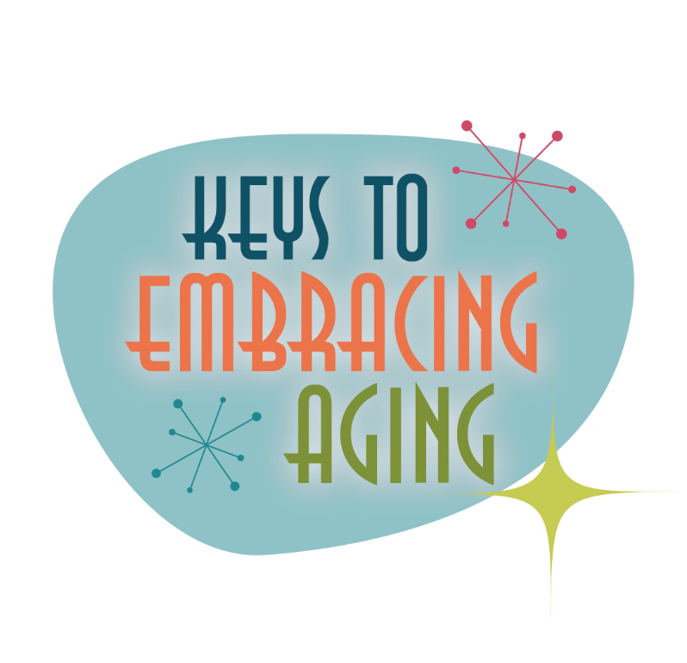
Eating Smart

Slide 2
Establishing healthy lifestyle behaviors throughout your life influences optimal aging
Positive Attitude
Eating Smart
Physical Activity
Brain Activity
Social Activity
Tuning Into the Times
Practice Being Safe
Know Your Health Numbers
Stress Management
Financial Affairs
Sleep
Taking Time for You
Notes:
Today we will be concentrating on the power of eating smart. I wanted to remind you what all of the keys to embracing include. Remember—these keys represent lifestyle behaviors. Practiced through the lifespan (although it is never to late to start), these lifestyles contribute to health, well-being, life quality and even longevity.
Attitude is Everything
Eating Healthy
Get Fit
Brain Health
Be Social
Tune-in to the Times
Stay Safe
Know Your Numbers
Manage Your Stress
Financial Affairs
Sleep Tight
Take Time for You

Slide 3
Tips for Eating Healthy
Examine your relationship with food
Control your portions
Eat breakfast
Eat a variety of foods
EAT THE RAINBOW!
Notes:
Eating is an activity that most of do at least three times a day. We eat because food appeals to our taste buds. We eat because it is a social activity. We also eat because it is good for us. Eating provides our body with energy so that we can breathe and function. It also has an impact on our overall health.
Nutritious foods help us maintain a healthy body and protect us against various illnesses, disorders and chronic diseases, such as heart disease, stroke, dementia, type 2 diabetes, bone loss, cancer, and anemia. Diet and nutrition can also help reduce high blood pressure, lower cholesterol, handle arthritis, maintain healthy skin, hair and nails, and manage diabetes. The good news about nutrition is that it is never too late to start eating well. Smart, nutritious eating contributes to health and well-being at any age.
Examine your relationship with food.
Find healthy alternatives. Do you turn to unhealthy foods when you are stressed? If so, find a substitute food or activity. For example, instead of grabbing a candy bar to de-stress, eat a carrot, go for a walk or call a friend to relieve the stress.
Think of food in terms of nutrition. Are you eating because you are hungry, need the energy, you are bored or because you are in a social setting? Instead of eating just to eat, think about food in terms of what it does to keep your
body healthy and functioning. Before you eat that cookie, ask yourself if it will help your body function better.
Seek help if you have an unhealthy relationship with food. Are you an emotional eater, turning to food when you are stressed out, angry or sad? Do you withdraw from food as a way to maintain control? Unhealthy food relation-
ships are destructive both mentally and physically and can cause severe long-term health problems. Overeating and undereating are eating disorders classified and treated as mental health illnesses. Unhealthy relationships with food occur for a number of reasons including genetic predisposition, societal pressures on appearance, body image and poor diet practices. Professionals, such as therapists/counselors, medical providers, nutritionists and university health services, can help you work through the problem or prescribe the appropriate care. Unhealthy food relationships are treatable.
Control Your Portions
The amount you eat us just as important as what you eat. Too many calories, fat and bad cholesterol are often a result of people putting too much food on their plate, taking seconds or eating until they are full (Clover Way, 2013).
Eat Breakfast
Many people don’t make time, think they don’t need breakfast or may not even feel hungry in the morning…but breakfast is THE MOST important meal of the day. A small nutritious breakfast, such as a piece of fruit and a cup of green tea, is better than nothing. In addition to helping fight off hunger and kick starting your metabolism, a nutritionally balanced breakfast helps improve concentration and performance. It is also linked to weight control and gives you more strength and endurance for physical activity. Breakfast positively affects mood and patience and also helps lower cholesterol. Breakfast is especially important for children…it helps them in school and on the playground and can even enhance concentration, eye-hand coordination and problem-solving skills.
Eat a variety of nutritious foods.
It is important to eat a variety of nutritious foods from all of the food groups. The United States Department of Agriculture’s (USDA) newest nutrition guide is called MyPlate. MyPlate reinforces that a well-balanced, well-portioned meal should include approximately 30 percent grains, 30 percent vegetables, 20 percent fruits and 20 percent protein, in addition to a small portion of low-fat dairy, such as a cup of low-fat/nonfat milk or a cup of yogurt. MyPlate also recommends reductions in sodium and sugar intake.
Fruits and vegetables
– The USDA recommends filling half your plate with fruits and vegetables. Fruits and vegetables are keys to promoting health, especially those that are rich in vitamins, nutrients and antioxidants such as berries, citrus fruits, tomatoes, broccoli and spinach. People who eat generous amounts of fruits and vegetables can reduce the risk of chronic disease, including stroke, heart diseases, diabetes and certain cancers. Fruits and veggies can also help you manage weight and reduce the risk of obesity.
Grains
– The USDA recommends that at least half of the grains you eat should be whole grains versus refined grains (2011). Whole grains are made from the entire grain kernel, which includes bran, germ and endosperm. Refined grains are those that have been milled to have the bran and the germ removed. While this improves shelf life, crucial dietary components such as fiber, iron and many B vitamins are taken out. Whole grains such as oats, whole wheat crackers, bread and pasta, wild and brown rice provide an instant boost of fiber, which can relieve constipation, make you feel fuller longer and help keep your weight under control. Whole grains are also associated with improvement in cholesterol levels, lower blood pressure, reduced risk of heart disease and prevention of certain cancers).
Protein
– Approximately one quarter of your plate should contain protein. Protein is a nutrient that the body needs to grow, repair and maintain itself. Protein acts as a foundation for bones, muscles, cartilage, skin and blood. By choosing lean or low-fat protein choices, you are building a strong foundation and receiving multiple vitamins and minerals such as B vitamins, vitamin E, iron, zinc and magnesium. Both animal and plant foods contain protein; thus diets should include a variety of lean meats, poultry, beans, peas, nuts and eggs to improve nutrient intake and health benefits. It is also important to eat at least 2 servings of fish per week. Seafood contains significant amounts of beneficial nutrients that prevent heart disease, specifically the omega-3 fatty acids.
Calcium and vitamin D
– From the time we are born and throughout our lifetime, we need calcium. Calcium helps cells and nerves function, blood clot, muscles contract, the heart beat and bones and joints stay strong. Additional health benefits of calcium include a decreased risk of osteoporosis, cardiovascular disease, type 2 diabetes and hypertension. Dairy products, which are great sources of calcium, include milk, plain yogurt and cheese. To avoid empty calories and excess fat, choose fat-free or low-fat products and avoid foods that have been sweetened by added sugars (flavored milk, yogurt and frozen desserts) (USDA, 2011). Some non-dairy products that contain calcium include broccoli, almonds, kale, soy and oranges. In general, if you are not drinking 3 cups of milk daily, starting at age 9, or taking calcium supplements, you are likely not getting enough calcium.
Vitamin D helps the body absorb and metabolize calcium more effectively. Vitamin D comes from fortified dairy products, cod liver oil and fatty fish as well as exposure to direct sunlight (about 15 minutes a day).
NIH recommends the following daily amounts of calcium:
0-6 months (ideally breast milk)200 mg
7-12 months (ideally breast milk) 260 mg
1-3 years 700 mg
4-8 years 1,000 mg
9-18 years 1,300 mg
19-50 years 1,000 mg
51-70 years 1,000 mg (men); 1,200 mg (women)
71+ years 1,200 mg
Pregnant and breastfeeding teens 1,300 mg
Pregnant and breastfeeding adults 1,000 mg

Slide 4
Tips for Eating Healthy
Drink more water
Eat healthy fats
Limit your sodium intake
Choose the right carbs
Notes:
Drink more water.
Every system in your body needs water. Water flushes out toxins, carries nutrients to cells, provides a moist environment for ear, nose and throat tissues and aids in digestion. Water is lost from everyday tasks such as breathing, perspiration, and digestion and therefore must be replenished to help prevent dehydration. Dehydration can leave you feeling sluggish or tired. Severe dehydration can even cause confusion and changes in your heart rate.
Fluid intake varies from person to person depending on your environment, activity level and health. On average, you should drink enough fluid, primarily water, so that you rarely feel thirsty and so that you produce about 6.3 or more cups of colorless or light yellow urine. Talk to a health care provider if you have concerns.
Water also helps you feel full…so if you feel like snacking, drink a cup of water first and then see how you feel becomes sometimes we confuse hunger for thirst. If after 15 minutes you are still hungry—then grab that snack! Water is also a good substitute for sugary sodas, juices and artificial sweeteners.
Eat healthy fats.
Fats are an important part of a healthy diet. Fats provide essential fatty acids, keep skin soft, deliver vitamins and are a great source of energy. But there are two kinds of fat from which we have to choose – unsaturated (healthy fat) and saturated (unhealthy fat).
Unsaturated fats
include both polyunsaturated fatty acids (PUFAS) and monounsaturated fats (MUFUS). MUFUS helps lower cholesterol, reduce the risk of heart disease and may even influence insulin levels and blood sugar, which can be helpful for those with type 2 diabetes (Mayo, 2014). PUFAS improve cholesterol and can decrease the risk of heart disease. PUFAS are found in vegetable oils, salmon, trout, mackerel, flaxseed and walnuts. Omega-3 fatty acids
are a type of polyunsaturated fat associated with heart health. Omega-3 fatty acids can be found in fatty fish, such as salmon and tuna. MUFUS are found primarily in the form of olive, canola and peanut oils, but can also be found in olives, avocados, hazelnuts, almonds, Brazil nuts, cashews, sesame seeds and pumpkin seeds. Monosaturated fats are also a good source of Vitamin E, an antioxidant that helps heal, repair and rejuvenate. Mediterranean diets are often high in monosaturated fats.
The unhealthy fats that should be eaten sparingly include saturated and trans fatty acids. Both can raise cholesterol levels, clog arteries and increase the risk for heart disease. Saturated fats are found naturally in animal products, such as meat, poultry skin, high-fat dairy and eggs, and in vegetable fats that are solid at room temperature, such as coconut and palm oils. Trans fats can occur naturally, as in dairy products and the fatty part of meat, and it can be added to foods artificially. Artificial trans fats cause great health concerns as even small amounts can increase the risk for heart disease. They are used in frying, baked goods, cookies, icings, packaged snack foods, microwave popcorn and some margarines. The American Heart Association advises less than 7 percent of total daily calories from saturated fat
and less than 1 percent from transfats. For a 2,000-calorie diet, that allows 15g of saturated fat and 2 g of transfats.
The bottom line, total fat intake should be limited to less than 20-35 percent of your total daily calories from fat, or 44-78 grams of total fat for a 2,000-calorie diet.
Limit your sodium intake.
An excess intake of sodium, or table salt, can lead to high blood pressure and an increased risk of heart disease, stroke, congestive heart failure and kidney disease. While sodium is naturally found in some foods, the majority of sodium intake comes from processed foods, restaurant foods and the salt we personally add at the table or while cooking.
The average American consumes 3,436 mg of sodium daily. It is recommended that everyone, including children, should limit their intake of sodium to less than 2,300 milligrams per day (about 1 teaspoon of salt). For adults age 51 and older, African Americans of any age and those with hypertension, diabetes or chronic kidney disease, salt intake should be limited to less than 1,500 milligrams per day (about 2/3 of a teaspoon of salt).
To reduce daily sodium intake:
• Keep the salt shaker off of the dinner table.
• Choose foods that have “low sodium,” “reduced sodium” or “sodium free” labels.
• When eating out, ask for low-sodium dishes or ask for no salt to be added.
• Enjoy home-cooked meals so you can control the amount of salt.
• When cooking, replace salt with other heart-healthy herbs and spices such as cinnamon, cumin, turmeric, cayenne,
oregano, ginger, thyme and rosemary or add a splash of fresh lemon juice.
• Pay attention to condiments like soy sauce, ketchup and seasoning packets that can have excess sodium.
Choose the right carbs.
Many diet trends warn you to stay away from carbohydrates because they will cause you to gain weight. But the body needs carbohydrates to properly function. Carbohydrates provide energy, protect against disease and can actually help control weight. The trick is choosing healthy carbohydrates. The 2010 Dietary Guidelines for Americans advise that 45 to 65 percent of total daily calories should come from carbohydrates. This is between 900 and 1,300 calories a day if you eat a 2,000-calorie diet. There are three main types of carbohydrates: sugars, starches and fibers. For the best carbohydrates, aim for fiber-rich fruits and vegetables, whole grains, low-fat dairy products, beans and legumes that are usually high in vitamins, nutrients and fiber. These types of carbohydrates are filling and slow to digest, which helps keep the digestive system running smoothly. Limit added sugars and refined grains, including candy, sweets and sugary drinks. These are packed with calories and little nutrition.

Slide 5
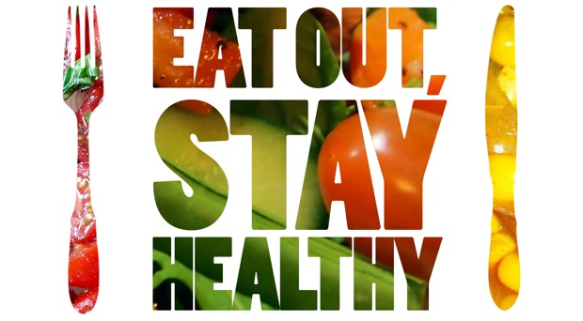
Tips for Eating Healthy
Eat less sugar
Count your calories
Eating out? Stay healthy.
Notes:
Consume less sugar.
Added sugars are often hidden ingredients that are dense in calories and have zero nutrients. Typically, added sugars can be found in breads, canned soups, canned vegetables, pasta sauces, instant mashed potatoes, frozen dinners, fast food, ketchup, fruit juices, flavored water and soft drinks. Hidden sugars will be listed on ingredients labels as fructose, corn syrup or corn sweetener, fruit juice concentrate, molasses, brown rice syrup, cane or sugar cane juice, fruit nectar, sucrose, glucose, crystal dextrose or maltose. Added sugars can lead to tooth decay and adverse health effects such as obesity, lower HDL levels, hypertension, cardiovascular disease and type 2 diabetes. The American Heart
Association recommends no more than 6 teaspoons of added sugar per day for women and no more than 9 teaspoons per day for men. Keep in mind that 4 grams of sugar equals 1 teaspoon. To reduce added sugar intake:
• Eat fresh or frozen fruits and vegetables
• Avoid canned fruits in syrup, particularly heavy syrup
• Choose low-carbohydrate, low-sugar or sugar-free versions of syrup, pasta, bread, ice cream and beverages
• Limit candy, baked goods and other sweet treats
• Opt for water instead of sugary fruit drinks, sodas and sweet teas
• Limit processed foods that are typically high in sugar, fat and sodium
• Enhance foods with spices instead of sugar
Count your calories.
Depending on your body size, metabolism, activity level and age, the number of daily calories (energy) you need to properly function may vary. Based on activity level, the U.S. Department of Agriculture and the U.S. Department of Health and Human Services recommend the following daily caloric intake as defined by age, gender and physical activity level. Always talk with a health care provider before making any major dietary changes.
Eat smart while eating out.
Eating out is a great opportunity to try new foods, have a night out with friends and family or have a meal prepared for you while you relax. It can be easy to consume foods that are large in portion, calories, rich in bad fat, excess sodium and sugar. To eat smart when eating out:
• Order your food baked, broiled or grilled instead of fried • Substitute – instead of French fries, ask for a salad, fruit or vegetable of the day • Choose dishes without gravies or creamy sauces
• Avoid dishes described with words such as creamy, buttery, fried, crispy, smothered, breaded, alfredo, hollandaise, augratin and smothered
• Ask for dressings on the side or choose a low-fat option
• Split a meal with a friend – it saves calories and money
• Try fruit for dessert

Slide 6
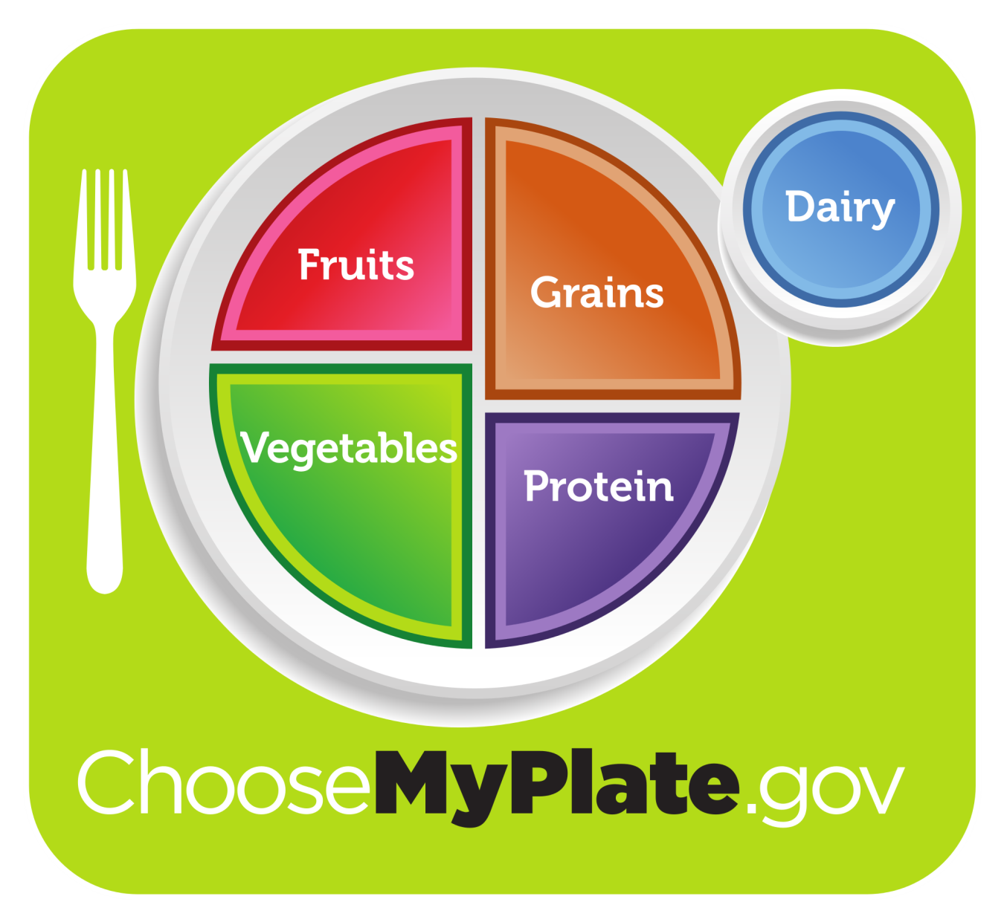
USDA MyPlate
Notes:
To help you examine your eating habits, you may want to consider the USDA My Plate…
MyPlate is the current nutrition guide published by the United States Department of Agriculture. This picture highlights the proportion of fruits, vegetables, protein, grains, and dairy that we should consume each day. MyPlate is supplemented with additional recommendations, such as:
– make half of your plate fruits and vegetables
– make the other half of your plate grains and protein
– make at least half of your grains whole grains
– try lean meats, skinless poultry, fish, beans, eggs and nuts
– choose low-fat or fat-free milk and dairy products
– enjoy limited amounts of fats, cholesterol, sodium and added sugars
Optional Activity: Eating Smart and Healthy (individual and/or group activity/discussion)
Supplies: Eating Smart and Healthy MyPlate worksheet; pens/pencils
Ask participants to think about the last lunch or dinner they ate. Using the “Eating Smart and Healthy MyPlate” worksheet, ask participants to write down each food and drink item in the proper MyPlate quadrant. Then ask the group whether or not their plate represented all of the food groups? Ask if half their lunch or dinner was fruits and vegetables? Ask if at least half of their grains were whole grains? Ask if their protein was lean or low-fat and whether or not their dairy was fat-free or low-fat?
Recommend participants to further track their foods and nutrition the USDA SuperTracker at https://www.supertracker.usda.gov/. The SuperTracker website also provides tips and support to help people make healthier choices, including physical activity.

Slide 7
Aging is inevitable…
By embracing a healthy lifestyle throughout your life, you will have a greater ability to engineer a positive approach to the aging process.
Notes:
Aging in an inevitable and unavoidable process. It is a process that brings on many changes as a person progresses from childhood to adulthood. The way in which you take care of yourself through the years both physically and mentally will impact the ways in which you enter your later years. Life does not diminish with aging. In fact, the acceptance of aging can be something that is positive, joyful, and exciting. With aging comes new experiences, knowledge, wisdom and a greater ability to engineer a positive approach to the aging process. I hope today that the Keys to Embracing Aging program highlighted ways you can eat smarter, and gave you some helpful tips for doing so!

