Slide 1
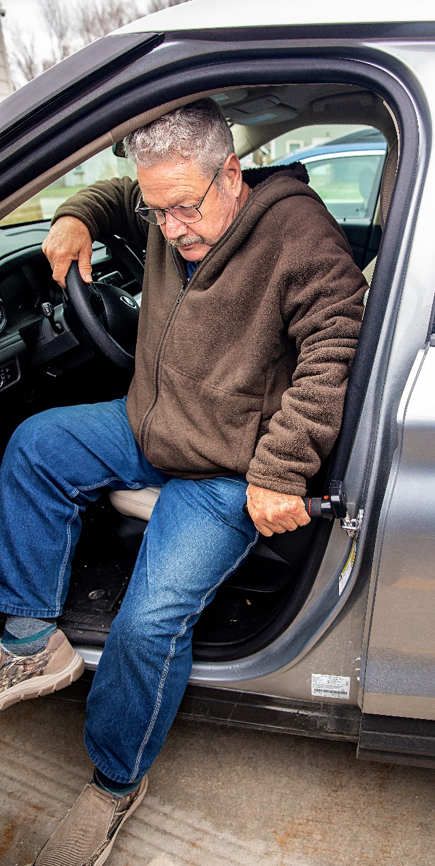
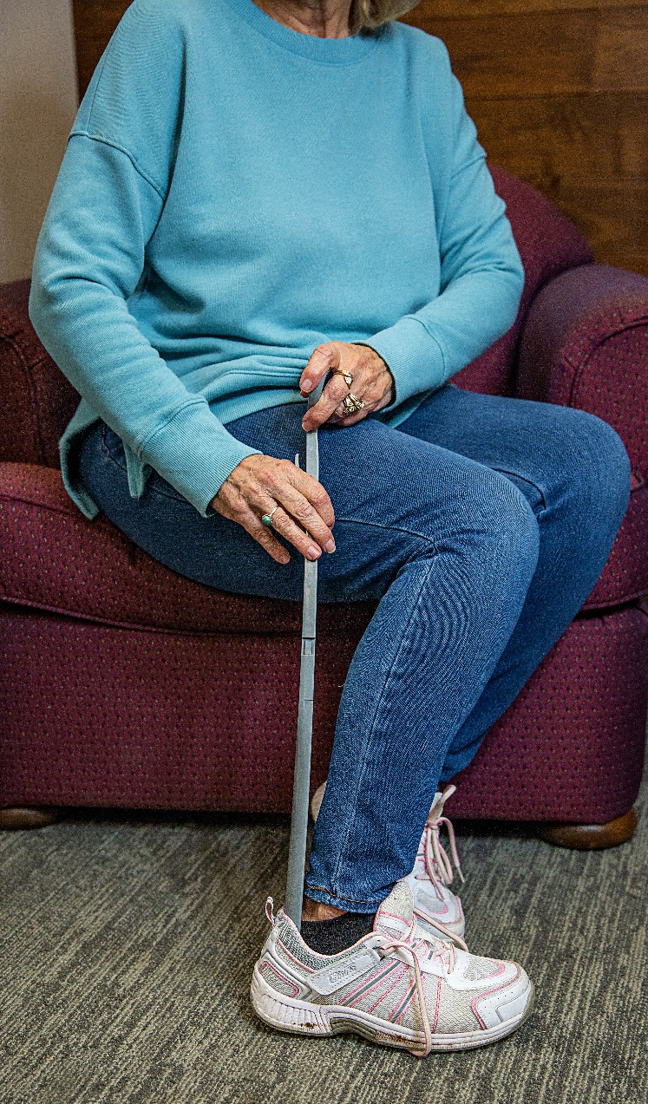
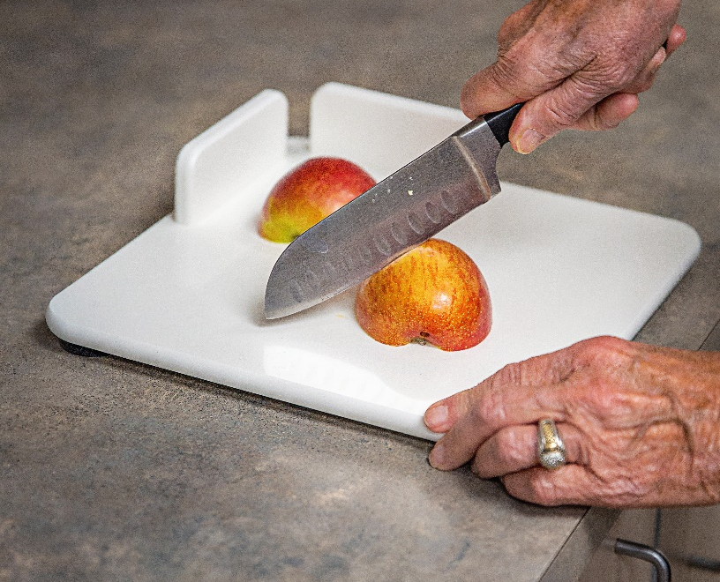
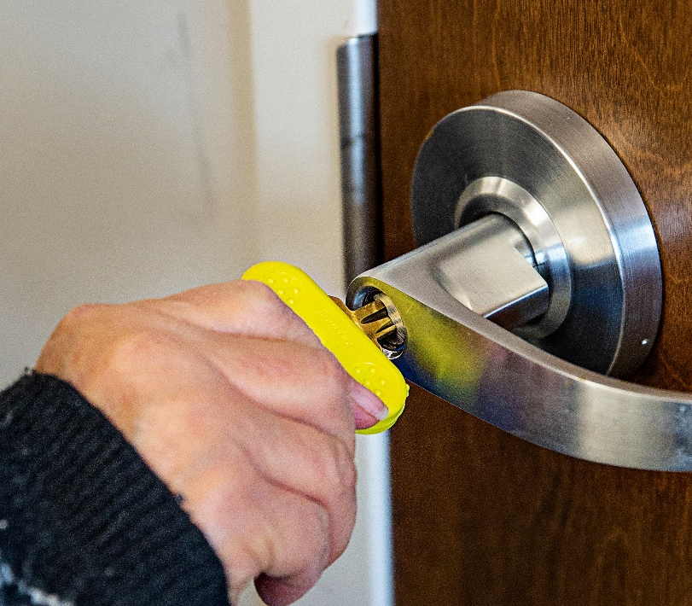

Assistive Technology Basics

Slide 2

Assistive Technology
Assistive technology refers to a variety of devices that help a person complete functional tasks with ease and efficiency.
Notes:
Sometimes everyday tasks can become difficult or impossible.
If you break an arm, have a stroke, or live with arthritis, diabetes or chronic conditions, brushing your teeth, cooking dinner, or even tying your shoes can be a challenge.
With age, changes in vision, hearing and mobility can mean that everyday activities may be more problematic.

Slide 3
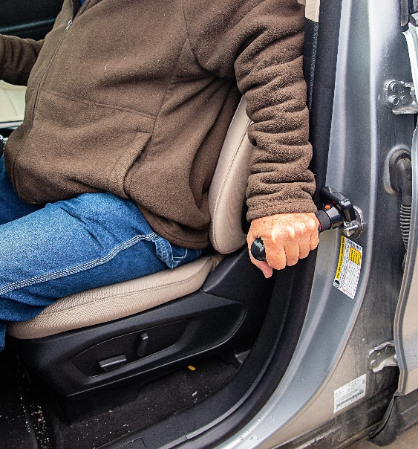
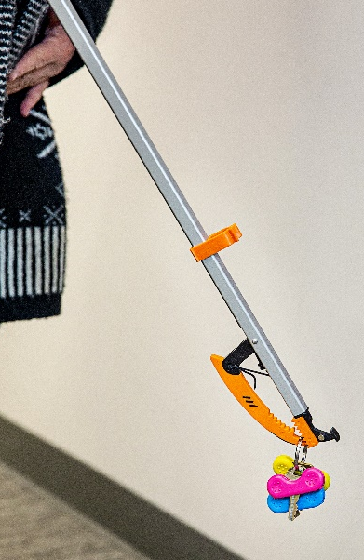
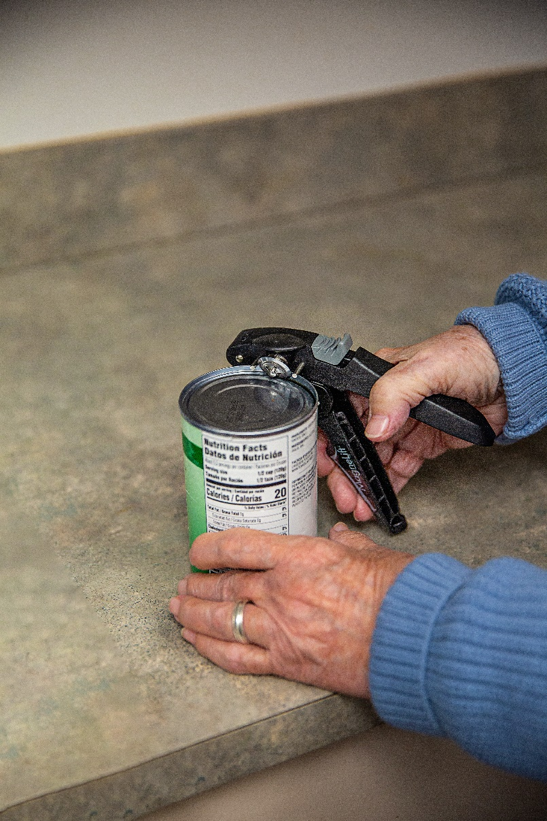
Assistive Technology
Includes everyday tools that can be found in stores or online.

Slide 4
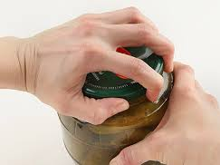
Assistive Technology
Assistive technology is beneficial for people of all ages and abilities.
Temporary injury or recovering from surgery
Chronic condition (arthritis)
Stroke survivor
Disability
If you have ever used a step stool, you have used assistive technology!

Slide 5
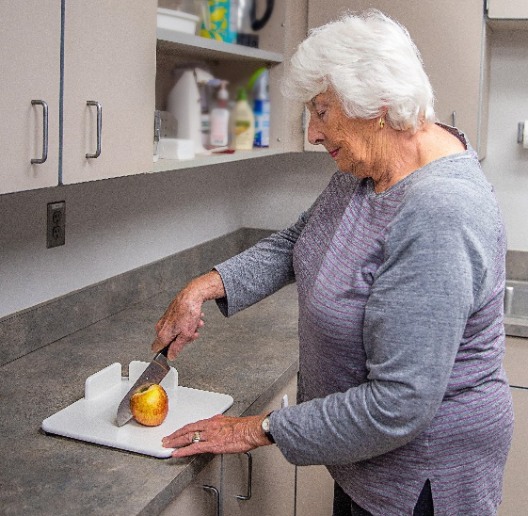
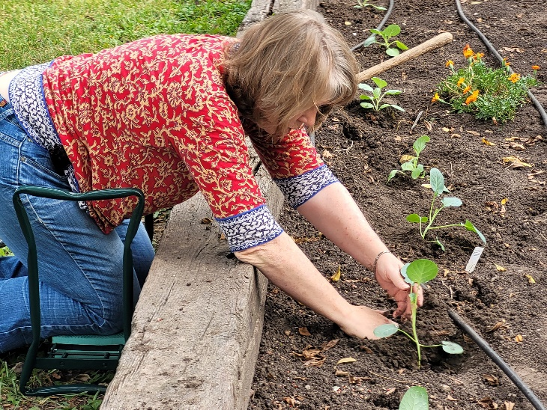
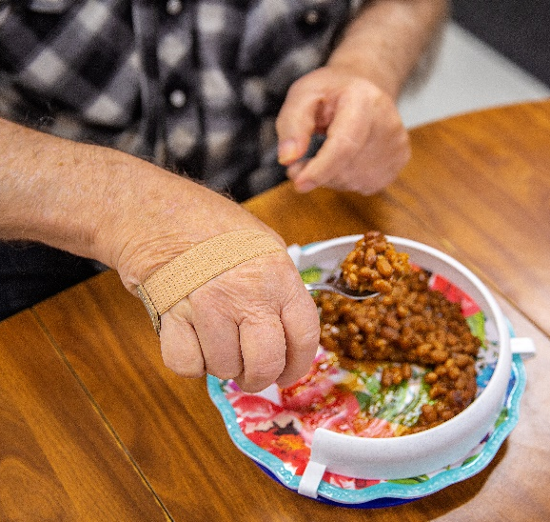
Assistive Technology
Be more independent. Stay in workforce longer. Lessen the demands of caregiving.

Slide 6
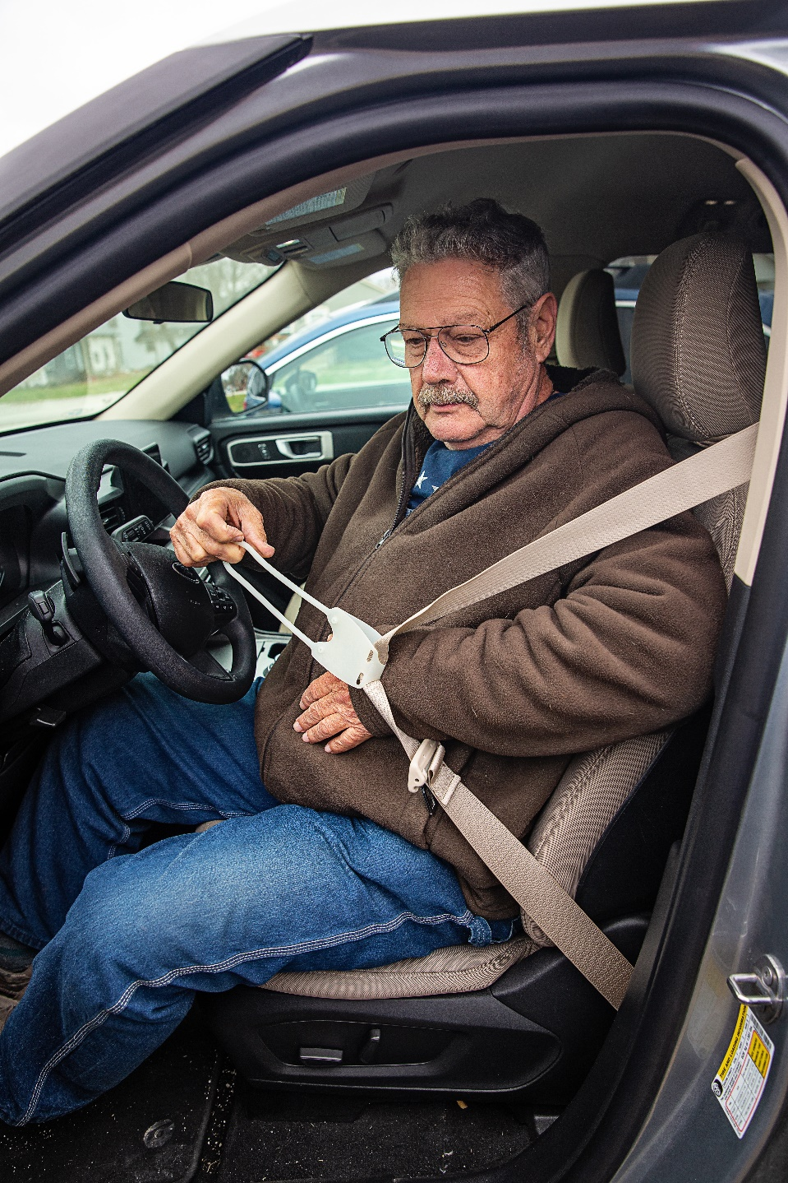
Assistive Technology
What kind of assistive technology is right for me?
What are the biggest challenges I face every day or multiple times a week?
What tasks are particularly difficult?

Slide 7

Assistive Technology
What experts can help me decide what is best?
Primary health care provider
Occupational therapist
Physical therapist
Audiologist
Ophthalmologist
Medical supply store staff

Slide 8
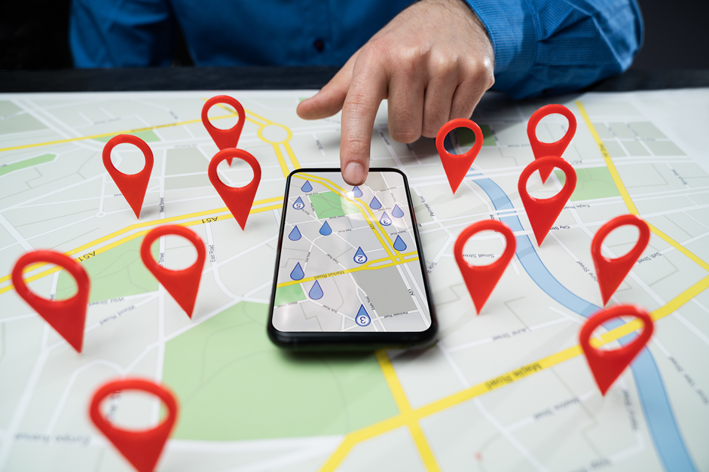
Assistive Technology
Where can I get assistive technology?
Medical supply stores
Pharmacies
Online retailers
Big box stores
Community lending programs
Always read the instructions, adjust for comfort, and ask for help from a professional, if necessary.

Slide 9

Assistive Technology
How do I pay for assistive technology?
Out of pocket
Medicare
Insurance providers
Veterans Affairs
HSA and FSA funds
Special programs, rent,
reuse and recycle

Slide 10
Assistive Technology
Where can I learn more?
Assistive Technology for Kansans (ATK)
Kansas Equipment Exchange Reuse Program (KEE Reuse)
K-LOAN
Kansas Chapter of the Arthritis Foundation
ADAPTECH Research Network
National AgrAbility Project

Slide 11
Technology for Everyday Tasks
Personal care
Preparing meals
Basic household chores
Recreational activity
Transportation

Slide 12
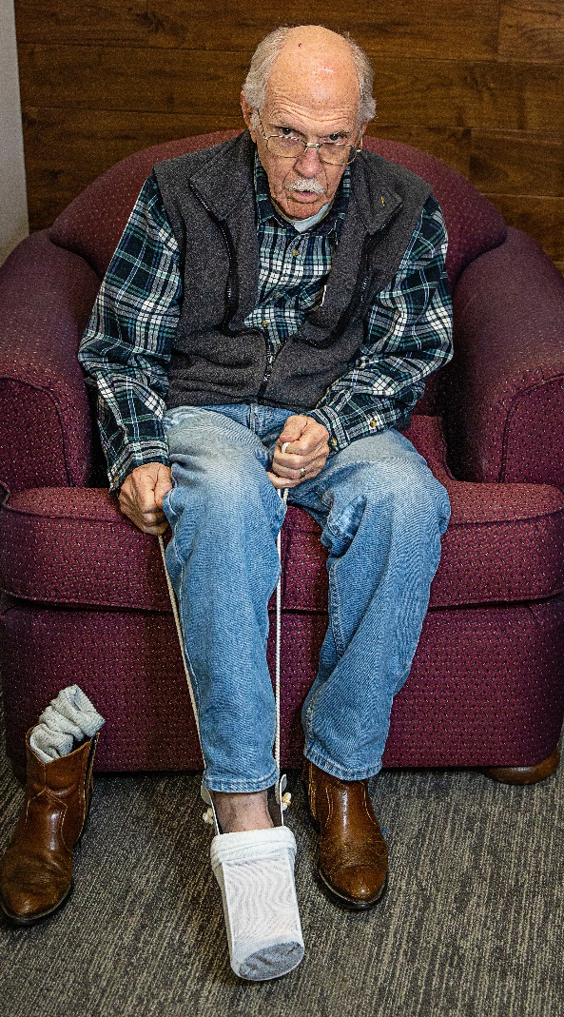
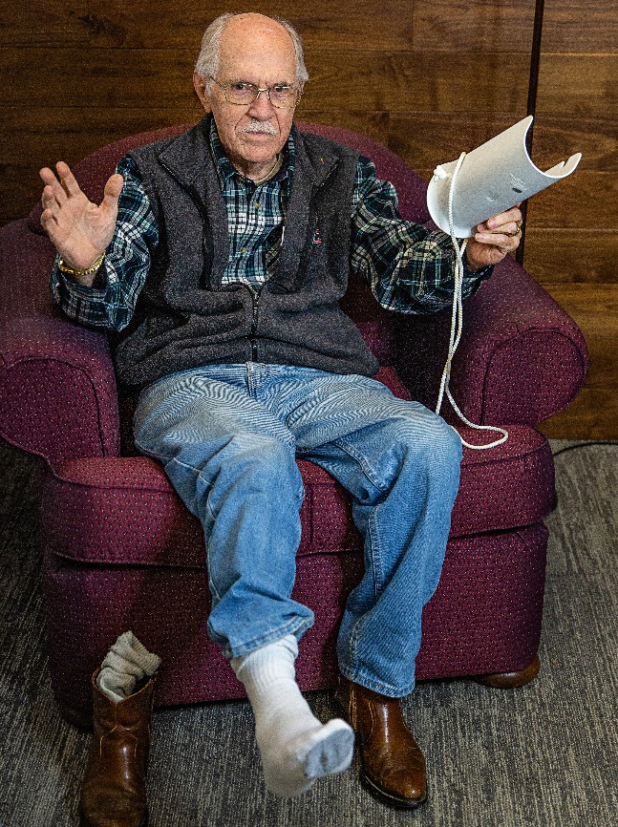
Personal Care
Sock Aid

Slide 13
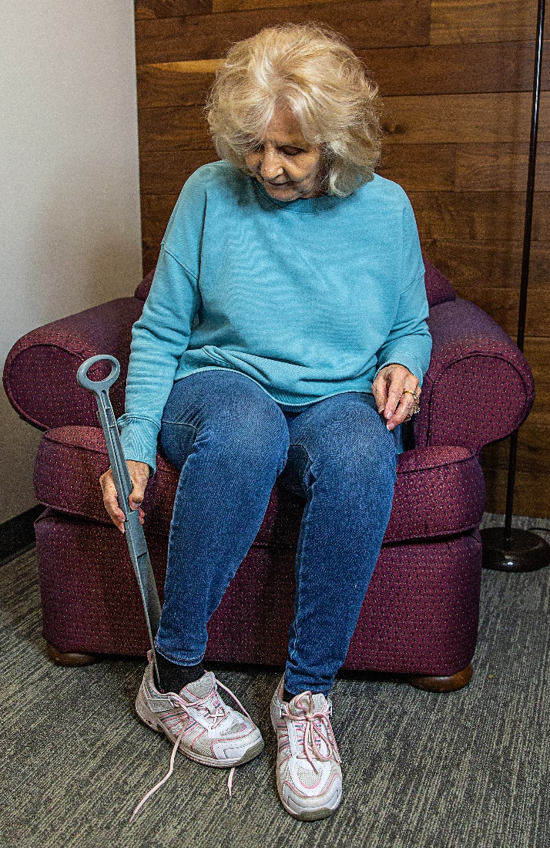

Personal Care
Long-Handled Shoehorn

Slide 14
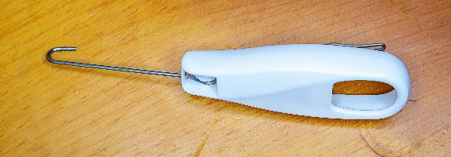
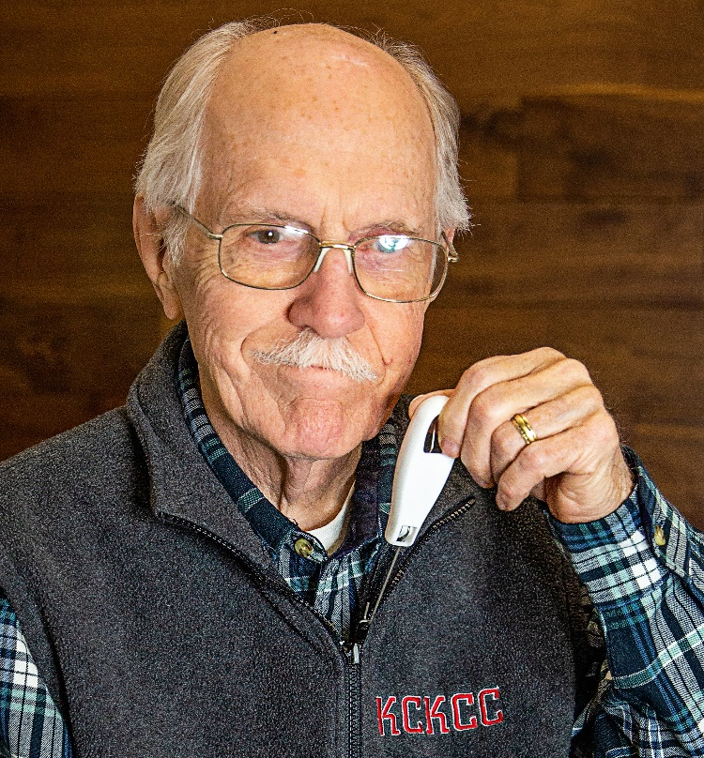
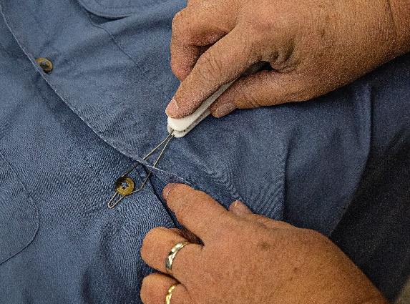
Personal Care
Zipper & Button Puller
One tool helps with both zippers and buttons.
Hook assists with zippers.
Loop helps pull buttons through button holes.

Slide 15
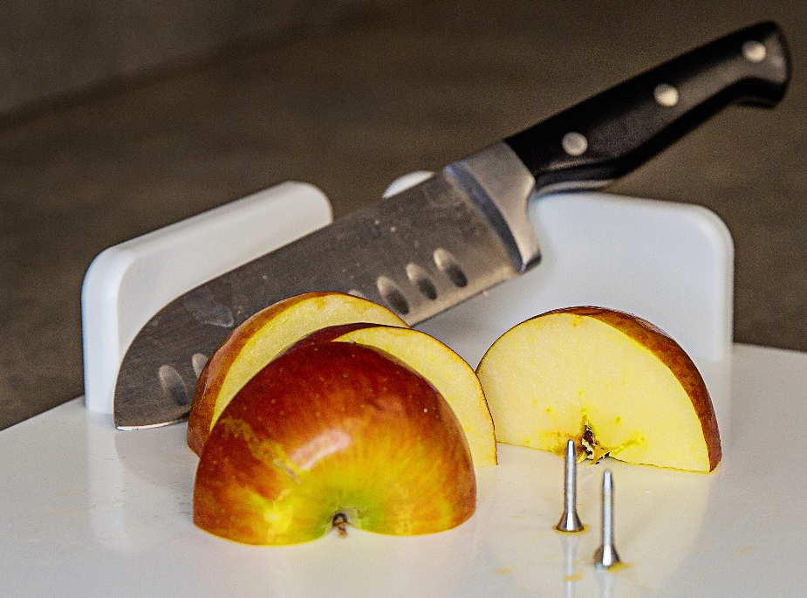

Food Preparation
Cutting Board
Suction cups hold cutting board in place.
Spikes hold food in place on cutting board.

Slide 16
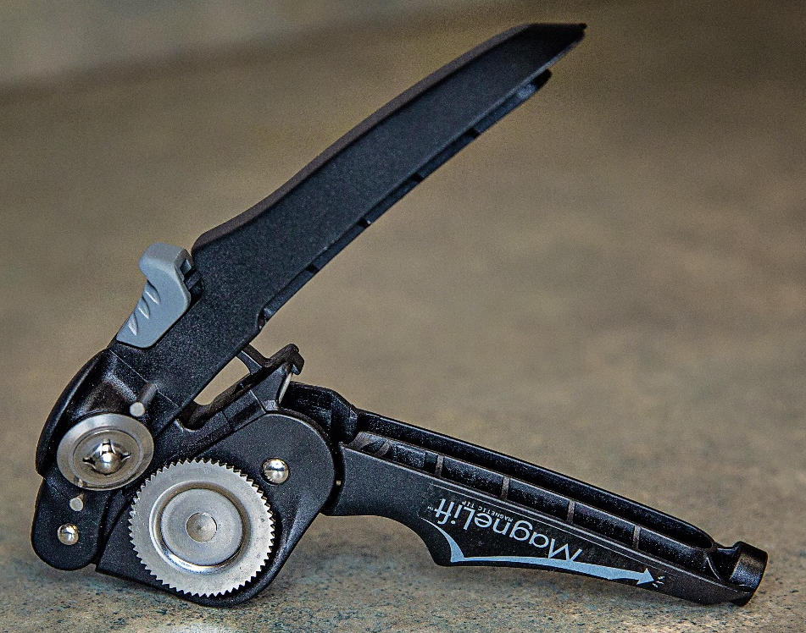

Food Preparation
Gear-Driven Can Opener

Slide 17
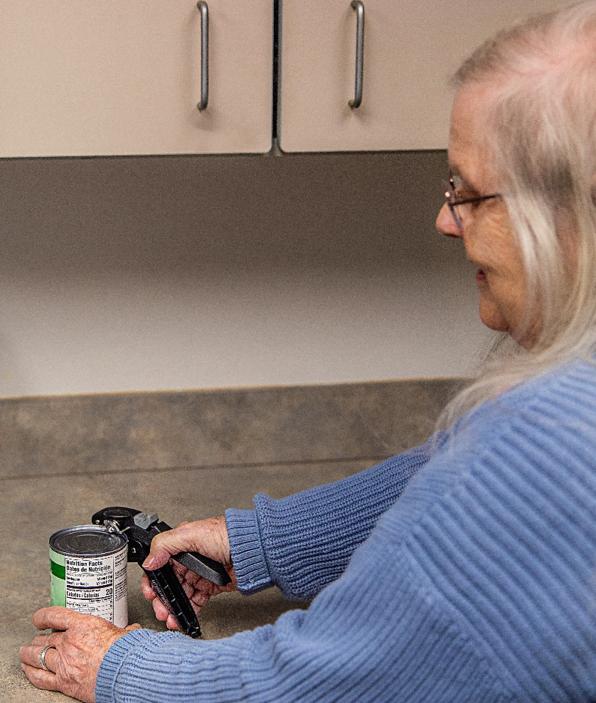
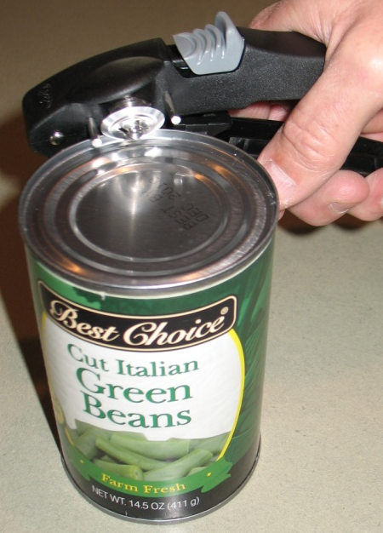
Food Preparation
Gear-Driven Can Opener
Slide gray button back to release can opener.
Place opener on can.

Slide 18
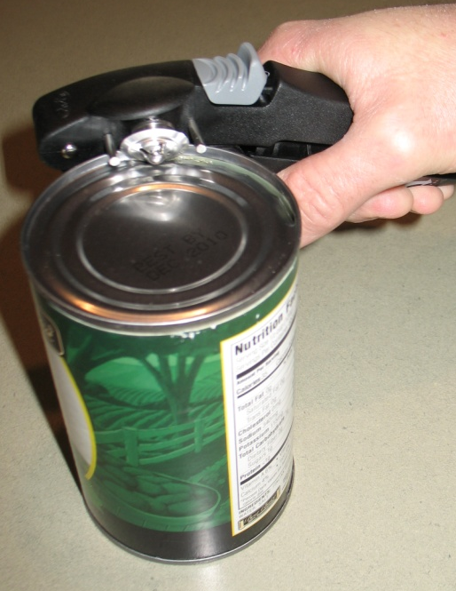
Food Preparation
Gear-Driven Can Opener
Squeeze opener until it snaps into place.
Continue squeezing and releasing opener until can is open.

Slide 19
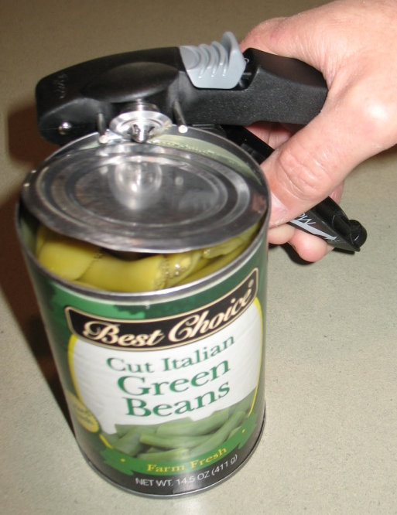
Food Preparation
Gear-Driven Can Opener
Slide back gray button to release can opener.

Slide 20
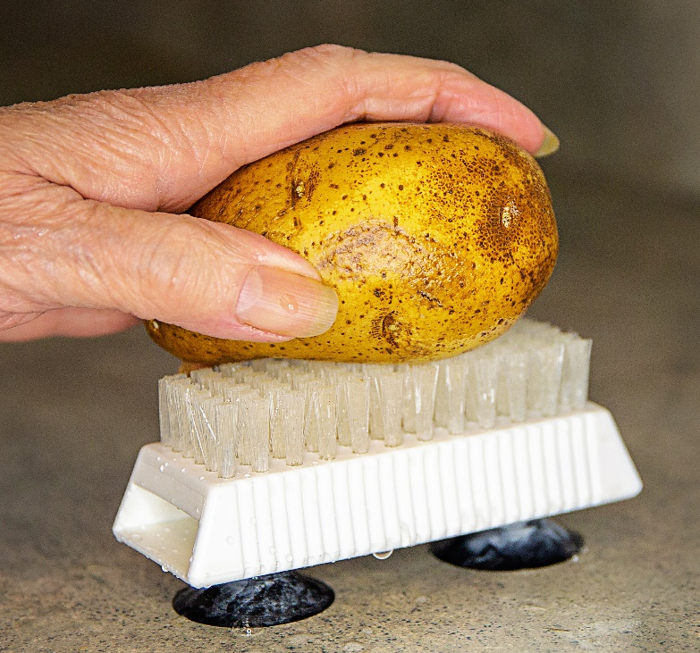
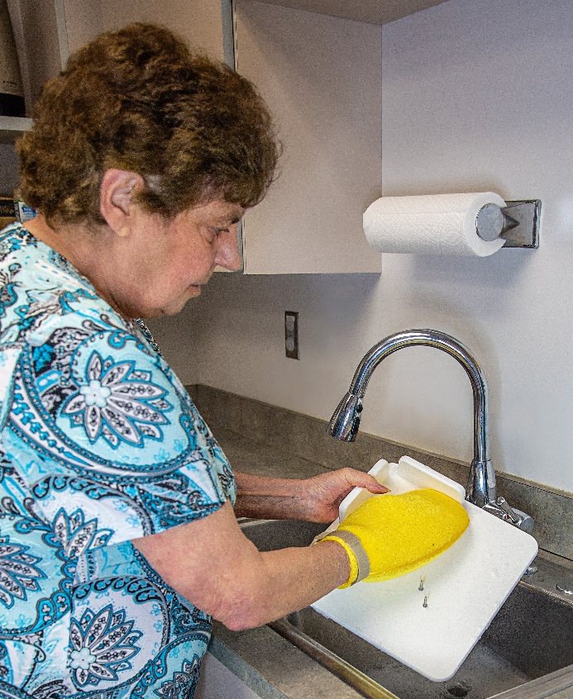
Food Preparation
Sponge Wash Mitt
Suction Brush
(Also good for washing fingernails.)

Slide 21
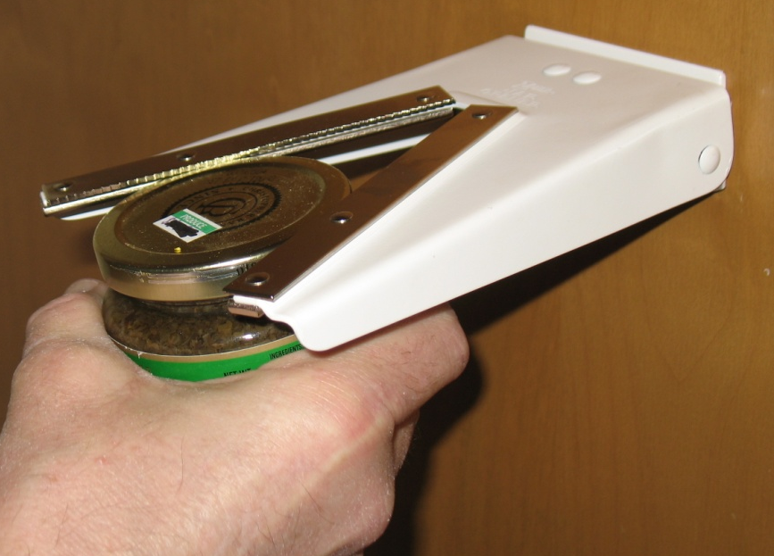
Food Preparation
Jar & Bottle Opener
Attaches to wall.
Screws are included.

Slide 22
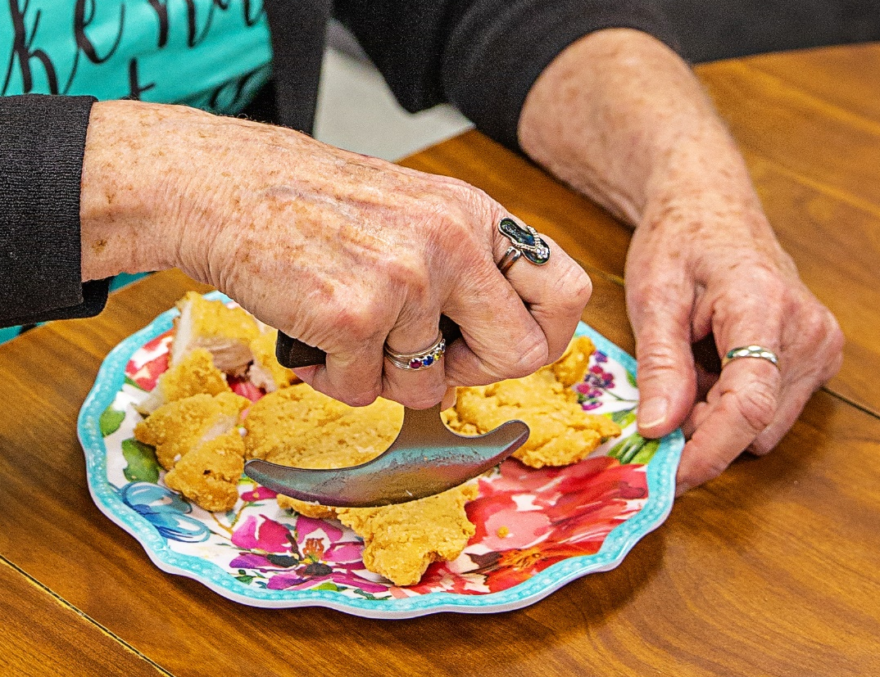
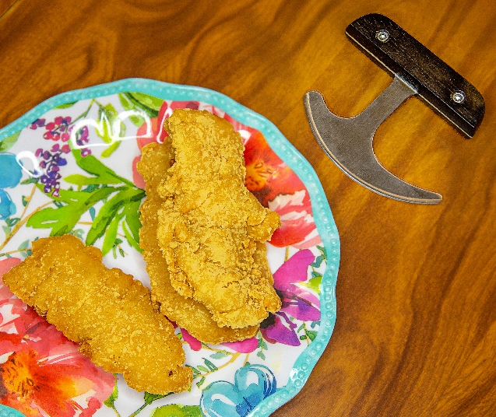
Food Preparation
Rocker Knife
Easy, one-handed cutting.

Slide 23
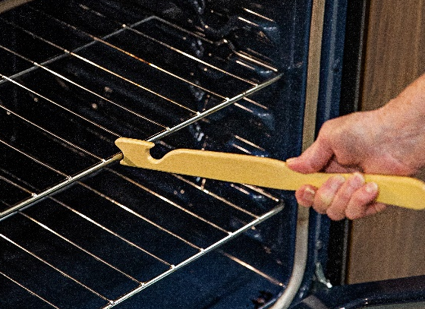
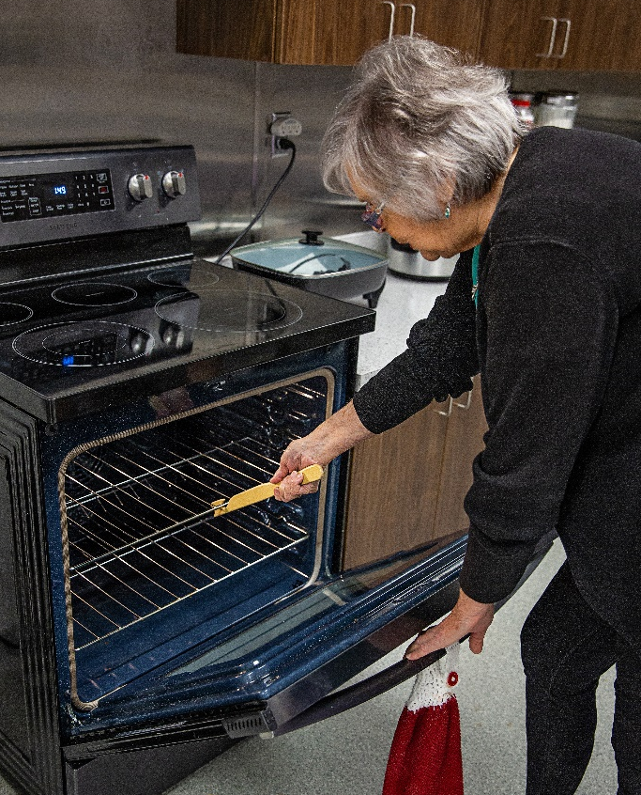
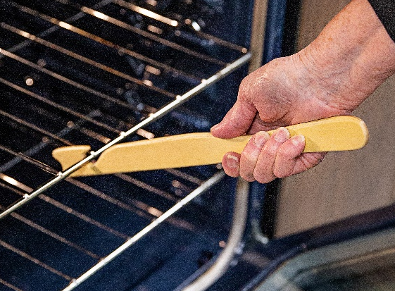
Food Preparation
Oven Push/Pull Helper
Safely slide oven shelves in and out.
Helps reduce the amount of bending required.

Slide 24
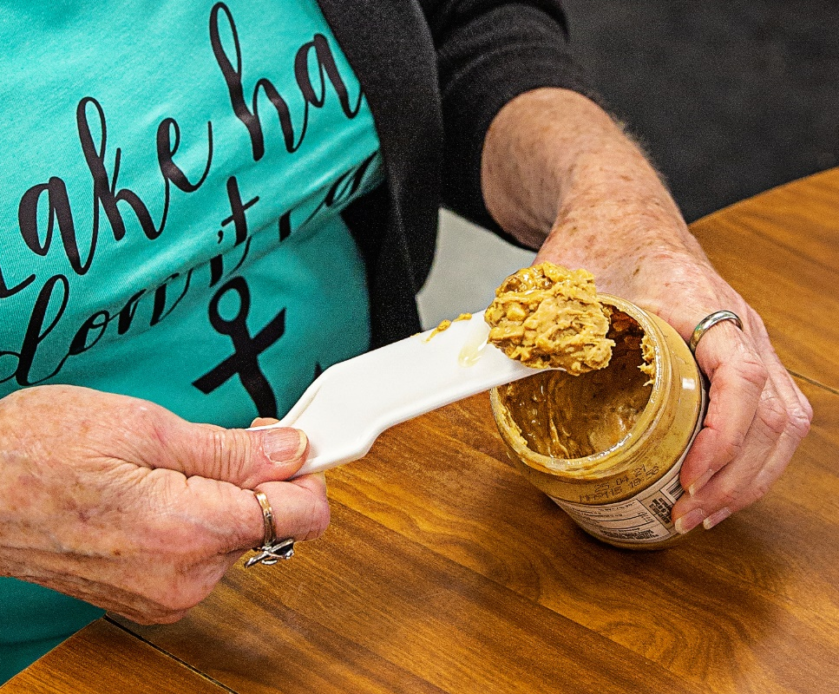
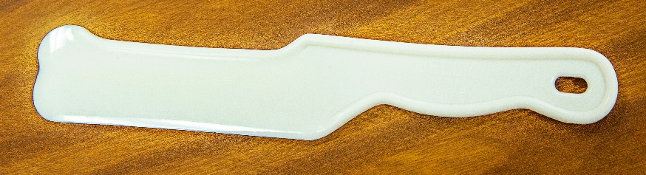
Food Preparation
Jelly Knife
Works great for peanut butter or jelly!
Scrapes the inside of the jar, leaving very little waste.

Slide 25
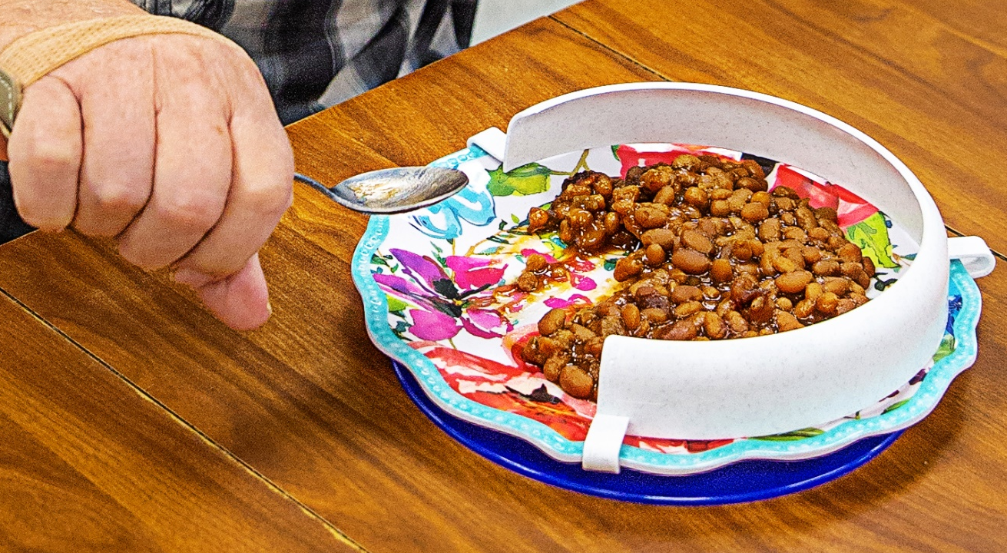
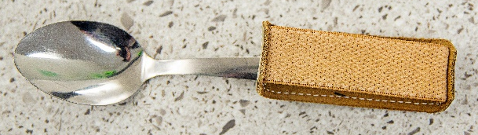
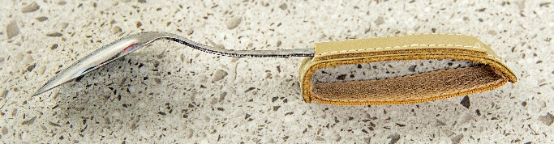
Mealtime
Universal Cuff & Food Guard
Universal cuff holds a variety of different types of silverware.
Guard holds food in place.

Slide 26

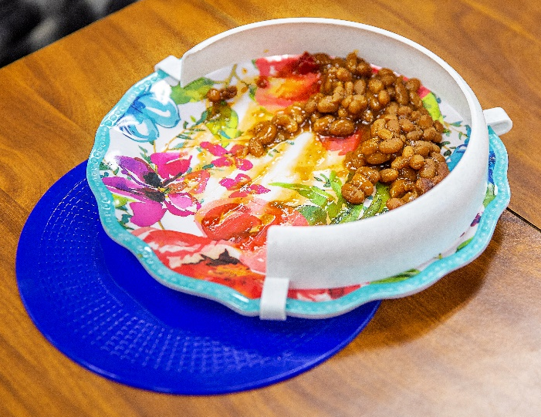
Mealtime
Dycem Pad
Circular, non-slip pad.
Holds plate securely in place during mealtime.

Slide 27
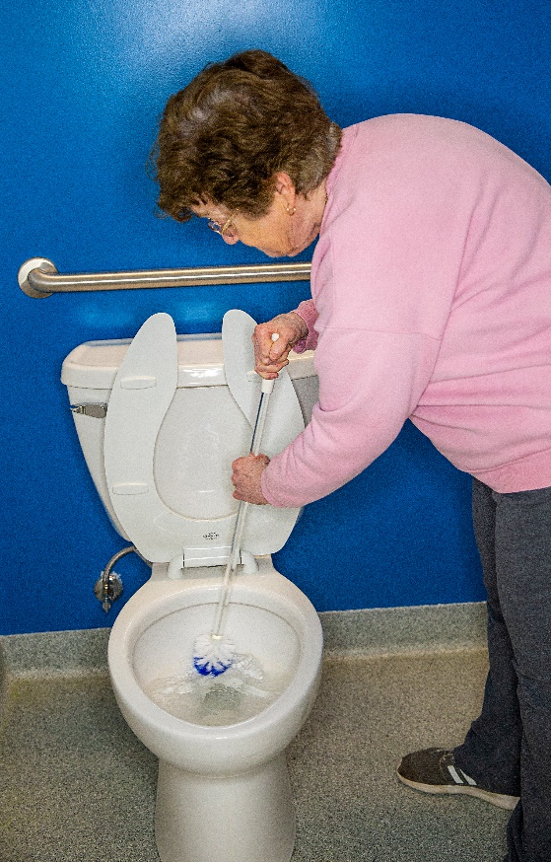
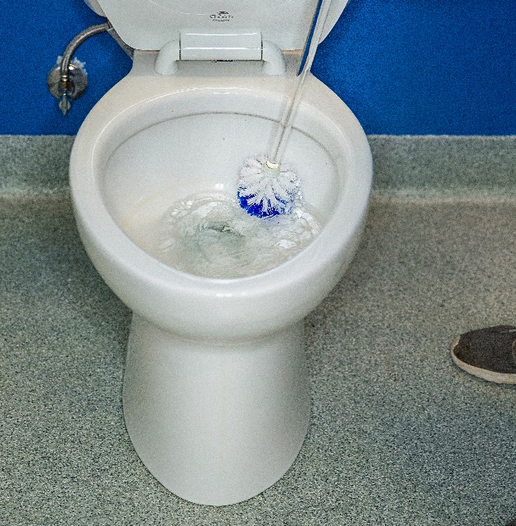
Household
Long-Handled Toilet Bowl Brush
Reduces amount of bending required.

Slide 28
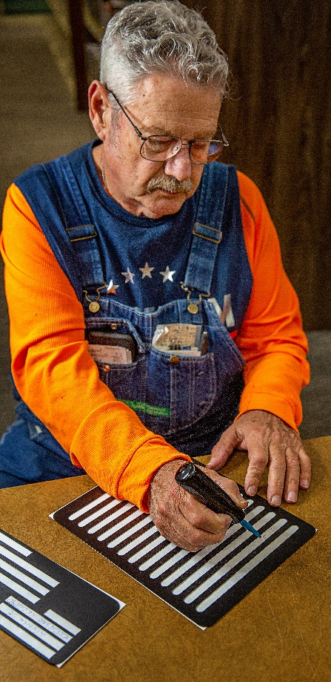
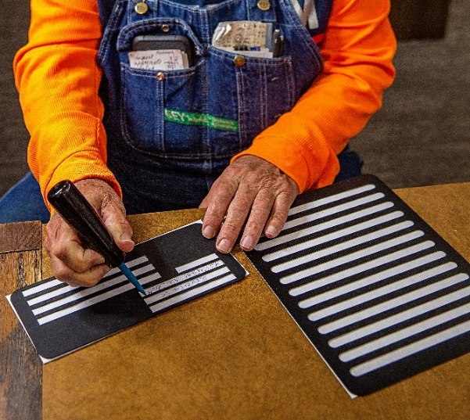
Household
Writing Guides Set
Helps those with low vision or physical limitations (such as tremors) to write and sign documents.

Slide 29

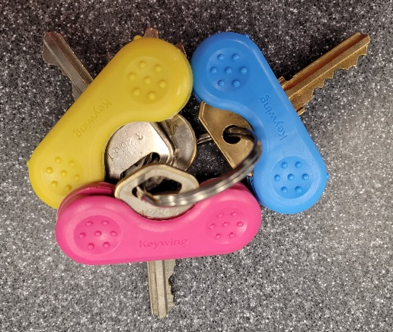
Household
Key/Lock Identifiers
Makes it easy to insert and turn keys.
Assorted colors helps easily identify keys.

Slide 30
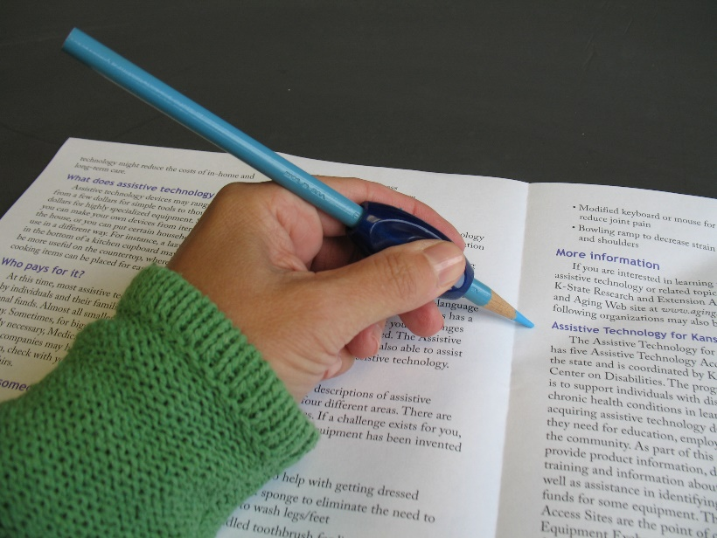
Household
Pen/Pencil Cushions
Comfortable, easy grip helps hold pens/pencil.

Slide 31
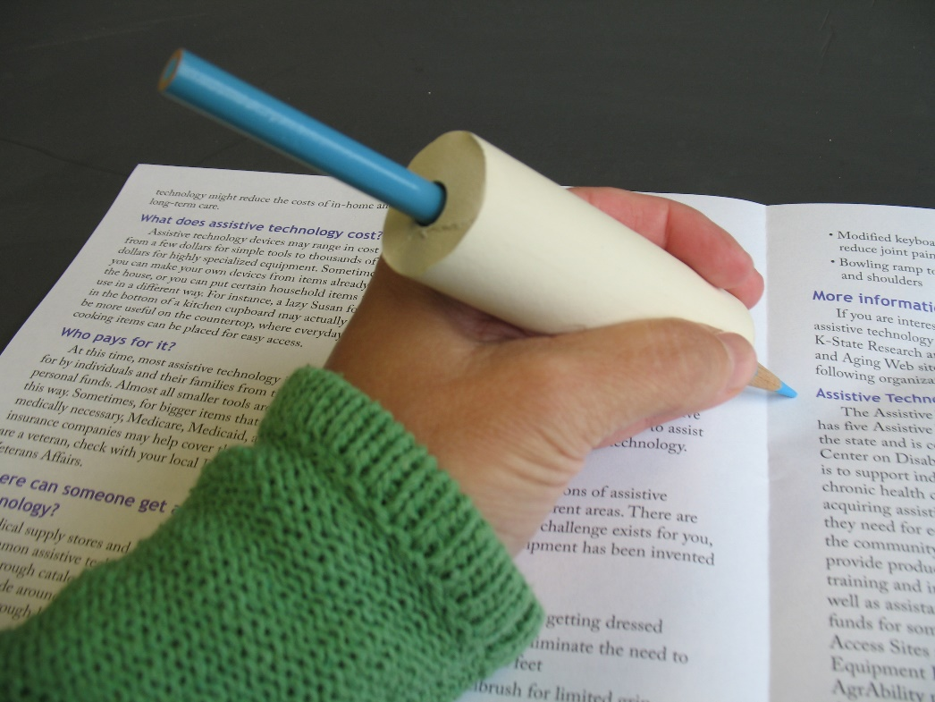
Household
Foam
Multiple uses for an easier grip:
Pen/Pencil
Eating Utensils
Personal care (toothbrush, razor)
Inexpensive to replace!

Slide 32

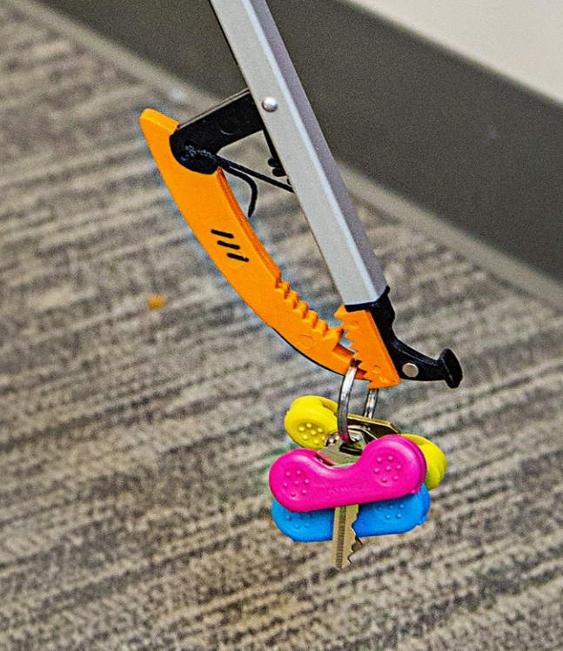
Household
Reacher
Helps reach items stored on high shelves, behind furniture, on the ground or in tight spaces.
Eliminates bending and twisting.

Slide 33
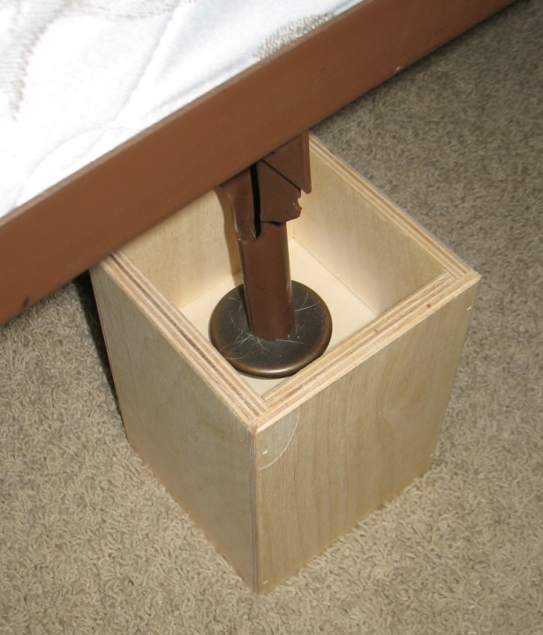
Household
Furniture Risers
Helps adjust furniture to the height that is best suited for the individual, minimizing bending and back strain.

Slide 34

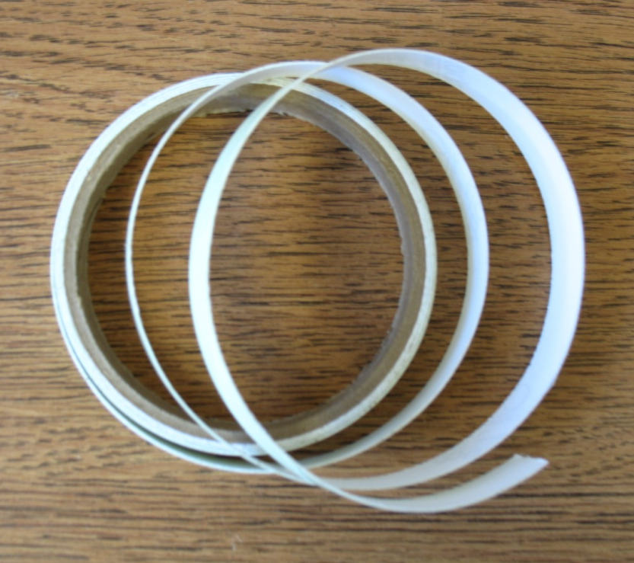
Household
Glow Tape
Mark items that need to be easily located in the dark.
Illuminate light switches, stairs and doorframes.

Slide 35
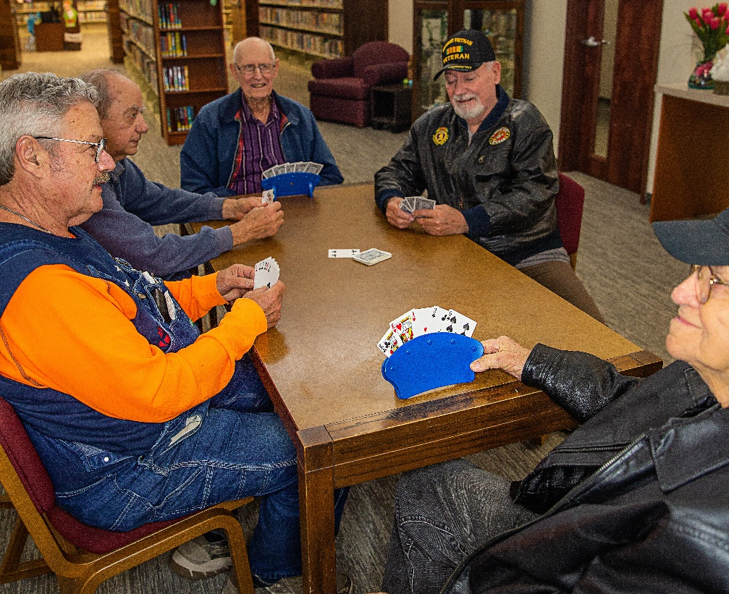

Recreation
Hands-Free Card Holder
Removes the challenge
of holding cards for those with limited mobility and hand strength/grip.

Slide 36



Recreation
Folding Book Stand
Reduces
glare and assists those with limited mobility and hand strength/grip.
Great for the kitchen too!

Slide 37


Recreation
Standing Page Magnifier
Magnifies text to allow for easier reading.

Slide 38
Transportation
Seat Belt Handle
Attaches to seat belt to allow for easier reach.
Minimizes twisting & turning to get seatbelt secured.

Slide 39

Transportation
Gas Cap Wrench
Easy to grip and turn.
Helps minimize challenges related to range of motion and joint pain.

Slide 40


Transportation
Vehicle Support Assist Handle
What text
Do we want
To use to describe
This item
Portable handle also cuts seatbelts and breaks glass.

Slide 41

Transportation
Vehicle Support Assist Handle
Provides leverage to assist in exiting a vehicle.

Slide 42



Gardening
Ergonomic Garden Tools
Minimizes stress on hands and wrists.
Ideal for individuals with limited hand strength, arthritis or carpal tunnel syndrome.

Slide 43


Gardening
Garden Stool
Cushion relieves stress on knees.
Support for arms when kneeling down and getting up.
Garden bench seat relieves pressure on back and legs.

Slide 44
Thank You!
Brand names appearing in this publication are for product identification purposes only. No endorsement is intended, nor is criticism implied of similar products not mentioned.
Contents of this publication may be freely reproduced for educational purposes. All other rights reserved. In each case, credit Erin Martinez, PhD, Ethel Schneweis and Nancy Honig, Assistive Technology Basics. Kansas State University. January 2024.
For more information about adult development and aging, contact your local extension office. Kansas State University is an equal opportunity provider and employer.

Slide 45


Thank You to Our Partners
Photos used in this presentation were taken by Heather Sears Photography. Volunteers in the photos are members
of the LaCygne Library Senior Group and the LaCygne Community Garden.

