Slide 1
Financial Affairs

Slide 2
Establishing healthy lifestyle behaviors throughout your life influences optimal aging
Positive Attitude
Eating Smart and Healthy
Physical Activity
Brain Activity
Social Activity
Tuning-in to the Times
Safety
Know Your Health Numbers
Stress Management
Financial Affairs
Sleep
Taking Time for You
Notes:
Today we will be concentrating on the power of financial management, but I wanted you to see what all of the keys to embracing include. Remember—these keys represent lifestyle behaviors. Practiced through the lifespan (although it is never to late to start), these lifestyles contribute to health, well-being, life quality and even longevity.
Attitude is Everything
Eating Healthy
Get Fit
Brain Health
Be Social
Tune-in to the Times
Stay Safe
Know Your Numbers
Manage Your Stress
Financial Affairs
Sleep Tight
Take Time for You
Today we are going to be discussing financial affairs and giving simple tips that can make a big financial difference.

Slide 3
Basic Financial Affairs
Budget Development
Money Management
Wise Use of Credit
Consumer Protection
Saving Goals
Notes:
There is a lot to talk about when it comes to money, funny thing is, nobody likes to talk about it in public. Not going into major financial issues, but just looking at the basics, we can still spend a long time on the topic of money. Today we’re going to talk about: budget development, money management, wise use of credit, consumer protection, and savings goals.
Optional Activity 1: Rags to Riches
Supplies: pen/pencil, paper, dry erase board or easel with paper
We often don’t realize how rich we are in comparison to the rest of the world. Ask the participants to:
Think about how blessed they are
Ask participants to consider everything on their body (clothes, undergarments, shoes, jewelry, glasses/contact, tattoos, hearing aids, etc.) and the cost associated with each item. Then ask them to consider items that they normally carry on their person: cell phone, purse, and wallet. Ask participants to add these costs and to write the total on a piece of paper. Tell participants not to write their name on this paper.
Ask participants to pass their papers to the front
On a dry erase board or tablet, list the various totals that were handed forward. Discuss with the participants whether or not they are surprised at how high or how low the figures are.
Compare the value of what is participants are wearing with the national poverty threshold for a family of four: As of 2015, the national poverty threshold for a family of four was an income of $24,250 per year or $2,020.83 per month. Some people might be wearing more than what a family of four makes per month.

Slide 4
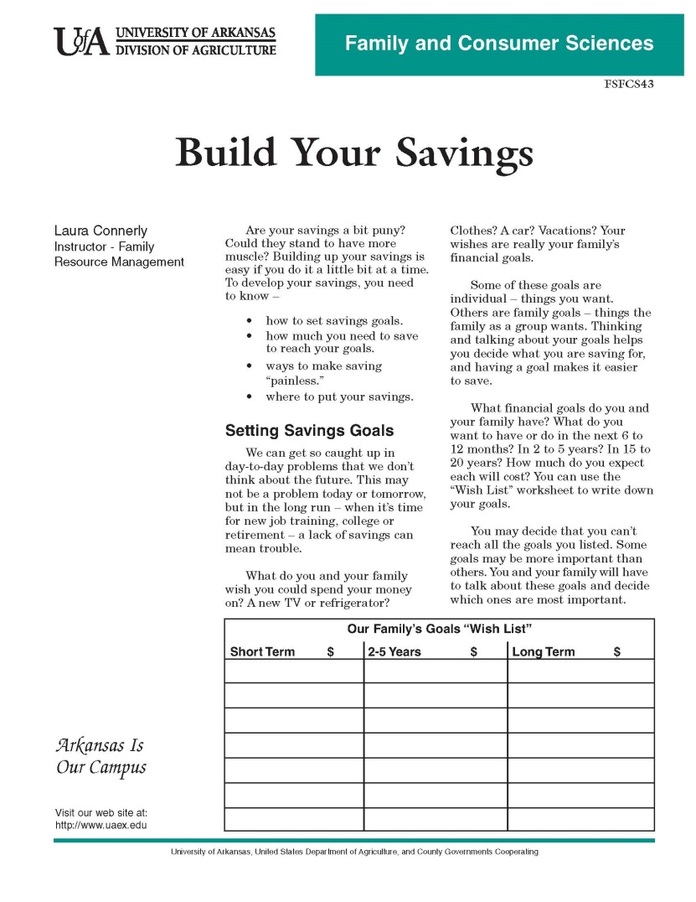
A budget helps you make a plan for your money
Why Budget?
Budget development involves:
Income
Monthly expenses
Balance between income and monthly expenses
Notes:
Discussion Question: Why do you think a budget is important? What can a budget do you for you?
To keep it short and simple, the very first thing everyone should do is develop a budget. What is your income? What are your expenses? Balance your expenses so that they do not exceed your income and develop a spending plan. That is a budget.
A budget is often called a spending plan or an accounting plan is an itemized summary of income and expenses for a given period. It is an effective tool to help you get the most for your money because it forces you to rethink your spending habits and re-focuses you to think about things you need and the things that are important to you. In addition, a budget helps you focus on your financial goals.
A budget is especially important when you have a sudden change in your income, such as retirement. A budget helps you make decisions about how to spend your money, determine your needs before your wants and match your spending to your current income. Budgets can even help decrease unnecessary arguments and stress over money and help you get more sleep at night.
Note: according to the US World Report and News, 56% of adults don’t budget.
Developing a budget involves three factors—income, monthly expenses and the balance between income and expenses.
Step 1 – Income
Add up your current total monthly income. Include income from other family members if such income is used toward expenses. Include only the take-home amount or what you actually have to spend after deductions. Income comes from a variety of sources, including:
• Earnings from employed family members
• Unemployment compensation
• Withdrawal from savings
• Tips or commissions
• Interest or dividends
• Social Security
• Child support or alimony
• Public assistance
• Veterans benefits
Step 2 – Monthly Expenses
Now add up your monthly expenses. Some of these expenses are fixed, such as a mortgage or rent, where others can fluctuate like groceries or entertainment. If you have never had a budget before, you can save and keep track of receipts and/or use old records, such as cancelled checks and bill statements, to help you figure out what you typically spend a month. Some of the most common categories include:
• Housing – mortgage or rent payments, property taxes, insurance
• Utilities – electricity, gas, oil, phone, water, sewer, garbage, cable or satellite television
• Food – groceries, eating out, school/senior center lunches
• Transportation – gas, car repairs and maintenance, license, tags, parking, bus, taxi fares
• Medical Care – doctor, dentist, clinic, hospital, medicine, glasses
• Loans – car payments, installment and education loans, credit cards, charge accounts
• Insurance – health, life, liability, car, disability
• Household Operations and Maintenance Repairs – cleaning and laundry supplies, paper supplies, towels,
equipment
• Clothing and Personal Care – new clothing purchases, dry cleaning, hair care, cosmetics, toiletries
• Education and Recreation – books, subscriptions, magazines, newspapers, lessons, tuition, hobbies, club
dues, sports, entertainment, vacation, alcohol, tobacco
• Pets – veterinarian visits, vaccines, food, supplies
• Miscellaneous – child care, gifts, contributions, personal allowances, child support
Remember that not all of your expenses are monthly. Property taxes, insurance premiums, tuition and holiday
gifts may come once or twice a year. It is easy to forget about them and then not have the money to pay for them.
You will need to adjust your monthly budget by setting aside additional money to meet these occasional costs.
Step 3 – Balance Income and Expenses
Add up your adjusted monthly expenses and compare the total to your current monthly income. Then adjust your budget accordingly. You may have to decrease spending in one area to have enough money for another area. As you set your budget, think about the following questions:
• Which expenses are essential to your and/or your family’s well-being?
• Which expenses have the highest priority?
• Which spending categories can be reduced to keep expenditures within your income?
• How much can you afford to spend in each category?
Note: It is not all about spending money, we should also be aware of saving money. Think about your short, medium, and long-term savings goals. Put that into the budget too.
Lets try it…
Optional Activity
Activity 2: Build Your Savings
Supplies: pen/pencil, University of Arkansas Fact Sheet FSFCS43 “Build your Savings”
(http://www.uaex.edu/Other_Areas/publications/PDF/FSFCS43.pdf)
Ask the participants to take a few minutes to complete the University of Arkansas fact sheet, “Our Family’s Goals Wish List.” If more than one family member is present for the program, encourage families to compare/contrast/discuss their lists and/or discuss the goals and wish lists as a group in addition to the importance of having such goals and discussion.

Slide 5
Money Management
Money management will help you keep up with your budget
Find the best buy
Use wisely
Substitute
Share it
Find it free
Rent or borrow
Trade or swap
Make it
Beware of “phantom” money
Learn to say “No”
Notes:
Everyone has a style of spending money. Some people’s philosophy is “easy come, easy go,” whereas others believe that “a penny saved is a penny earned.” A budget supports all kinds of spending styles while helping you maintain enough money to pay the bills.
The following smart spending habits can help with money management:
• Find the best buy. Look in several places – catalogs, newspapers and multiple stores including garage sales or secondhand stores. Spend time looking before you spend.
• Use wisely. Make the things you buy last longer by taking proper care of them. See if you can find ways to make the clothes you buy wear longer and keep the food you buy from spoiling.
• Substitute. When you go to buy something, ask yourself if a lower-priced item will do the job just as well. Use store brands and generics instead of name brands. Rent a video or DVD instead of going to a movie.
• Share it. Stretch resources by sharing with family, friends and neighbors. You can chip in to buy larger amounts at lower unit prices (for example, share a bushel of apples) or join a carpool.
in to buy larger amounts at lower unit prices (for example, share a bushel of apples) or join a carpool.
• Find it free. There are some items that are available for free. Use public parks and playgrounds instead of expensive health clubs for exercise. Borrow books, records and Blu-ray discs from the library rather than buying them.
• Rent or borrow. When you need something for a short time, it is often cheaper to rent or borrow than to buy. Rented or borrowed items must be returned in good condition.
• Trade or swap. Do you have things in your home that you no longer use? Can you trade them for things you need? Do you have talents or skills you could trade with your neighbors, such as time babysitting in exchange for help with home repairs?
• Make it. Sometimes it’s cheaper (and more fun) to make something than to buy it but this means you must use your time and skills. Make sure the cost of materials is cheaper than buying the finished product.
• Watch out for “phantom” money. Keep track of the money in your wallet. Cut back or cut out spending on snacks, phone calls, movies, magazines, eating out, record/book/DVD clubs. Stick to your shopping list and avoid impulse buys.
• Don’t buy it. Ask yourself if you really need this item or if there’s something you want even more. Learn to say “no” to yourself, your children, salespeople and to things you feel pressured into buying. Doing without one item can help you get something else you want more. Don’t go shopping just for fun or as form of “retail therapy,” which is what some people do to relieve stress. In the long run, such unnecessary spending causes stress.
It is easier to say than to do, but learning money management skills will help in keeping with your budget.

Slide 6
Using Credit Wisely
Keep credit use at a safe, manageable level that can be paid off quickly
Notes:
Credit is the ability to obtain goods or services before payment, based on the trust that payment will be made in the future. Credit allows you flexibility in managing your budget to purchase goods and services when they are needed the most, then paid off when you have the means to pay for them. Individuals are offered credit because lending institutions, such as a bank or credit card company, trusts you to repay them within a stated period of time.
“But all debt is not created equal.” For example, while mortgage, student and auto loans may work to “strengthen your financial position,” according to the 2015 American Household Credit Card Debt Study, “credit card debt—and other debt with high interest rates– tends to be unnecessarily costly and should be paid off as soon as possible.”
Can you guess how much money the average US household has in credit card debt?
The average US household with debt carries $15,310 in credit card debt.
Do you think consumers underestimate or overestimate the amount of debt that they actually have?
“Consumers vastly underestimate or underreport how much debt they have. In fact, as of 2013, actual lender-reported credit card debt was 155% greater than borrower-reported balances.”
With credit cards comes interest. How much money do you think the average US household pays in credit card interest per year?
“The average household is paying a total of $6,658 in interest per year. This is 9% of the average household income ($75,591) being spent on interest alone.”
Wise use of credit means that you keep your credit use at a safe, manageable level you are able to pay off within the stated time. This is often difficult in today’s consumer environment because reading contracts can be confusing and calculating the actual cost or interest charges requires knowledge and math skills.
When using or applying for credit, it is important to:
• Budget your credit spending carefully
• Shop around for the lowest total finance charges
• Establish a debt limit and stick to it
• Read credit contracts carefully and ask questions before you sign anything if you do not understand something
• Avoid depending on credit to pay for day-to-day living expenses if and when possible
• Pay your bills on time to ensure that you can continue to use credit
• Use credit for items with values that will outlast the installment payments
• Obtain a copy of your credit report annually; check it for accuracy and completeness

Slide 7
Protect Yourself as a Consumer
DO:
DON’T:
Read contracts before signing them and ask questions if you need to
Insist that all promises be put in writing
Keep copies of all contracts, payment records, and complaint letters in a safe place
Deal with any salesman who refuses to let you take home a completed contract before you sign it
Sign anything unless you have time to read it carefully and you fully understand what it says
Sign a contract with blank spaces that are to be filled in later by a salesperson
Fall for “too good to be true” offers
Notes:
There are multiple laws that protect the consumer from the unfair business practices and fraud that surround us. For example, the Federal Truth-in-Lending Act requires most businesses that extend credit to tell consumers what that credit will cost in the long run, including the finance charge and annual percentage rate of interest. The Fair Credit Billing Act requires, among other things, prompt investigation of billing errors by creditors.
The best way to protect yourself when using credit or entering into an agreement for services is to read and understand the credit contract before signing it. Contracts are common and expected for various purchases and services, such as buying a car or hiring a lawn service. Some people don’t realize that contracts are also involved with downloading new computer software or apps. The “terms of use” or other similar wording is used in electronic downloads and by checking the box that you read such terms holds you accountable to the contract.
The following “dos and don’ts” will protect you as a consumer:
Do insist that the salesman lets you take home a copy of the contract before you sign it or gives you adequate time to read it
Do show the contract to a friend or a lawyer if you have any questions about some of the provisions
Do insist that all promises be put in writing
Do keep copies of all contracts, payment records and complaint letters in a safe place•
Don’t deal with any salesman who refuses to let you take home a completed contract before you sign it
Don’t sign anything unless you have time to read it carefully and you fully understand what it says
Don’t ever sign a contract with blank spaces that are to be filled in later by a salesperson
Don’t believe offers that are “too good to be true” because they usually are not true

Slide 8
Make a Savings Goal
To achieve your savings goals:
First, set a goal!
Set daily goals
Be realistic in determining short, medium and long-term goals
Consider less expensive alternatives
Put savings where it can draw interest
Notes:
When thinking about saving, what are your financial goals? What do you want to do in the next 6 to 12 months (short term), 3 to 5 years (medium term) and 15 to 20 years (long term)? Refer to your wish list from the Build Your Savings worksheet.
Sometimes the items in the short term list have to be put off to obtain items in the medium term. For example, does your family want to go on vacation this year or pay off the family car in four years?
Follow these saving tips to help you achieve your saving goals:
• Set a saving goal. If you have a family, have the entire family agree on this goal. Saving for a goal is easier if all members can agree on it and work toward it together.
• Set goals of how much to save per day. When saving for a goal, it is often helpful to think about how many cents a day you need to save. For example, if you want to buy a new pair of shoes for a cruise you are taking in 6 months, that $100 pair of shoes can motivate you to save approximately 55 cents per day for 90 days. When compelled to buy that soda at the gas station or candy bar at the checkout, think about those
shoes and save the cash.
• Be realistic in determining short/medium/long-term goals. If you feel you cannot afford to save enough to reach a goal, maybe the goal needs to be adjusted or put off for another 6 months to a year. Larger purchases, such as a house (saving for the down payment), may even have to be put off for even longer.
• Consider a less-expensive version of your goal. This is not to say you cannot achieve your goal, but consider ways to achieve what you desire at a lower cost. For example, if one short-term goal is to save enough to splurge for a day at the spa, consider a beauty school and/or massage school. You can still get the spa treatment for a fraction of the retail cost. Another example for a medium-term goal includes buying a car. Rather than buy a new car, investigate purchasing a used car or a program car (a vehicle used by a
dealership or a car rental agency that has never been “owned” by an individual).
• Put your savings where it will draw interest, perhaps a bank, money market or certificate of deposit. It is best to shop around for the best interest rate to help you make money while saving money.

Slide 9
Aging is inevitable…
By embracing a healthy lifestyle throughout your life, you will have a greater ability to engineer a positive approach to the aging process.
Notes:
Aging in an inevitable and unavoidable process. It is a process that brings on many changes as a person progresses from childhood to adulthood. The way in which you take care of yourself through the years both physically and mentally will impact the ways in which you enter your later years. Life does not diminish with aging. In fact, the acceptance of aging can be something that is positive, joyful, and exciting. With aging comes new experiences, knowledge, wisdom and a greater ability to engineer a positive approach to the aging process. I hope today that the Keys to Embracing Aging program highlighted the basics in managing your finances and gave you some ideas on how you can better manage your own assets.

