Slide 1
Sleep

Slide 2
Establishing healthy lifestyle behaviors throughout your life influences optimal aging
Positive Attitude
Eating Smart
Physical Activity
Brain Activity
Social Activity
Tuning Into the Times
Practice Being Safe
Know Your Health Numbers
Stress Management
Financial Affairs
Sleep
Taking Time for You
Notes:
Today we will be concentrating on the power of sleep. I wanted to remind you what all of the keys to embracing include. Remember—these keys represent lifestyle behaviors. Practiced through the lifespan (although it is never to late to start), these lifestyles contribute to health, well-being, life quality and even longevity.
Attitude is Everything
Eating Healthy
Get Fit
Brain Health
Be Social
Tune-in to the Times
Stay Safe
Know Your Numbers
Manage Your Stress
Financial Affairs
Sleep Tight
Take Time for You

Slide 3
Sleep Tight
Sleep is Important for:
Learning and Memory
Metabolism and Weight
Safety
Mood
Heart Health
Disease Prevention
Notes:
1.Sleep, learning, and memory are complex phenomena that are not entirely understood. Research suggests that sleep helps learning and memory in two distinct ways. First, a sleep-deprived person cannot focus attention optimally and therefore cannot learn efficiently. Second, sleep itself has a role in the consolidation of memory, which is essential for learning new information. Consolidation represents the processes by which a memory becomes stable. Memory consolidation takes place during sleep through the strengthening of the neural connections that form our memories.
2. Sleep loss can affect the basic metabolic functions of storing carbohydrates and regulating hormones. Sleep deprivation from eight hours to four hours produces change in glucose tolerance and endocrine function. Sleep plays a vital role in regulating metabolism and appetite. When sleep deprived, the metabolic system will be out of balance, which will ultimately affect the dietary choices people make. For example, teens who are sleep deprived crave more carbohydrates. Sleep deprivation is a risk factor for obesity among adults.
3. Scientific research is revealing how sleep loss, and even poor-quality sleep, can lead to an increase in errors at the workplace, decreased productivity, and accidents that cost both lives and resources. For example, A National Sleep Foundation survey has revealed that 60 percent of adult drivers—about 168 million people—say they have driven a vehicle while feeling drowsy in the past year, and that more than one-third (103 million people) have actually fallen asleep at the wheel. Unfortunately, many of these situations end in tragedy.
4. Sleep and mood are closely connected; poor or inadequate sleep can cause irritability and stress, while healthy sleep can enhance well-being. Chronic insomnia may increase the risk of developing a mood disorder, such as anxiety or depression.
5. Sleep and the heart health go together. Poor sleep can lead to heart disease and heart disease can keep you awake. Poor sleep has been linked with high blood pressure, atherosclerosis, heart failure, heart attack and stroke, diabetes, and obesity. The thread that ties these together may be inflammation, the body’s response to injury, infection, irritation, or disease. Poor sleep increases levels of C-reactive protein and other substances that reflect active inflammation. It also revs up the body’s sympathetic nervous system, which is activated by fright or stress. In contrast, sometimes heart disease is a cause of poor sleep. People with heart failure may wake up with trouble breathing, which stems from fluid buildup in the lungs. There’s also some evidence that heart failure leads to sleep apnea, a breathing problem that can awaken a person repeatedly throughout the night. Some people have nighttime angina (chest pain), bouts of atrial fibrillation, or palpitations (the sensation of a racing or pounding heart) that disturb sleep.
6. Research has revealed that people who consistently fail to get enough sleep are at an increased risk of chronic disease. Treating sleep as a priority, rather than a luxury, may be an important step in preventing a number of chronic medical conditions.

Slide 4
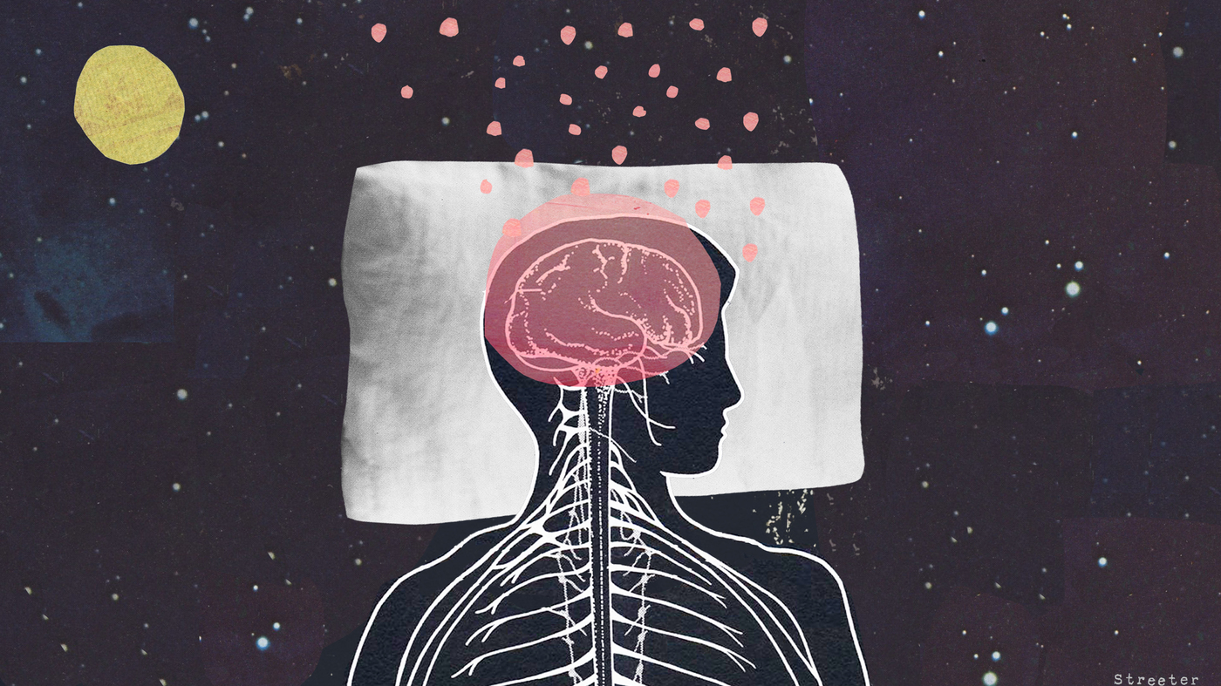
Learning and Memory
Sleep:
Improves brain functioning and memory
Helps you focus and make decisions
Helps you be more creative
Notes:
Sleep, learning, and memory are complex phenomena that are not entirely understood. Research suggests that sleep helps learning and memory in two distinct ways.
First, a sleep-deprived person cannot focus attention optimally and therefore cannot learn efficiently.
Second, sleep itself has a role in the consolidation of memory, which is essential for learning new information. Consolidation represents the processes by which a memory becomes stable. Memory consolidation takes place during sleep through the strengthening of the neural connections that form our memories.
The bottom line: Sleep helps your brain work the way it is supposed to. While you sleep, the brain prepares itself for the next day and helps you form new pathways that increase your ability to learn and remember things.
Note:
“Studies also show that sleep deficiency alters activity in some parts of the brain. If you're sleep deficient, you may have trouble making decisions, solving problems, controlling your emotions and behavior, and coping with change. Sleep deficiency also has been linked to depression, suicide, and risk-taking behavior”.
“Children and teens who are sleep deficient may have problems getting along with others. They may feel angry and impulsive, have mood swings, feel sad or depressed, or lack motivation. They also may have problems paying attention, and they may get lower grades and feel stressed”.

Slide 5
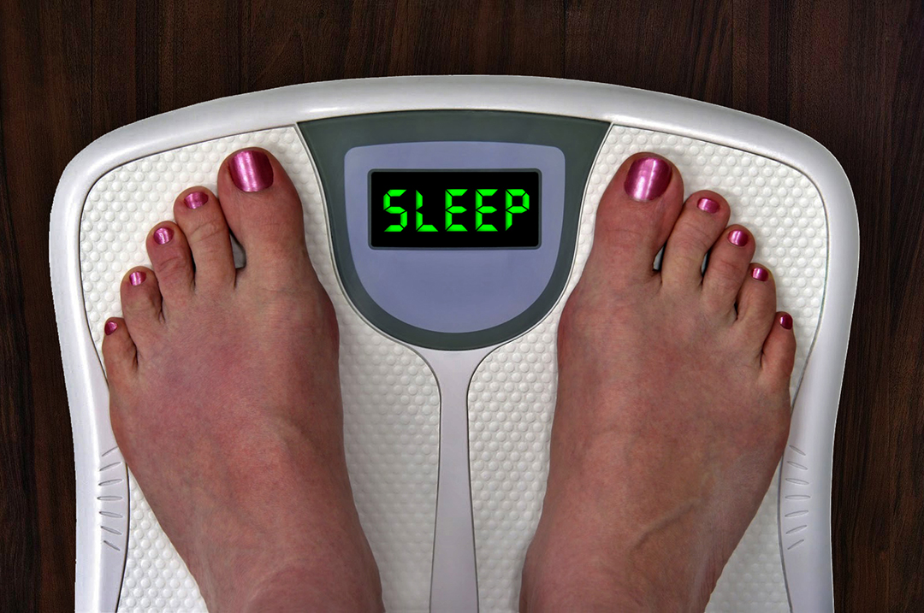
Metabolism and Weight
Having too little, or too much, sleep can increase your risk for weight gain.
Hunger-regulating hormones
Less physical activity
Notes:
Sleep plays a vital role in regulating metabolism and appetite. Recent studies have suggested an association between sleep duration and weight gain. Sleeping less than five hours — or more than nine hours — a night appears to increase the likelihood of weight gain.
One explanation might be that sleep duration affects hormones regulating hunger — ghrelin and leptin — and stimulates the appetite. Another contributing factor might be that lack of sleep leads to fatigue and results in less physical activity. Other studies have shown that recurrent sleep deprivation increased the preference for high-calorie foods and increased one’s overall caloric intake.
Just another reason to get a good night’s rest!

Slide 6
Safety
Sleep helps you safely function throughout day.
Notes:
Scientific research is revealing how sleep loss, and even poor-quality sleep, can lead to an increase in errors at the workplace, decreased productivity, and accidents that cost both lives and resources. For example, A National Sleep Foundation survey has revealed that 60 percent of adult drivers—about 168 million people—say they have driven a vehicle while feeling drowsy in the past year, and that more than one-third (103 million people) have actually fallen asleep at the wheel. Unfortunately, many of these situations end in tragedy. Furthermore, in regards to sleepy driving vs. drunk driving, sleepy driving is said to be “as mush as, or more [dangerous] than drunk driving”.
“After several nights of losing sleep—even a loss of just 1–2 hours per night—your ability to function suffers as if you haven't slept at all for a day or two”.
There is also something called “microsleep”. Microsleep “refers to brief moments of sleep that occur when you are normally awake”. Such as at a lecture or while driving, for example. This is sleep that occurs and you don’t even know it happened. It can be dangerous or make you miss important information.

Slide 7
Mood
Lack of sleep can cause:
Irritability
Short-temper
Stress
Anger
Sadness
Notes:
“Sleep and mood are closely connected; poor or inadequate sleep can cause irritability and stress, while healthy sleep can enhance well-being. Chronic insomnia may increase the risk of developing a mood disorder, such as anxiety or depression”.
Upon a good night sleep, however, mood often turns back to “normal” and helps you feel better.

Slide 8
Heart Health
Adequate sleep is essential for a healthy heart.
Notes:
Regardless of age, weight, smoking/drinking and exercise habits, people who don’t get enough sleep are at greater risk for heart disease.
It is not totally clear as to why sleep affects heart health so greatly, but research is linking it to blood pressure, inflammation and glucose metabolism.
Note: This information is NOT just for older adults. Recent studies demonstrate that sleep deficiency takes a negative toll on teens as well…leaving them at greater risk of heart disease, higher body mass index (BMI), bigger waist circumference, high blood pressure and increased risk of hypertension.
There is also some evidence that heart failure leads to sleep apnea (pauses in or shallow breathing when you sleep), a breathing problem that can awaken a person repeatedly throughout the night. Some people have nighttime angina (chest pain), bouts of atrial fibrillation, or palpitations (the sensation of a racing or pounding heart) that disturb sleep.

Slide 9
Disease Prevention
Sleep deficiency can cause:
Diabetes
Heart Disease
Obesity
Depression
Notes:
Research has revealed that people who consistently fail to get enough sleep are at an increased risk of chronic disease and poorly managing an existing chronic disease. Treating sleep as a priority, rather than a luxury, may be an important step in preventing a number of chronic medical conditions.

Slide 10
Sleep Recommendations
Try to:
Go to bed at the same time every night and wake up at the same time every morning
Limit your daytime naps
Notes:
Sometimes as we get older, it becomes harder to sleep through the night. The promotion of regular sleep is known as sleep hygiene. Here are some simple sleep hygiene tips.
Try to:
Go to bed at the same time every night and wake up at the same time every morning
Limit your daytime naps

Slide 11
Sleep Recommendations
You should avoid:
Large meals before bedtime
Exercising immediately before bedtime
Caffeine, nicotine, and alcohol before bedtime
Using your bed for things other than sleep or sex
Notes:
You should avoid:
Large meals before bedtime
Exercising immediately before bedtime
Caffeine, nicotine, and alcohol before bedtime
Using your bed for things other than sleep or sex

Slide 12
Sleep Recommendations
Your sleeping environment should be:
Quiet
Dark
Relaxing
Comfortable
Free of distractions and technology
Notes:
In order to promote optimal sleep, you need to ensure an optimal sleeping environment. Your sleeping environment should be:
Quiet
Dark
Relaxing
Comfortable
Free of distractions and technology

Slide 13
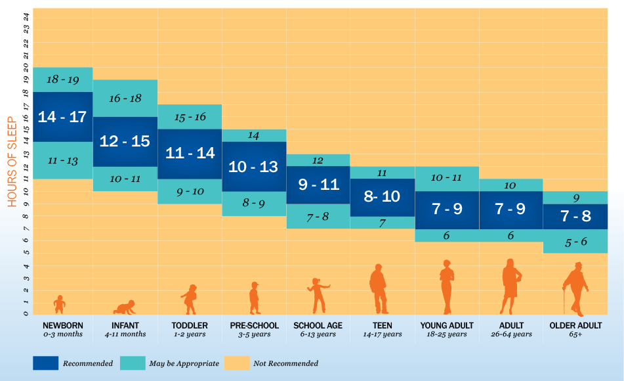
Sleep Recommendations
Notes:
How much sleep is enough for you or your family members?

Slide 14
Try it Out
Notes:
Activity: (Group Relaxation)
Supplies needed: None
Often when people cannot fall asleep they get impatient, which can result in not being able to sleep. To help yourself fall asleep, try to first relax. This starts with staying in the bed with the lights off, as moving around can make you more awake. Let’s try some relaxation techniques now. It’s okay if you snooze off, we will wake you up!
The first things I want you to do is to focus on your breathing. Consciously slow your breathing to a particular count (3 to 5 seconds in and out is good but it will vary by person). Counting focuses your mind and deep breathing relaxes you. Being relaxed and slowing your heart rate will make it easier to fall asleep.
Now that your breathing is slow and deep, picture a scene, a familiar place where you are happy—the beach, the mountains, your backyard. Visualize yourself moving around your place until you find a comfortable place to sit or lie down. In your imagination, sit or lie down and be comfortable there. When you are restless in bed trying to fall asleep, moving around in your favorite place in your mind can help relieve that restlessness. Once you are calm in your mind, you can become calm in your body.
Recheck your breathing. Slowly breathe in and out. Take a deep breaths. Are you still picturing your familiar place? Are you lying down in your mind? While you picture yourself in your favorite place in your mind, we are going to relax your muscles. Start by tensing up your toes for a few seconds while you breathe, then relax. Do it again. Tense the arches of your feet, hold, relax. Now your calves muscles…. (Walk the participants through tensing and relaxing their muscles up their body and end at the face.) By having this body awareness, it can help remove body tension and make you more comfortable enabling sleep to come easier.
Are you relaxed? Do you feel sleepy? Open your eyes and stretch. You can try these and other techniques at home to help you fall asleep at night.

Slide 15
Aging is inevitable…
By embracing a healthy lifestyle throughout your life, you will have a greater ability to engineer a positive approach to the aging process.
Notes:
Aging in an inevitable and unavoidable process. It is a process that brings on many changes as a person progresses from childhood to adulthood. The way in which you take care of yourself through the years both physically and mentally will impact the ways in which you enter your later years. Life does not diminish with aging. In fact, the acceptance of aging can be something that is positive, joyful, and exciting. With aging comes new experiences, knowledge, wisdom and a greater ability to engineer a positive approach to the aging process. I hope today that the Keys to Embracing Aging program highlighted how sleep impacts your overall ability to age well!

