Slide 1
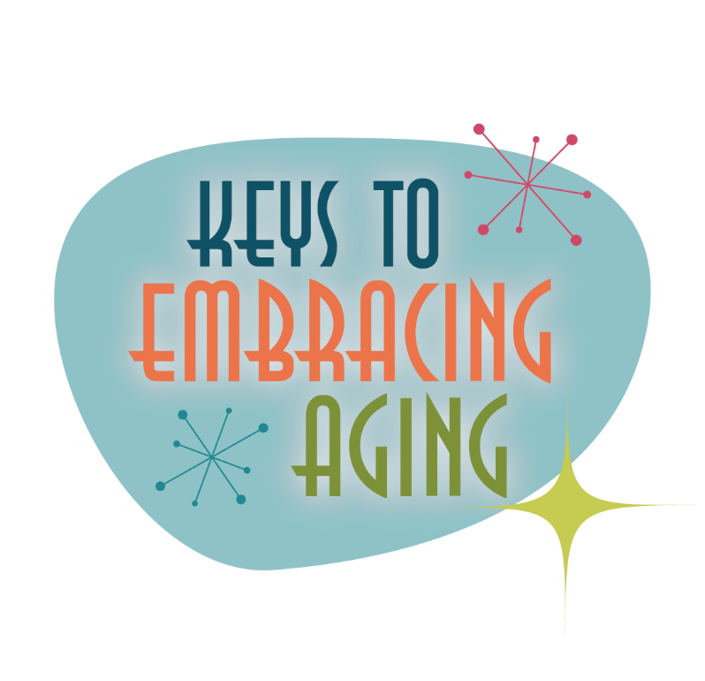
Taking Time for You

Slide 2
Establishing healthy lifestyle behaviors throughout your life influences optimal aging
Positive Attitude
Eating Smart
Physical Activity
Brain Activity
Social Activity
Tuning Into the Times
Practice Being Safe
Know Your Health Numbers
Stress Management
Financial Affairs
Sleep
Taking Time for You
Notes:
Today we will be concentrating on the power of taking time for you. I wanted to remind you what all of the keys to embracing include. Remember—these keys represent lifestyle behaviors. Practiced through the lifespan (although it is never to late to start), these lifestyles contribute to health, well-being, life quality and even longevity.
Attitude is Everything
Eating Healthy
Get Fit
Brain Health
Be Social
Tune-in to the Times
Stay Safe
Know Your Numbers
Manage Your Stress
Financial Affairs
Sleep Tight
Take Time for You

Slide 3
Taking Time for You
How often do you take a personal time-out?
Notes:
Begin by discussing: How often do you take a personal time-out?
You spend a lifetime making time for others – parenting, caregiving, volunteering and working, but how often do you take a personal time-out? The American Heart Association recommends making a conscious decision to do at least one thing every day that you enjoy. Taking time for you is good for your mind, body and soul.
What do you do for yourself on a daily basis that you enjoy? What would you like to do more of?

Slide 4
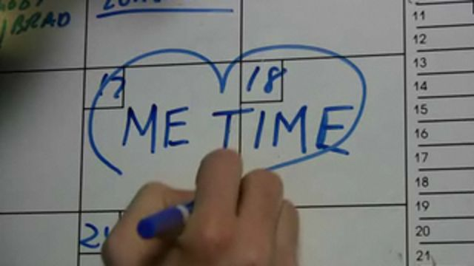
Take Time For You
Get to know yourself
Take care of yourself
Take a break
Make a “to do list”
Be physically active
Eat healthfully
Relax
Laugh
Learn to say “NO”
Create a bucket list
Notes:
Here is a list of ideas to help encourage you to spend at least 10 minutes a day on just you. We will spend the next few minutes going over each idea.
Get to know you
Take care of yourself
Take a Break
Make a “to do list”
Be physically active
Eat smart and drink water
Relax
Laugh
Learn to say “NO”
Create a bucket list

Slide 5
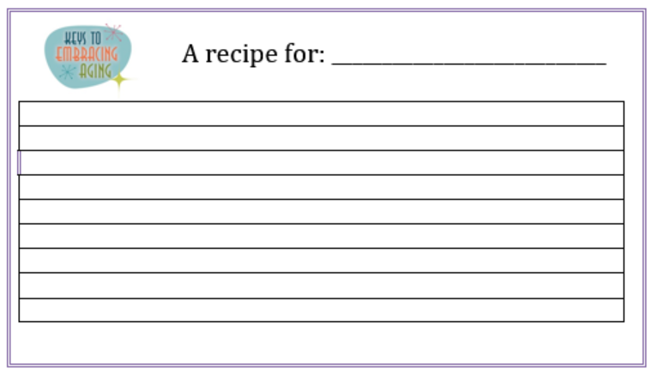
Get to Know Yourself
What makes you, YOU?
Notes:
What makes you, you? What gets you out of bed in the morning? What is your purpose? To help you answer these questions, think about the things you believe in, the values that guide your life and the passions that motivate you. Have you identified and thought about what is really important to you and what you want to get out of life, including your short-term and long-term goals? Once you answer and/or revisit these questions, gather your thoughts and seek opportunities that fulfill you.
Activity 1: Recipe of You
Supplies needed: Pens/pencils and Recipe worksheet.
This activity encourages participants to think carefully about the unique individual characteristics that make them who they are (a unique, one-of-a-kind individual who is a blend of “ingredients”). For example, you may be a mix of strength, 8 hours of sleep, and determination combined with short legs, blue eyes, brown hair and laughter and passion, to make a complete recipe of you.
Pass out Recipe Card worksheet
Read directions to the group
Think carefully about your personality, values, what makes you happy, what makes you special, favorite foods, hobbies, or any other characteristics that make up you. Use strong adjectives to describe you. Brainstorm first and then write down your ideas on the front of this card.
On the front of your card, list the ingredients and measurements that make you, YOU (1/2 cup love; 1 tsp. grouchy).
Provide directions on how to mix your ingredients together.
Name your recipe.
Share your recipe with the group!

Slide 6
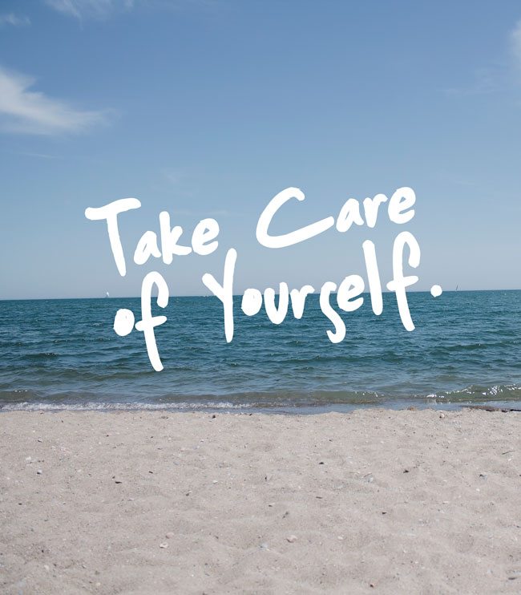
Take Care of Yourself
Improves mood & productivity
Enhances confidence & concentration
Leads to overall well-being & happiness
Notes:
Take care of yourself
Life is busy. As a result, you may neglect your own well-being which can lead to stress, irritability, moodiness and even depression. Proper self care, such as sleep, nutrition, physical activity, and low stress can help improve mood and daily productivity. By taking care of yourself, you will be more relaxed and content. You will also feel stronger and more confident. A person who places an emphasis on self care is more efficient, better able to concentrate and help others, and will be more likely to accomplish and enjoy more within a 24 hour period.
Group Discussion (optional):
Brainstorm about the many ways to take care of yourself/engage a healthy life. Some answers may include: Sleep, Exercise, Eat healthy, Laugh more, De-clutter or organize your house and/or office, Read a book, Walk your pet, Play with your kids/grandkids, Join a club, Go to your doctor for checkups…

Slide 7
Take a Break
Don’t feel guilty for taking time to unplug.
Notes:
Take a break from your daily routine without feeling guilty
It is mentally healthy to take a break from your daily routine. But such breaks often come with guilt. You feel guilty for while at work or running errand because you are not with you family, yet spending time with family can create pressure because you are not concentrating on work or household tasks. On top of it, people feel the most guilty when they time for themselves. Slipping away from your daily routine doesn’t have to occur for extended periods of time, it can mean going to your bedroom with your door closed to sit, take a bath, or read a book uninterrupted. Help your family and friends around you understand that this is a time you do not want any interruptions. If it's difficult for people to leave you alone, leave the house and go for a walk, meet a friend for coffee, see a movie, or go shopping.
What is your favorite way to take a break?

Slide 8
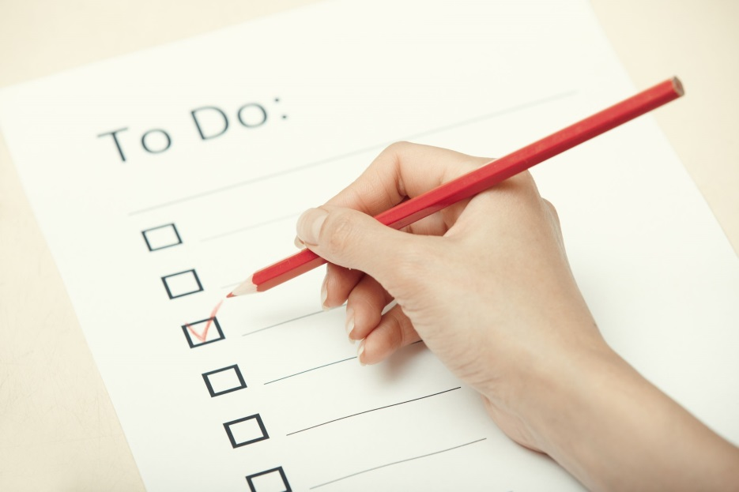
Make a To-Do List
Enhances time management
Promotes organization & prioritization
Provides control & balance
Encourages gratification & empowerment
Notes:
Make a “to do list”
A “to do list” is a motivating and organizational tool that helps you plan your day and manage your time effectively.
Prioritizing your list into due dates, short- and long-term goals and/or rank of importance can help you feel more control and balance.
It also helps you recognize that everything does not all need to be done in one day.
Crossing items off a list is a mental reminder that you’re making progress. It can be both gratifying and empowering.
But, always leave enough room for day-to-day tasks and other unplanned events that naturally appear during the day.

Slide 9
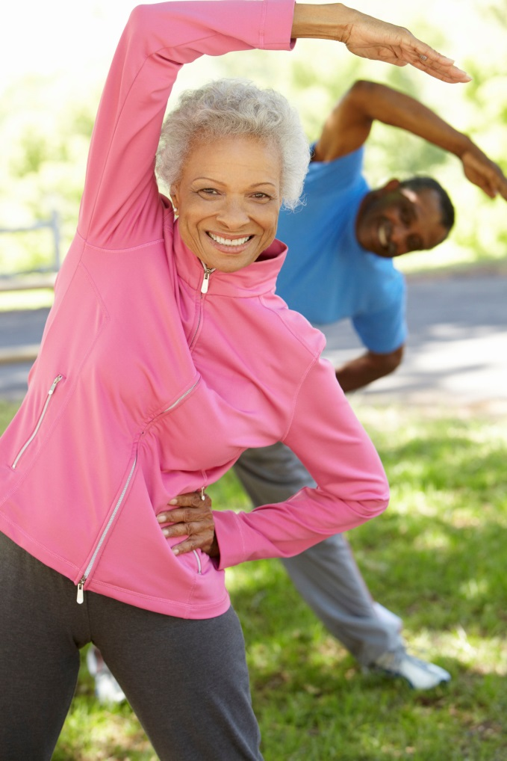
Be Physically Active
Enhances overall well-being
Improves health
Decreases stress & anxiety
Boosts self-esteem & confidence
Notes:
Take at least 10 minutes a day for you:
Be physically active
Physical activity and exercise, including strength training, is a healthy way to spend “me time.” Exercise affects overall physical and mental well-being. It increases strength, cardiovascular conditioning, flexibility, balance and muscle mass. It also decreases body fat, helps boost self-esteem and confidence and helps lower stress and anxiety.
Walking is a great way to get started with an exercise routine, even if it is just around the yard. If you already have a regular exercise routine, try something new like joining a yoga or cycling class. Group exercise provides both social and physical stimulation.
Children and teens should exercise for approximately one hour per day. Middle-aged and older adults should aim for at least 150 minutes of exercise per week.

Slide 10
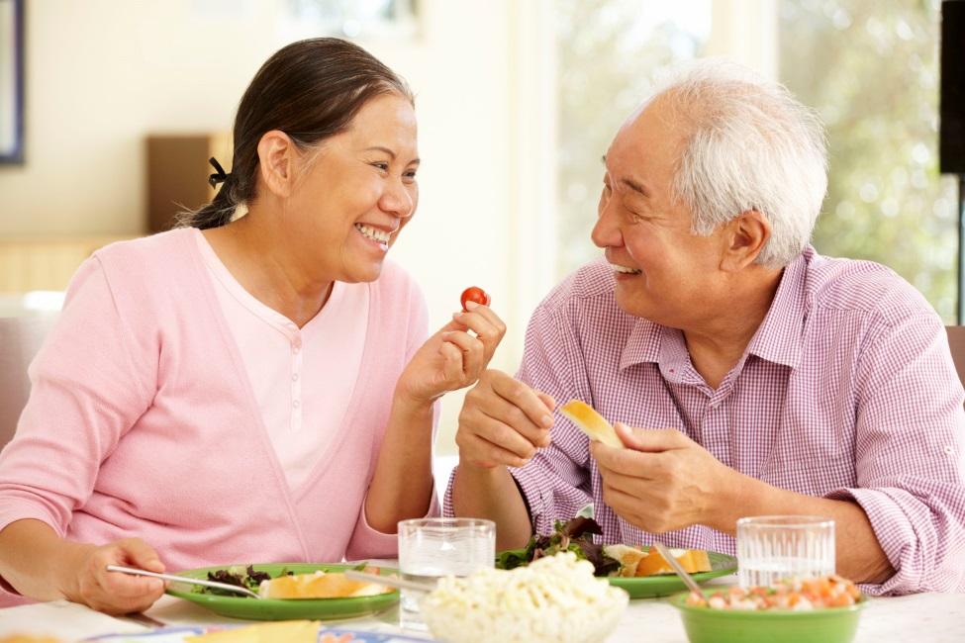
Eat Healthfully
Take the time to prepare and eat healthful meals.
Notes:
Eat healthfully
Eating well, especially heart-healthy foods, is a key to taking care of yourself. Wholesome, nutritious foods can give you more energy, combat depression by keeping your brain functioning at its best, and prevent numerous other health problems such as obesity, diabetes, heart disease, and cancers. Drinking plenty of water will help hydrate your skin and your body. It also flushes toxins out of your body and helps you concentrate.

Slide 11
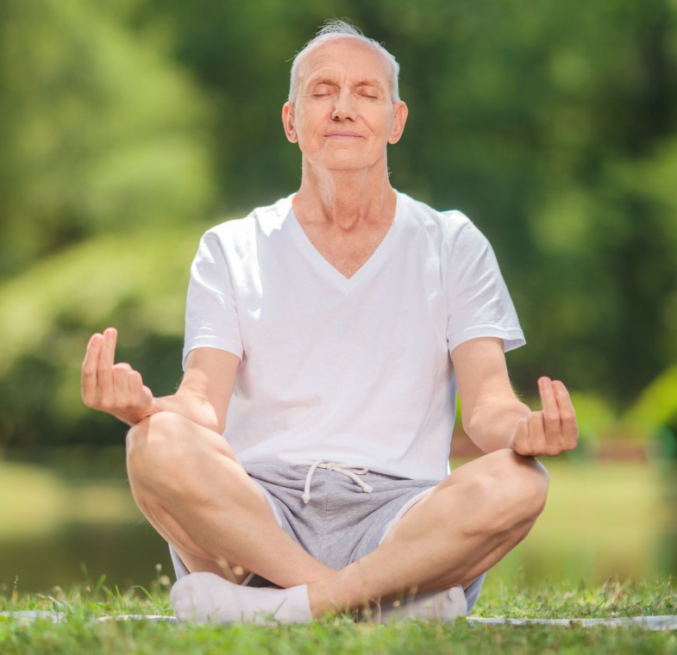
Relax
Relaxation is the single most important key to health and well-being.
Notes:
Relax
Relaxation, the body’s natural unwinding technique, has been referred to as the single-most important key to health and well-being. As a result of relaxation, you may experience more energy, better sleep, enhanced immunity, increased concentration and problem-solving abilities, greater efficiency, smoother emotions, and fewer physical reactions to stress.
Relaxation has also been known to decrease muscle tension and blood pressure, and increase blood flow, which is good for the heart. Relaxation can occur through taking a hot bath, reading a book, getting a massage, or taking a few deep breaths. Professional methods of relaxation include visual imagery, body awareness, and progressive muscle relaxation.
Meditation is a form a relaxation. Meditation is a state of peace that occurs when the mind is calm. Meditation helps to reduce stress, depression, and anxiety. In addition to contributing to a calmer, more peaceful and happier life, meditation can increase creativity and productivity in the workplace or classroom.

Slide 12
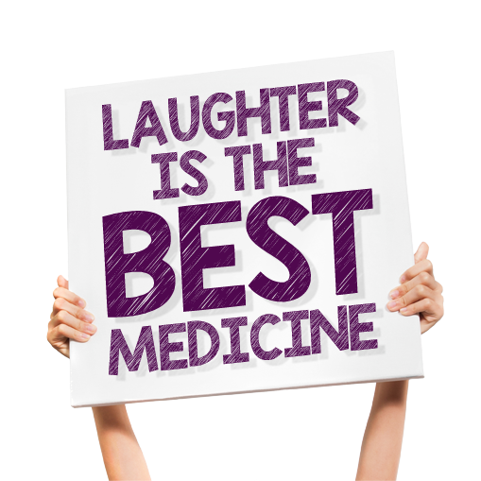
Laugh
Laughter:
Increases endorphins (the “feel” good hormones)
Boosts the immune system
Reduces stress
Lowers depression
Enhances a healthy mind and soul
Notes:
Laugh
It’s no joke. Laughter really is the best medicine. Laughter has the ability to increase the “feel good” hormones in the body called endorphins. Laughter boosts the immune system, which contributes to overall healthiness. Finding humor in daily situations can even reduce stress, lower depression and help your mind and body heal. With such positive benefits of laughter, make laughing a goal. Laughter is contagious. Watch a funny movie or television show, go to a comedy club, take an impromptu comedy class or simply laugh with a close friend or loved one.

Slide 13
Learn to Say “No”
Admit that there are limits in how much you can do in a day.
Notes:
Learn to say “NO”
The truth is that there are limits in how much you can do in a day. …and if you say “yes” to everything, in the end, you will have time for nothing because you will not be able to fit it all OR your days will be so crazy that you will have no time to rest and likely not meet all of your responsibilities if you do.
Do you find yourself saying “yes” to everything that is asked of you, even if it is something you really do not want to do? Always saying yes is not healthy. It often over-commits you, which can cause stress and fatigue. Saying no allows you to honor existing obligations and dedicate quality time to those commitments. Saying no to things that you have always done but are tired of doing, allows you to try new things. You should not feel guilty saying no, as saying no helps you to focus on what’s important.
To make room in your life and help create balance, say “yes” to what is most important—the people and things you love, work, your passions.

Slide 14
Create your Bucket List
Notes:
Create A Bucket List
A bucket list can act as a road map for “me time” today and into the future. A bucket list is a list of goals, dreams, and life-experiences that are important for you to experience before you die. Bucket lists aim to help you maximize every moment of your existence and live your life to the fullest. Bucket lists can be grounding because we too often get caught up in the madness of daily activities and fail to live by personal plans and goals. A bucket list helps you identify purpose and meaning because it provides reminders about what is important in life, what you have done, and where you want to go. While bucket lists are often associated with dreams of travelling the world or skydiving, your list should fit your personal goals and dreams no matter how big or small.
Activity: Bucket List (individual activity and group discussion)
Supplies needed: Pen/pencil and Bucket Sheet worksheet
A bucket list is a list of things you want to do before you die. Keep in mind that not everyone wants to jump out of planes or climb mountains. A bucket list can also include dreams, aspirations, plans and decisions for the future.
Read the directions:
In column 1, write down your dreams, aspirations, plans and/or decisions you want to make or anticipate making in the future.
Include your age/date that you think these events might take place in Column 2.
Allow 2-3 minutes for participants to brainstorm and write
Allow 5-8 minutes for group sharing/discussion

Slide 15
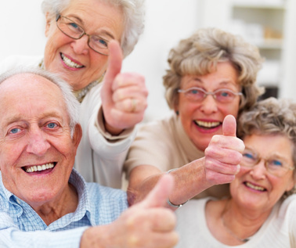
Aging is inevitable…
By embracing a healthy lifestyle throughout your life, you will have a greater ability to engineer a positive approach to the aging process.
Notes:
Aging in an inevitable and unavoidable process. It is a process that brings on many changes as a person progresses from childhood to adulthood. The way in which you take care of yourself through the years both physically and mentally will impact the ways in which you enter your later years. Life does not diminish with aging. In fact, the acceptance of aging can be something that is positive, joyful, and exciting. With aging comes new experiences, knowledge, wisdom and a greater ability to engineer a positive approach to the aging process. I hope today that the Keys to Embracing Aging program highlighted how taking time for you increases your overall well-being!

