Slide 1
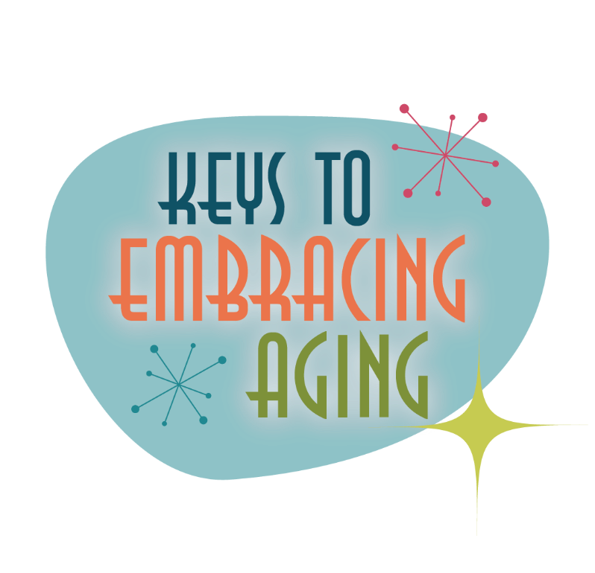



Positive Attitude
Notes:
George Carlin’s Take on Aging:
Do you realize that the only time in our lives when we like to get old is when we're kids? If you're less than 10 years old, you're so excited about aging that you think in fractions.
"How old are you?" "I'm four and a half!" You're never thirty-six and a half. You're four and a half, going on five! That's the key.
You get into your teens, now they can't hold you back. You jump to the next number, or even a few ahead.
"How old are you?" "I'm gonna be 16!" You could be 13, but hey, you're gonna be 16! And then the greatest day of your life...you become 21. Even the words sound like a ceremony. YOU BECOME 21. YESSSS!!!
But then you turn 30. Oooohh, what happened there? Makes you sound like bad milk! He TURNED; we had to throw him out. There's no fun now, you're just a sour-dumpling. What's wrong? What's changed?
You BECOME 21, you TURN 30, then you're PUSHING 40. Whoa! Put on the brakes, it's all slipping away. Before you know it, you REACH 50 and your dreams are gone.
But wait!!! You MAKE it to 60. You didn't think you would!
So you BECOME 21, TURN 30, PUSH 40, REACH 50 and MAKE it to 60.
You've built up so much speed that you HIT 70! After that it's a day-by-day thing; you HIT Wednesday!
You get into your 80s and every day is a complete cycle; you HIT lunch; you TURN 4:30; you REACH bedtime And it doesn't end there. Into the 90s, you start going backwards; "I Was JUST 92."
Then a strange thing happens. If you make it over 100, you become a little kid again. "I'm 100 and a half!"
(change slides)

Slide 2

May you all make it to a healthy 100 and a half!
Notes:
May you all make it to a healthy 100 and a half!!
Today we’re going to start our challenge journey. Throughout this journey we will talk about healthy lifestyle behaviors that can propel you towards 100 and a half.

Slide 3
Establishing healthy lifestyle behaviors throughout your life influences optimal aging
Positive Attitude
Eating Smart
Physical Activity
Brain Activity
Social Activity
Tuning Into the Times
Practice Being Safe
Know Your Health Numbers
Stress Management
Financial Affairs
Sleep
Taking Time for You
Notes:
The 12 keys that we will discuss in our challenge series will be:
Positive attitude
Eating smart
Physical activity
Brain activity
Social activity
Tuning in to the times
Practice being safe
Know Your health numbers
Stress management
Financial Affairs
Sleep
Taking Time for You
These keys represent lifestyle behaviors. Practiced throughout the lifespan, these lifestyles contribute to health, well-being, life quality and even longevity. The important things to remember, though, is that is NEVER TOO LATE to incorporate health and wellness into your life.
Today we are going to highlight the power of a positive attitude. So, let’s begin by doing a quick activity.

Slide 4
AGE
AGING
OLD
Notes:
What words come to mind when you think about age/aging/old? Shout out what words first come to your mind.
Activity 1: Attitudes about Aging
Supplies: flip chart paper, flip chart markers
1. Ask participants what words come to mind when they think of the words “age/aging/old”.
2. Once complete, go back through the list as a group. Ask participants if they think a word is positive (circle it) or negative (cross it out).
3. Sometimes there might be more negative words than positive. Why is this?
4. Discuss how aging is influenced by:
*Society and media (we live in a culture that values youth – we grow up learning/thinking this). Therefore, older adults might think they’re a burden, that they have no purpose, or that aches/pains/frailty is “normal”
*Ageism (negative stereotyping of older adults)
5. Discuss the positive words from the brainstorm
These positive words are a key component of this program that you will soon see. As George Carlin points out in his poem, embracing aging is a life long journey; therefore it is important to establish healthy lifestyle behaviors throughout life to influence optimal aging.

Slide 5
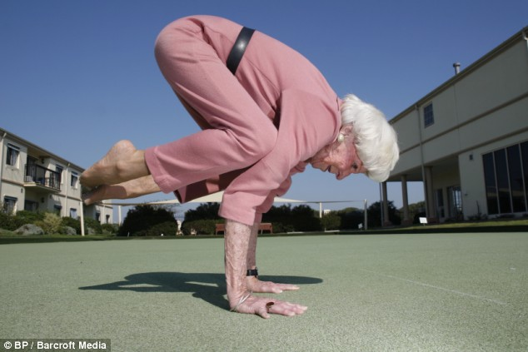
Avoid Ageism
Having a positive attitude about aging can help you live longer!
Notes:
ATTITUDE AND AGING
A positive attitude about growing old throughout the lifespan can help you live longer, yet we grow up in a society that constantly reinforces negative stereotypes of old age and aging. We grow up thinking that old age is terrible. We associate “old” with senility, crankiness and frailty. When primed with such negativity throughout life, we are more likely to believe such stereotypes and live up to those low expectations, thus performing at lower functioning levels in old age. It is therefore important that we recognize and value the contributions, accomplishments and wisdom of senior adults. Such a societal change in attitude towards aging will affect both today’s and tomorrow’s seniors for the better. When armed with a sense of happiness and purpose, older adults are more apt to suppress negative thoughts and carry on as competent and productive members of society, regardless of age or ability.
Optional: Read “Life Begins at 80”
I have good news for you. The first 80 years of your life are the hardest. The second 80 are just a succession of birthday parties.
Once you reach 80 you’ve got it made. Everyone wants to carry your baggage, help you up the stairs, find you a seat, get you a cup of coffee. Everyone is so nice. And if you forget your name, or anyone else’s name, or an appointment, or your own telephone number, or promise to be three places at the same time, or you can’t remember how many grandchildren you have, you need only explain that you’re 80.
Being 80 is a lot better than being 70. At 70, people are mad at you for everything – they want you to do everything, and know everything, and blame you for everything. If you act foolishly you’re in your second childhood. Everyone is looking at you for symptoms of softening of the brain.
Being 70 is no fun at all. At that age people expect you to retire to a house in Florida and complain about your arthritis. But if you survive until you are 80, everyone is surprised that you are still alive. They treat you with respect, and kindness just for having lived so long. Actually, they seem astonished that you can walk and talk sensibly.
So please folks, try to make it to 80. It’s the best time of your life. People forgive you for anything. If you ask me, life begins at 80.

Slide 6
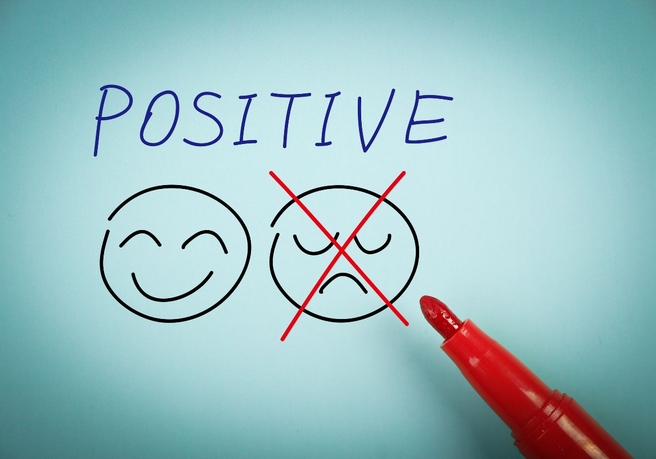
Benefits of a Positive Attitude
A positive attitude promotes:
Overall happiness, health, and well-being
Lower rates of depression
Lower levels of distress
Better coping skills
Notes:
Because the connection between the mind and body is so strong, an overall positive attitude, including an upbeat outlook on life, can affect overall happiness, health and well-being.
Researchers continue to explore the effects of positive thinking and optimism on health. Health benefits that positive thinking may provide include:
Increased life span
Lower rates of depression
Lower levels of distress
Greater resistance to the common cold
Better psychological and physical well-being
Reduced risk of death from cardiovascular disease
Better coping skills during hardships and times of stress
It's unclear why people who engage in positive thinking experience these health benefits. One theory is that having a positive outlook enables you to cope better with stressful situations, which reduces the harmful health effects of stress on your body. It's also thought that positive and optimistic people tend to live healthier lifestyles — they get more physical activity, follow a healthier diet, and don't smoke or drink alcohol in excess.
The bottom line: being more positive across the lifespan causes less stress and enables people to live healthier, happy lives.

Slide 7
Steps to Positivity
A positive attitude is often expressed through:
Positive, practical, and creative thinking
Optimism
Motivation and sense of purpose
Energy to get things done and accomplish your goals
Overall happiness
Notes:
We often take on a positive attitude when we do or think in the following ways:
Thinking positive, practically and/or creatively
Being optimistic vs. pessimistic (is the glass half full or empty?)
Having a sense of motivation and a sense of purpose…feeling driven…having a reason to get out of bed in the morning
Having the energy to get things done/to accomplish goals
Feeling generally happy

Slide 8

Change: Work to Accept It
Accepting change and learning from mistakes helps you to see the possibility of new and/or even better opportunities!
Notes:
ACCEPTING CHANGE
Being able to accept and adapt to change plays an important role in having a positive attitude, especially as life is filled with ups and downs.
A positive attitude allows you to meet such challenges – both the good and bad – with less resistance.
In this position, you are much more open to learn from mistakes, research what it is you may want or see the possibility of new and/or better opportunities.
When you approach change with rigid thoughts or feelings of apprehension, strain and stress are more likely to result, leaving you overwhelmed and more susceptible to a sense of failure and even depression.

Slide 9

Choose to be Happy
Start your day on a positive note
Focus on the good
Embrace life’s challenges
Surround yourself with positive people
Choose to be happy
Be gracious, helpful, and kind
Take care of yourself
Have fun!
Notes:
No matter what challenges you face or what life throws at you, you can always work on choosing to be happy. Make happiness a choice!
So, how do you CHOOSE to be happy? How can you CHOOSE to lead a more positive life? Discuss as a group.
Optional Group Activities:
Activity 1: Is the Glass Half Full or Empty?
Supplies Needed: Flip chart paper, flip chart markers
Ask the participants as a group to brainstorm several concerns that range from controversial issues such as abortion or fun issues such as ice-cream flavors. List the concerns/issues on your flip chart paper. After the list is written, ask the participants to state what they are FOR vs. AGAINST. When you are against something, you may sound and likely even feel negative. People can interpret your negativity as a personal attack and feel less likely to cooperate when they think you are against them. When you are “for” something, you are focusing your energy and thoughts more positively (See examples below). Positive attitudes not only contribute to well-being, but they also contribute to healthier, more meaningful collaborations with others.
Topic: Abortion. Instead of saying: “I am against abortion.” Say: “I am for pro-life.”
Topic: Chocolate ice cream. Instead of saying: “I don’t like chocolate.” Say: “I like vanilla.”
Activity 2: You Don’t Say (Group Activity).
Another way to change your attitude to being more positive is by being more positive to others. Ask each participant to pay at least two sincere compliments to every person in the room. The key word is sincere. People care what you think about them. They appreciate your mentioning their good work or hard effort. Therefore, when the participants pay a the complement and recognize the individual, have them be specific in their compliments. For example, don’t just say, “You look nice today” but say “You look very nice in your blouse. It is a pretty color.”
In return, the participants must accept sincere compliments. Deflecting a compliment often draws unwanted attention and belittles both you and the person offering the compliment. During this activity, have the participants practice just saying, "Thank you." They may be pleased with how gracious they become after this activity.

Slide 10
Attitude Check!
(3) Mostly Yes (2) Sometimes (1) Mostly No
____Are you friendly? ____Do you try not to complain? ____Can you be optimistic when others aren’t? ____Do you have a sense of duty and responsibility? ____Do you control your temper? ____Do you speak well of your employer or your instructor? ____Do you feel well most of the time? ____Do you follow directions willingly, asking questions when necessary? ____Do you keep your promises? ____Are you organized? ____Do you admit to your mistakes? ____Is it easy for you to like most people? ____Can you stick to a boring task without being forced to? ____Do you know your weaknesses and work to improve them? ____Can you take being teased? ____Do you try not to feel sorry for yourself? ____Are you courteous? ____Are you neat in your personal appearance and work habits? | ____Do you respect other people’s opinions? ____Can you adapt easily to new and unexpected situations? ____Do you tolerate other people’s beliefs? ____Can you stop yourself from sulking when you don’t get your way? ____Are you a good listener? ____Are you the kind of friend you would like others to be? ____Can you disagree without being disagreeable? ____Are you normally on time? ____Do you consider yourself to be a courteous driver? ____Do you usually speak well of others? ____Can you take being criticized without feeling hurt or resentful? ____Do you generally look at the bright side of things? ____Can you work with someone you dislike? ____Are you pleasant to others even when you aren’t pleased about something? ____Are you enthusiastic about other people’s interest? ____Do you tend to be enthusiastic about whatever you do? ____Are you honest and sincere?
Notes:
Instruct participants to complete the “attitude” section of their evaluation.
Instruct participants to total their scores (add all of the numbers)
Score Results:
95 – 105: You are positively terrific!
75 – 94: Your positives are definitely admirable!
45 – 74: Your positives need work in certain areas
Below 45: Your positives have almost fizzled out. Take a close look at your attitude!
Discuss the results.

Slide 11

Aging is inevitable…
By embracing a healthy lifestyle throughout your life, you will have a greater ability to engineer a positive approach to the aging process.
Notes:
Aging in an inevitable and unavoidable process. It is a process that brings on many changes as a person progresses from childhood to adulthood. The way in which you take care of yourself through the years both physically and mentally will impact the ways in which you enter your later years. Life does not diminish with aging. In fact, the acceptance of aging can be something that is positive, joyful, and exciting. With aging comes new experiences, knowledge, wisdom and a greater ability to engineer a positive approach to the aging process. I hope today that the Keys to Embracing Aging program highlighted the power of a positive attitude and gave you some tips to think about how you could develop some more positivity in your life.

