Slide 1
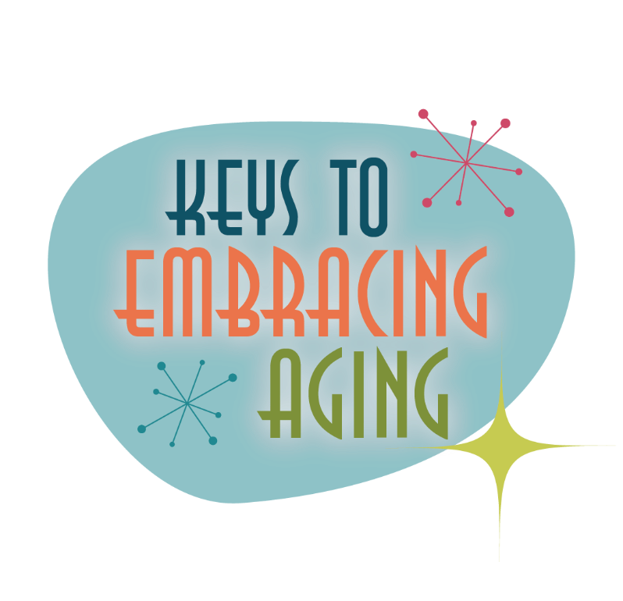



Physical Activity

Slide 2
Establishing healthy lifestyle behaviors throughout your life influences optimal aging
Positive Attitude
Eating Smart
Physical Activity
Brain Activity
Social Activity
Tuning Into the Times
Practice Being Safe
Know Your Health Numbers
Stress Management
Financial Affairs
Sleep
Taking Time for You
Notes:
Today we will be concentrating on the power of physical activity…but I wanted you too see what all of the keys to embracing include. Remember—these keys represent lifestyle behaviors. Practiced through the lifespan (although it is never to late to start), these lifestyles contribute to health, well-being, life quality and even longevity.
Attitude is Everything
Eating Healthy
Get Fit
Brain Health
Be Social
Tune-in to the Times
Stay Safe
Know Your Numbers
Manage Your Stress
Financial Affairs
Sleep Tight
Take Time for You
Today we are going to highlight the power of physical activity. So, let’s begin by talking about the importance of physical activity to overall health and well-being.

Slide 3
Brainstorm…
What are the health and wellness benefits associated with regular physical activity?
Notes:
Let’s start today by brainstorming, what are the health and wellness benefits associated with regular physical activity?
Have participants list out loud/or write their ideas down on post-it paper.
Most participants will immediately think of the physical benefits…you can also ask them - what about emotional benefits?

Slide 4
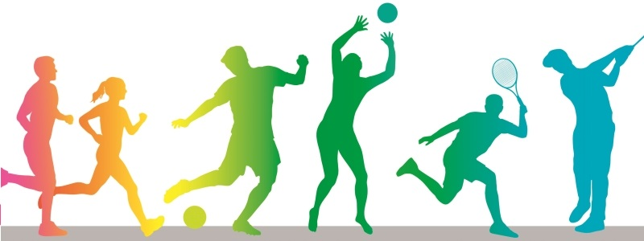
Physical Activity Leads to Health
Strengthens bones and muscles
Improves cardiovascular health
Maintains or increases range of motion and flexibility
Reduces chronic disease risk factors
Improves mental health and mood
Improves cognitive functioning
Protects against dementia, including Alzheimer’s disease
Improves quality of life and ability to do daily activities
Controls weight
Increases energy
Promotes restful sleep
Reduces the risk of falling
Contributes to longevity
Notes:
Physical activity includes any body movement that works muscles and requires more energy than resting. Walking, gardening, pushing a stroller and climbing the stairs are just a few examples of physical activity that are low in intensity. Exercise is a type of physical activity that is planned and structured for an extended period of time. Exercise often includes more vigor or intensity such as running, swimming, weightlifting, aerobics or participating on a sports team.
Physical activity is important because it:
• Strengthens bones and muscles
• Improves cardiovascular health
• Maintains or increases range of motion and flexibility
• Protects against certain health conditions, such as heart disease, stroke, hypertension, obesity, type 2 diabetes mellitus, osteoporosis, colon cancer and depression
• Improves mental health and mood
• Improves cognitive functioning
• Protects against dementia, including Alzheimer’s disease
• Improves quality of life and ability to do daily activities
• Controls weight
• Increases energy
• Promotes restful sleep
• Reduces the risk of falling
• Contributes to longevity

Slide 5
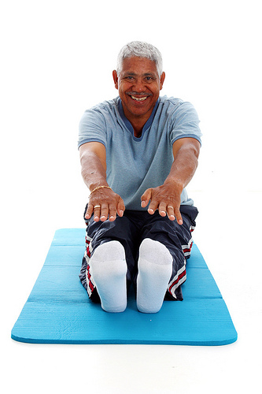
Get Fit!
Balance
Endurance
Strength
Flexibility
Goal = 150 minutes per week
Notes:
Did you know that there are 4 types of exercise? It is not just strength training/weight lifting and aerobics any more. There are official categories for balance exercises and flexibility/stretching exercises.
Balance exercises help prevent falls, a not uncommon problem in older adults. Falling is a major cause of broken hips and other injuries that often lead to disability and loss of independence. Some balance exercises build up your leg muscles while other exercises focus on your stability.
Examples of balance exercises include several strength exercises for the lower body such as front leg raises, side leg raises, and toe stands, as well as stability exercises such as forward toe-touch/arm reach and the stork pose. You can also practice balance by doing yoga, or something similar.
Endurance exercises increase your breathing and heart rate. They improve the health of your heart, lungs and circulatory system. Increased endurance keeps you healthier and improves stamina for daily activities. Endurance exercises may also delay or even prevent many diseases associated with aging, such as heart disease and diabetes.
Examples of endurance exercises are walking, jogging, dancing, and playing tennis.
Strength training makes you stronger by building muscle. This increased strength allows you to perform daily activities on your own. Strength training also plays a key role in keeping obesity and diabetes at bay by increasing your metabolism, which helps you maintain a healthy weight and ideal blood sugar levels. Additionally, studies suggest strength training may help prevent the progression of osteoporosis.
Examples of strength training exercises include lifting or pushing free weights, pulling resistance bands, and using strength-training equipment at a fitness center or gym.
Stretching Exercises keep your body flexible by stretching the muscles and tissues that hold your bone’s together. These exercises help give you more freedom of movement to do everyday activities such as reaching and looking over your shoulder. Specific stretches are recommended to prevent injuries but others are recommended to recover from injuries. Flexibility may also play a part in the prevention of falls.
Examples of stretching exercises include shoulder, back, and upper arm stretch, calf stretch, and hamstring stretch. You can also practice stretching by doing yoga, or something similar.
How Much Exercise Do You Need?
Infants and babies (aged 0-2)
There are no specific requirements for infants; however, infants/ babies/very young children should not be inactive for prolonged periods of time — no more than 1 hour unless they are asleep.
Small children (aged 2-5)
Toddlers and preschoolers need 90 to 120 minutes of physical activity every day. This activity should be roughly halved between planned exercise and free play physical activity. Small children should not be inactive for more than 2 hour unless they are asleep.
Children and Adolescents (aged 6–17)
Children and teenagers need a minimum of 60 minutes of moderate intensity aerobic physical activity in 15-minute segments or longer every day. Children and adolescents should perform vigorous-intensity aerobic activity and strength training 3 days per week. However, it is important to note that children and adolescents should participate in physical activities that are appropriate for their age. For example, a muscle and bone strengthening activity for a 7 year old may include jumping rope and climbing on monkey bars whereas for a 17 year old it may include going to a gym and lifting weights. Children and adolescents also need to stretch.
Adults and Senior Adults (aged 18 and older)
In general, adults and senior adults should get 150 minutes of exercise a week and this needs to be in bouts of at least 10 minutes in length. When you break this down, 150 minutes is only (approximately) 20 minutes a day 7 days a week, 30 minutes a day for 5 days a week, or 50 minutes a day for 3 days a week. And when you break that down into 10 minute segments, it seems much easier to accomplish.
Optional Activity: Deskercise
See https://www.uaex.edu/publications/PDF/FSFCS29.pdf and https://www.uaex.edu/publications/pdf/MP523.pdf from the University of Arkansas

Slide 6
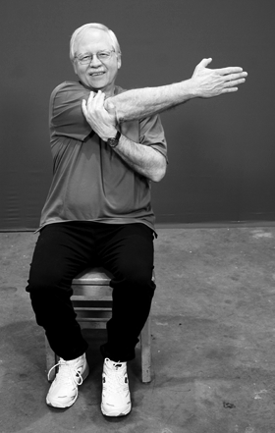
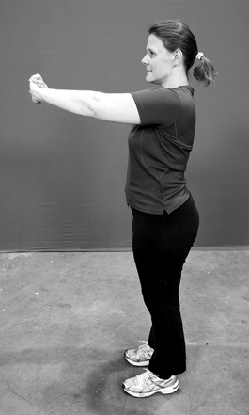
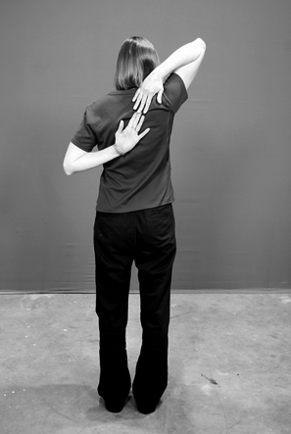
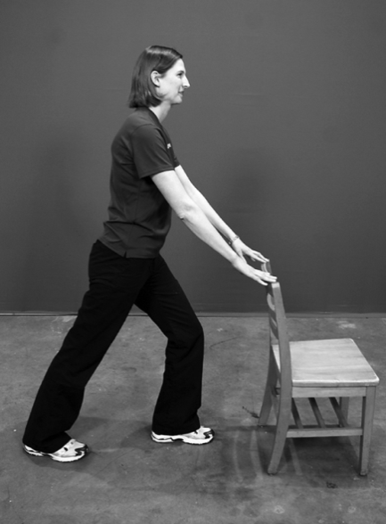
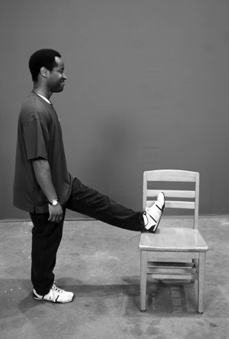
Stretching Exercises
Try It Out
Notes:
Stretching helps keep your body flexible and limber.
Stretching allows muscles and joints to move smoothly and helps give you more freedom of movement to do everyday activities, such as reaching and looking over your shoulder.
Although it is often the most overlooked part of an exercise routine, stretching should not be disregarded as it:
Reduces muscle tension, soreness and even low back pain.
Increases blood and nutrients to the muscle tissues, improves coordination, contributes to good posture and can even reduce stress.
Flexibility will also contribute to your ability to participate in physical activity.
Specific stretches are recommended to prevent injuries, but others are recommended to recover from injuries.
Flexibility may also play a part in the prevention of falls.
Activity: Practice Stretching
Practice the stretching exercises as shown on the slide.
For additional exercises or different options, refer to the Keys to Embracing Aging: Physical Activity publication.

Slide 7
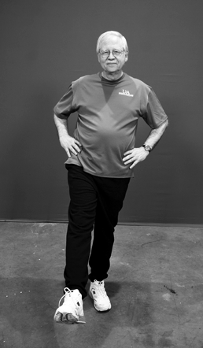
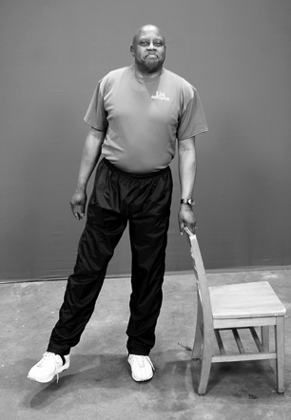
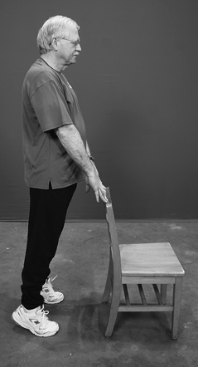
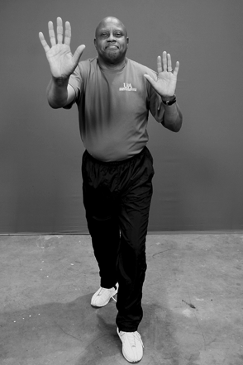
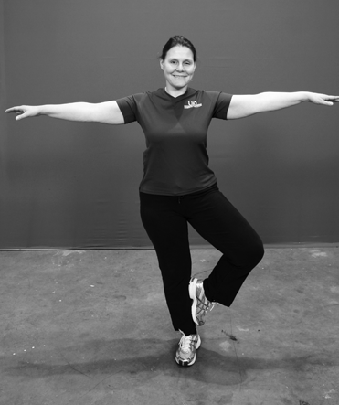
Balance Exercises
Try It Out
Notes:
Balance exercises are recommended specifically for senior adults and adults with balance issues for various reasons.
Balance exercises help prevent falls, the most common form of injury and injury-related death among adults age 65 and older. Falling is a major cause of broken hips and other injuries that often lead to disability and loss of independence.
Some balance exercises help build muscles while other exercises focus on stability.
For adults and senior adults, muscle-strengthening balance exercises, such as front and side leg raises, should be performed two or more days a week.
Stability exercises, including forward toe touches and arm reach, should be performed daily.
Balance exercises, while not discouraged, are not included in exercise recommendations for children under 18 years of age. Many forms of play, such as walking on a balance beam and hopscotch, enhance balance.
Activity: Practice Balance Exercises
Practice the balance exercises as shown on the slide.
For additional exercises or different options, refer to the Keys to Embracing Aging: Physical Activity publication.

Slide 8
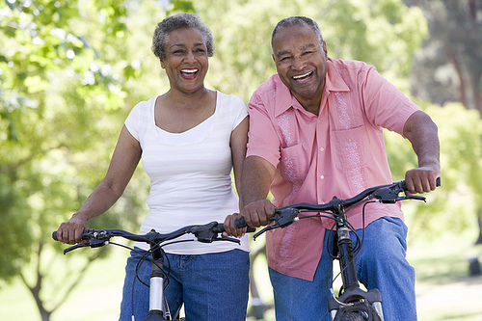
Get Fit!
Include Physical Activity in your Daily Life
Make it a priority
Make it easy
Make it social
Make it interesting
Make it fun
Exercise doesn’t just happen, you have to make it happen
Notes:
The hardest part of exercising for many is getting started, but when you think about fitness goals in 10 minute segments, it doesn’t seem as daunting. It is helpful to some to make it part of their routine. For example, after you put the coffee on to brew, do 10 minutes of exercise, then have breakfast; or if you work in an office that has breaks, get with some colleagues and make an “appointment” for a 10 minute walk during your afternoon breaks. By accumulating several 10 minute segments throughout the week, you can reach your fitness goal. To help you get started and keep going, try to include physical activity in your everyday life, try all four types of exercise, and plan for breaks in routine—life happens—but you need to get back in action as soon as possible.
Discuss: How can you work to incorporate physical activity into your daily life?

Slide 9

Aging is inevitable…
By embracing a healthy lifestyle throughout your life, you will have a greater ability to engineer a positive approach to the aging process.
Notes:
Aging in an inevitable and unavoidable process. It is a process that brings on many changes as a person progresses from childhood to adulthood. The way in which you take care of yourself through the years both physically and mentally will impact the ways in which you enter your later years. Life does not diminish with aging. In fact, the acceptance of aging can be something that is positive, joyful, and exciting. With aging comes new experiences, knowledge, wisdom and a greater ability to engineer a positive approach to the aging process. I hope today that the Keys to Embracing Aging program highlighted physical activity and hopefully gave you some tips for incorporating physical activity into your daily life.

