Slide 1
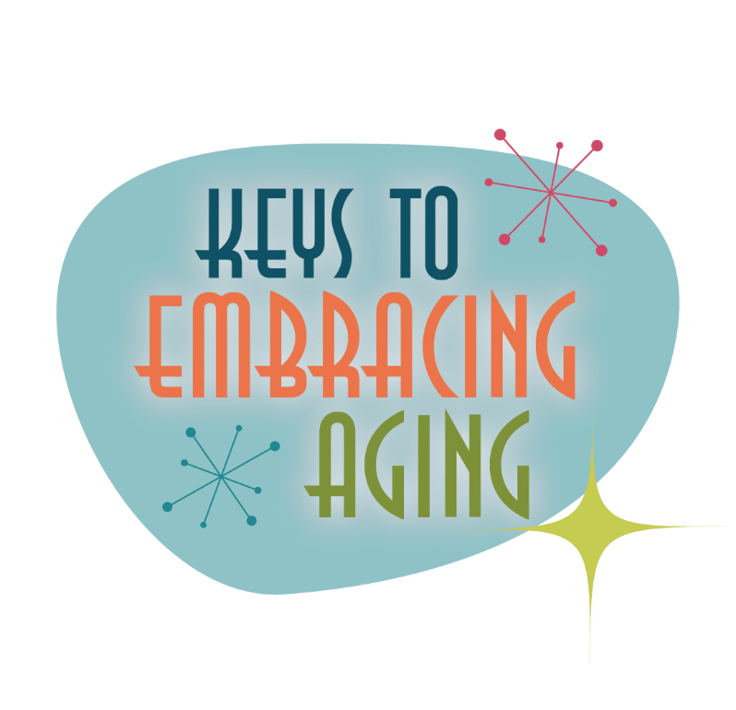
Brain Activity

Slide 2
Establishing healthy lifestyle behaviors throughout your life influences optimal aging
Positive Attitude
Eating Smart
Physical Activity
Brain Activity
Social Activity
Tuning Into the Times
Practice Being Safe
Know Your Health Numbers
Stress Management
Financial Affairs
Sleep
Taking Time for You

Slide 3
A picture of me when I'm 100 ½
Notes:
Neurobics are aerobic exercises for the brain. Neurobics are fascinating—and challenging—because you can use all of the senses to exercise your brain, which helps your brain get stronger by growing new cells. Neurobics force you out of our habitual routines that do not demand as much brain power. For example, you don’t think about the way in which you brush your teeth every night—you just do it. But if you were to brush with your non-dominant hand, you will have to work harder to properly brush. This same concept can be applied to getting dressed, eating, or doing other familiar activities, including driving a new route home from the store or cleaning the kitchen last if you usually clean it first. Today, we’re going to do some neurobic art!
Activity: Sensory Art.
Supplies: 100 ½ year old worksheet and colored markers. Tape to hang up pictures for participants to see (optional).
Instruct participants to draw a picture of what they think they’ll look like when they are 100 ½ while listening to music (any kind). For an added challenge, instruct them to draw their picture with their non- dominant hand (see handouts for sensory art worksheet). This activity helps challenge the brain because you are (1) thinking/concentrating with distraction (music) and (2) using a non-dominant hand breaks habitual routine, forcing you to think about how and what you are drawing.

Slide 4
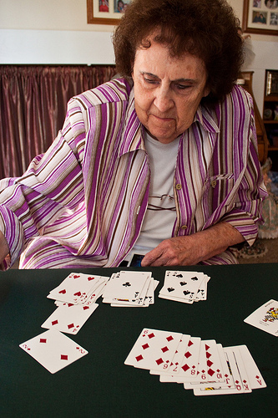
Better your Brain
Socialization
Mental Stimulation
Physical Activity
Nutrition
Sleep
Notes:
The brain allows you to interact with the world, understand, analyze, and respond to various surroundings. Therefore, a healthy brain is crucial to survival, growth, and everyday successes. Similar to the rest of the body, the brain needs exercise and maintenance in order to optimize and protect its current and future health. In particular, the brain needs: socialization, mental stimulation, physical activity, nutrition, and sleep.
Today, we’re going to talk about 5 ways to better your brain health: socialization, mental stimulation, physical activity, nutrition, and sleep.

Slide 5
Socialization
Keep in touch with friends and friends
Stay engaged or involved
Know your neighbors
Plug-in to the world
Notes:
Socialize
Socializing with others provides opportunities for communication, critical thought, creativity and emotional expression. It can also play a role in boosting personal meaning and identity. People who isolate or segregate themselves are at greater risk of developing depression and dementia. Ways to socialize include: Keeping in touch with friends and family; staying engaged/become involved in clubs, groups, classes, or organizations; get to know your neighbors—those who live next door, down the street or those who work at nearby stores; plug-in to the internet to email, join a chat room, or online date.
Keep in touch with friends and family. Friends and family can be a simple avenue to maintain a social
environment. Busy schedules and various life transitions can challenge such connections and require planning and scheduling.
Stay engaged or involved. Connecting to your community can help the brain thrive. Joining a club, volunteering or becoming active in a church are just a few ways stronger social networks can be developed.
Know your neighbors. From someone living next door to a local shopkeeper, neighbors are right outside your door. They can help you create meaningful connections close to home.
Plug into the Internet. The Internet has the potential to introduce you to a network of new people and reconnect you with old friends or acquaintances. Online communities, dating services, chat rooms and social media accounts such as Facebook are just a few examples of ways to stay connected via the Internet. Plugging in the internet/staying connected to the world, helps to keep you updated with what is going on.
Optional Discussion: Discuss various ways in which participants can/do stay socially active. Some answers may include: joining a club, organizing a game night, volunteering, exercising with friends, etc.

Slide 6
Charades!
CHARADES!
Notes:
Here is another fun, neurobic exercise!
Activity: Charades
Supplies: charade ideas (see handout)
Using the charades list included in the program, or by creating your own, instruct participants to act out what is on the sheet while the rest of the group guesses – no talking! You might also choose to have half of the group act while the other half tries to guess. This activity challenges the brain because you have to guess non-verbal language versus spoken word.

Slide 7
Mental Stimulation
Mental exercise can:
Stimulate and enhance brain cell connections
Delay the onset of Alzheimer’s disease and/or reduce the effects
Increase blood flow to the brain
How do you exercise your brain?
Notes:
Mental Stimulation
Just as going to the gym is important for your physical health, exercising your brain through mental stimulation is equally important throughout the lifespan. Through mental exercise, you can stimulate and enhance brain cell connections and even delay the onset of Alzheimer’s disease.
The brain, similar to other parts of the body, needs blood which carries essential nutrients and oxygen to help maintain its health and functioning. Researchers have demonstrated that increased cognitive effort can actually enhance blood flow to the brain.
Note: The key to mental exercise or stimulation is to provide the brain with new challenges that exercise a range of cognitive functions. This means that whatever the activity, it needs to challenge and force the brain to solve new problems versus relying on old experience and habits which lets the brain be “lazy” and reduces mental effort.
Discuss: How do you exercise your brain?
Some common forms of mental stimulation include: games and puzzles, reading and writing, education and lifelong learning, recreation and leisure, and emotional/spiritual/psychological engagement.
Games and puzzles: Games and puzzles that challenge you to think and test your skill and intelligence not only provide entertainment when practiced over time, they target areas of the brain linked to memory, concentration, language skills, visual-spatial abilities and logic and organization.
Reading and writing: Reading and writing engage the hippocampus – the memory component of the brain. To further challenge yourself, try reading a word backwards or write with your nondominant hand.
Education and lifelong learning: Education is linked to health and healthy behaviors. The more educated you are, the healthier you are likely to be. Pursuing new knowledge throughout life and beyond formal settings enhances social activity, active citizenship and personal development.
Hobbies: Hobbies can challenge the brain, especially ones that require hand-eye coordination and mental calculation, such as knitting, woodcrafts, painting, sculpting and playing an instrument. Hobbies also create rich environments and provide a sense of purpose.
Emotional/psychological/spiritual engagement: Spirituality encompasses more than religious values and beliefs. It involves an escape from the hurried and material world. Spiritual practices can involve prayer, yoga, walking, meditation, quiet contemplation and other relaxation techniques that help you slow down and connect with the essence of who you are and what you value in life. Such practices can also help reduce stress, which has a negative impact on brain health.
Exposure to new environments: Whether you take a trip or drive a different route to work, new environments are good for the brain. New environments are enriching because they can be exciting and they challenge the brain to process new information.

Slide 8
Try This…
Notes:
Optional Activity: Puzzle
Supplies: Puzzle handout; writing utensil
Using the puzzle on one of the handouts, or by finding your own, instruct participants to complete a puzzle. The key is to use a puzzle or word or number game that is challenging (e.g., the New York Times Crossword will likely be more challenging than a crossword puzzle found in a local community bulletin.
Background information:
Neurobics are fun activities that challenge your brain and use your senses in unconventional ways. A puzzle is one way to challenge the brain.
Background information: Neurobics are aerobic exercises for the brain. Neurobics are fascinating—and challenging—because you can use all of the senses to exercise your brain, which helps your brain get stronger by growing new cells. Neurobics force you out of our habitual routines that do not demand as much brain power. For example, you don’t think about the way in which you brush your teeth every night—you just do it. But if you were to brush with you non-dominant hand, you will have to work harder to properly brush. This same concept can be applied to getting dressed, eating, or doing other familiar activities, including driving a new route home from the store or cleaning the kitchen last if you usually clean it first.

Slide 9
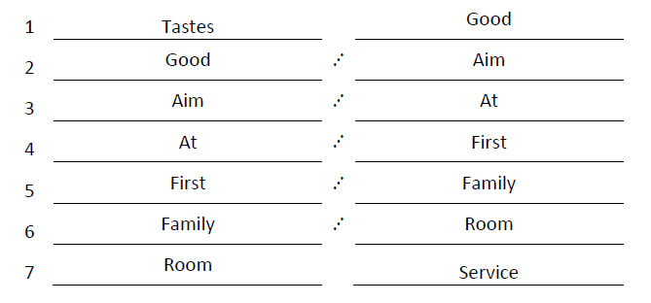
Try This…Answers

Slide 10
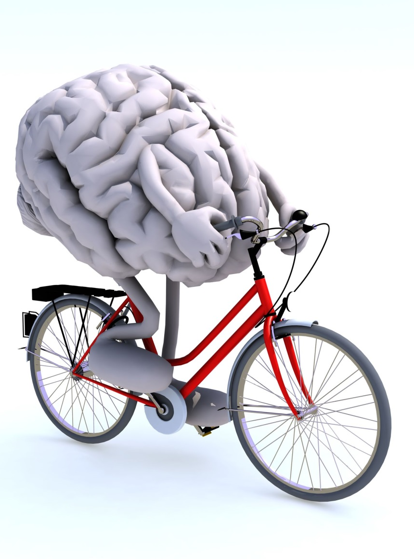
Physical Activity
Increases blood flow
Helps memory and thinking
Reduces stress
Enhances decision-making
Helps delay Alzheimer's disease
Notes:
Physical Activity
Engaging in physical activity is one of the biggest boosts you can give your brain, especially exercise that gets your heart pumping. There are many ways throughout the day to increase physical activity—try walking 10,000 steps a day, play with your children or grandchildren outside, take the stairs, ride a bike, go dancing, or move around during television commercial breaks. It is also important to strength train.
Physical activity is associated with better decision-making, focus, and conflict resolution skills. Exercise can also trigger other health benefits such as a decreased risk of obesity, heart disease, stroke, and diabetes as well as improved mood, improved sleep, an increase in energy, and reduced anxiety and stress.
In general, Physical Activity helps to:
Increase blood flow to the brain, which is rich with essential nutrients and oxygen needed for brain health and functioning
Physical activity:
Increases blood flow
Helps memory and thinking
Reduces stress and anxiety
Enhances decision-making, concentration and attention
Contributes to good sleep
Improves reaction time and vocabulary learning
Helps delay Alzheimer's disease
Exercise is not your thing? Try to join a class or participate with a friend so that you are held accountable. Find activities that you think are fun. Make goals for yourself and track your progress. Over time, exercise can and should become a habit.

Slide 11
Walkin’ Wonky
Try each of the following exercises for 20 steps.
Then repeat with your eyes shut!
Walk on your toes
Walk on your heels
Skip
Walk sideways
Walk backwards
Hop on one foot
Notes:
More neurobics!

Slide 12
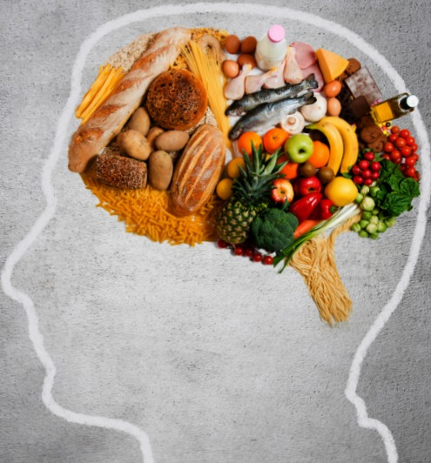
Nutrition
A heart healthy diet = A brain healthy diet
Seek foods high in:
Antioxidants
Omega-3s
Avoid:
Excess calories
Excess sodium
Bad cholesterol
Notes:
Nutrition
Nutrition plays a large role in brain development and function throughout life. A brain healthy diet can help reduce the risk of chronic-age related brain diseases, including Alzheimer’s disease. A brain healthy diet is one that protects your heart, encourages good blood flow to the brain, and fights against diabetes. For a healthy brain diet: Seek foods high in antioxidants, such as fruits, vegetables, whole grains and nuts.
For a healthy-brain diet:
Seek foods high in antioxidants. Antioxidants are dietary substances that include various nutrients that prevent, slow and even repair natural cell damage, including mental decline. An eating plan containing plenty of fruits, vegetables, whole grains and nuts can supply all the antioxidants your body needs. Some potent antioxidant foods to consider are blueberries and other berries, red delicious apples, sweet cherries, black plums, cranberries, oranges, red grapes, strawberries, avocados, raw garlic, cooked cabbage and broccoli, spinach, kale, red bell peppers, carrots, sweet potatoes, onions, tomatoes, whole wheat, oatmeal, brown rice, pecans, walnuts and hazelnuts.
Power up with omega-3. Omega-3 are fatty acids that the body needs to properly function but does not make on its own. The best way to get omega-3 is through food sources. Examples of foods high in omega-3 include salmon, tuna, mackerel, trout, sardines, walnuts, pecans, almonds, leafy green vegetables, flax, pumpkin seeds, sesame seeds and eggs.
Cut calories. Being overweight and obese leads to increased risk of brain function decline in later life. Overweight people often have high cholesterol and high blood pressure, which also increase the risks of developing dementia in later life.
Fight sodium and cholesterol. Go easy on eating meats and other animal products high in fat, be stingy with salt and limit preserved and preprocessed foods.
Optional Activity: Serve a brain healthy lunch or snack and/or a brain health cooking demonstration.

Slide 13
Nutrition
Brain Healthy Foods to Try | Food to Limit or Avoid
Dark-skinned vegetables | Fried, greasy, high-fat foods
Cold water fish | Excess sugary products/ high fructose corn syrup
Nuts | Salty foods
Dark-skinned fruits | Fast foods and processed foods
Drink lots of water | Alcohol and caffeine
Whole grains | Refined grains
Olive oil | Other oils and solid fats

Slide 14
Sleep
A lack of sleep negatively affects:
Memory
Mood
Concentration
Coordination
Safety
Notes:
Sleep
Sleeping well is essential to good health and brain functioning. A lack of sleep or poor sleep quality can impair alertness, concentration, memory, the ability to learn, solve problems, and remember important information. A lack of sleep can also contribute to obesity, the ability to safely drive a car, and it can hamper the ability to maintain overall healthy functioning.
Sleep is good for the brain:
“Clears away toxins” In essence, there are part of the brain that work while you sleep to basically act as a recycling system that gets rid of your brains toxins, including the plaques associated with Alzheimer’s disease.
“Repairs daily wear and tear” New research demonstrates that chronic sleep deprivation can lead to irreversible brain damage because neurons needed for alertness and cognition can become permanently damaged. Lack of sleep can also lead to brain shrinkage. Lastly, certain chemicals are released during deep sleep that are important for repairing the body—including the brain.
“Makes order from chaos” Sleep helps process ALL of the sensory information that floods your brain during the day. During sleep, your memory works to “archive” materials—sorting through what to keep and what to discard. People need more than 4 or 5 hours of sleep to do this!
“Creates Memories” Acetylcholine is a chemical necessary for creating memories…and it is also involved with sleep and dreaming.
A lack of sleep negatively affects:
Memory
Mood
Concentration
Coordination
Safety

Slide 15
Keys to Better Sleep
Exercise
Eat a well-balanced diet
Set regular bedtime and waking hours
Avoid reading or watching television while in bed
Notes:
For better Sleep:
Exercise, but not within a few hours of bedtime
Eat a well-balanced diet
Set regular bedtime and waking hours
Get up and do something until you are tired and ready to sleep if you cannot fall asleep within the first 20 minutes of getting into bed
Avoid reading or watching television while in bed
Keep a sleep journal to keep track of the activities, diet and other things that might affect how you’re sleeping
Consult a health care provider if you’re consistently having trouble sleeping
Optional Discussion: Discuss sleeping habits and ways in which participants get good nights of sleep.

Slide 16
What can you do?
What steps can you take starting today to better your brain health?

Slide 17
Aging is inevitable…
By embracing a healthy lifestyle throughout your life, you will have a greater ability to engineer a positive approach to the aging process.
Notes:
Aging in an inevitable and unavoidable process. It is a process that brings on many changes as a person progresses from childhood to adulthood. The way in which you take care of yourself through the years both physically and mentally will impact the ways in which you enter your later years. Life does not diminish with aging. In fact, the acceptance of aging can be something that is positive, joyful, and exciting. With aging comes new experiences, knowledge, wisdom and a greater ability to engineer a positive approach to the aging process. I hope today that the Keys to Embracing Aging program highlighted the steps to brain health and that you have some ideas of how to better your brain!

