Slide 1
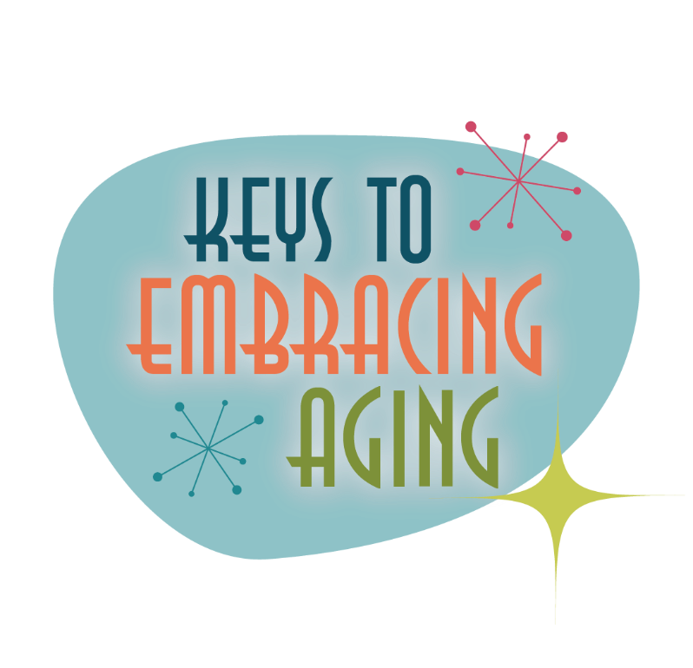



Tuning Into the Times

Slide 2
Establishing healthy lifestyle behaviors throughout your life influences optimal aging
Positive Attitude
Eating Smart
Physical Activity
Brain Activity
Social Activity
Tuning Into the Times
Practice Being Safe
Know Your Health Numbers
Stress Management
Financial Affairs
Sleep
Taking Time for You
Notes:
Today we will be concentrating on the power of tuning into the times. I wanted to remind you what all of the keys to embracing include. Remember—these keys represent lifestyle behaviors. Practiced through the lifespan (although it is never to late to start), these lifestyles contribute to health, well-being, life quality and even longevity.
Attitude is Everything
Eating Healthy
Get Fit
Brain Health
Be Social
Tune-in to the Times
Stay Safe
Know Your Numbers
Manage Your Stress
Financial Affairs
Sleep Tight
Take Time for You

Slide 3
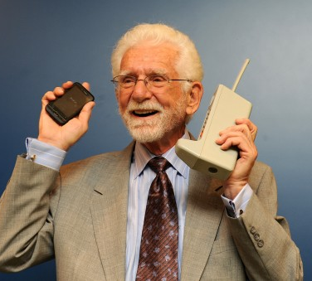
Tuning Into the Times
Promotes life-long learning
Increases knowledge
Enhances problem-solving & decision making
Exercises the brain
Broadens social opportunities
Notes:
When asked why they had lived so long, participants of a centenarian study (people who are 100+ years old) shared that they spent a life time staying in tune with the times.
Staying in tune to the times throughout life:
Promotes lifelong learning
Increases knowledge
Enhances problem-solving & decision making
Exercises the brain
Broadens social opportunities

Slide 4
Let’s Discuss
How do you tune-in to the times?
Do you feel discouraged or overwhelmed with new technology?
When should you stop trying to tune-in to the times?
Notes:
Let’s Discuss!
When should you stop trying – NEVER!!

Slide 5
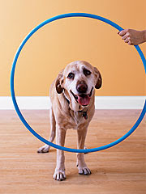
Tuning Into the Times
Cell Phones and Smart Phones
Computers and the Internet
Video Games
Music
Current Events
Old dogs CAN
learn new tricks!
Notes:
Old dogs CAN learn new tricks!!
Tuning in to today’s world will likely include:
Cell phones and Smart phones
A cell or mobile phone is a hand-held, cordless device that can make and receive calls.
A smartphone is a high-end mobile phone that incorporates computing abilities. Smartphones have an “app” or application for almost everything. An application is a computer program that can be downloaded to a smartphone allowing it to take photos, play music and videos, and access internet sites.
Charged on batteries, a mobile phone fits in your pocket and can be ready in hand to call a friend or call for help.
Computers and the Internet
Computers are used to type and print documents, calculate, sort, search and store data. They are also used for entertainment as they play and store games, music, movies and photos.
The majority of today’s computers are linked to the internet. The Internet is a worldwide collection of computer networks that connect users through satellite and telephone. Many people consider the internet to be the world’s largest encyclopedia.
The internet allows you to:
Surf the Net. Surfing the net means spending time on the internet to see what you find.
Social net-work. Social networking services, such as Facebook, allow you to register and create a personal profile, exchange messages, and join common-interest groups.
Email. Electronic mail, known as email, is a method of sending digital messages to or exchanging digital messages with one or more persons with accounts on the Internet. There is not post office or paper needed for this instant, modern-day letter writing.
Video Call. Through the use of webcams and microphones, various computer and social media programs allow you to communicate while both seeing and hearing the person you called.
Share, post and update information for others to see
Request and provide assistance with problems and questions
Market and publicize products and services
Read newspapers and other current events
Research your family tree
Plan and book a vacation
On-line date
3. Video games
The benefits of playing today’s video games include improved:
Reflexes
Processing speed
Memory
Attention skills
Spatial abilities
Reasoning and cognition
Physical activity
Video games may even contribute to slowing the progression of Alzheimer’s disease and other dementias
Music
Music releases dopamine, the feel-good chemical in the brain involved in motivation and addiction. As a result, music that moves you provides a sense of emotional arousal and pleasure.
Today it is simple to take music with you wherever you go. Portable music players such as an MP3 player or iPodTM, are electronic devices that allow you to download and save digital music and audio books.
Current events
Staying connected with the world influences longevity.
Whether it is the television, newspaper, internet, or radio, current events have a positive effect on long life because they encourage social interactions. For example, it is easier and more fun to engage in conversation when there are interesting topics to discuss or debate.
Staying in tune to your community and the world also exercises the brain and can keep you more mentally active as you read or listen and process the news.
Optional Activity: Electronics Presentation
Supplies needed: none (unless you do the presentation yourself)
If you have a local electronics store, or even a big-box store, call to ask if they would send a representative out to show off some of the latest gadgets and do a presentation for you. Or, if you feel inclined, do a presentation yourself – or ask someone you know that is technologically savvy to present to your group.
Optional Activity: Social Media
Supplies needed: computer and internet access
Do a short presentation on the latest social media. Snapchat, twitter, pinterest, and more! Ask one or two of your 4-H teen leaders to come do the presentation for you – they’ll certainly know what ‘all the rage’ is!

Slide 6
A Peek into the Class of 2020
They have never had to watch or listen to programs at a scheduled time
Books have always been read to you on audible.com
While chads were hanging in Florida, they were potty training in all 50 states
Instant tray-less ice cubes have never been a novelty
Notes:
For an interesting discussion, download and discuss The Beloit College Mindset List for the Class of 2020 https://www.beloit.edu/mindset/2020/ (There is a slideshow version you can download on the link as well).
When you think about the current generation of young people, particularly the Class of 2020, life is very different for them than it was for many of us growing up. You can see here that:
They have never had to watch or listen to programs at a scheduled time
Books have always been read to you on audible.com
While chads were hanging in Florida, they were potty training in all 50 states
Instant tray-less ice cubes have never been a novelty
So, what trends do you remember from when you were growing up? What trends do you want to know more about now? Discuss things you embraced as a teenager, and talk about the latest trends that you would like to embrace or learn more about.

Slide 7
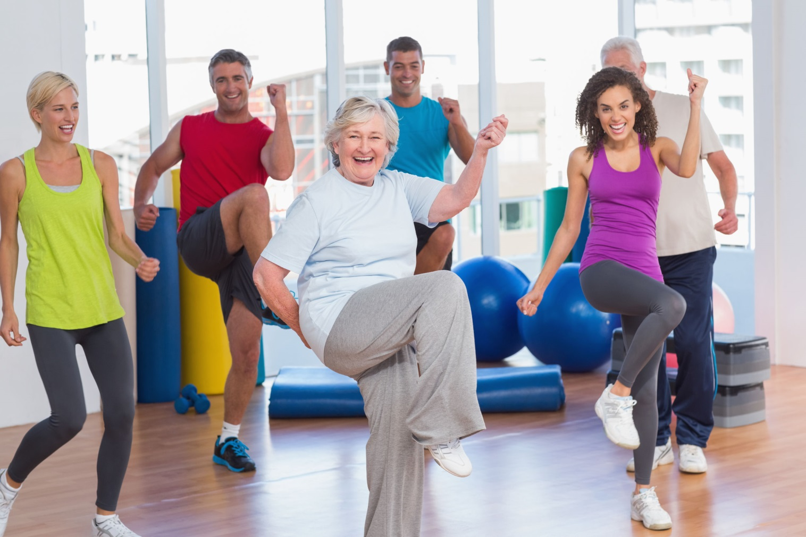
Get Up and Dance!
Notes:
Let’s end today by embracing a current trend!
Activity: Get Up and Dance!
Supplies needed: Internet Access, Speakers
Teach your group the latest dance moves! Whether it’s the ‘whip/nae nae’ or the ‘wobble baby’ – they’re sure to have a good time. If you don’t know or can’t teach the moves and don’t have a volunteer to do so, then look up and show a You Tube video. Try something new along with your participants and learn together.
Here is a link to whip nae nae: https://www.youtube.com/watch?v=vjW8wmF5VWc

Slide 8
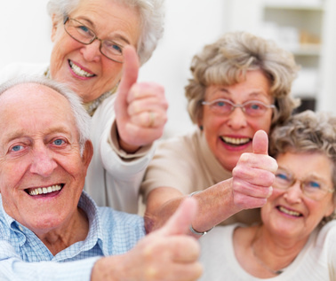
Aging is inevitable…
By embracing a healthy lifestyle throughout your life, you will have a greater ability to engineer a positive approach to the aging process.
Notes:
Aging in an inevitable and unavoidable process. It is a process that brings on many changes as a person progresses from childhood to adulthood. The way in which you take care of yourself through the years both physically and mentally will impact the ways in which you enter your later years. Life does not diminish with aging. In fact, the acceptance of aging can be something that is positive, joyful, and exciting. With aging comes new experiences, knowledge, wisdom and a greater ability to engineer a positive approach to the aging process. I hope today that the Keys to Embracing Aging program highlighted how and why you should tune into the times!

