Slide 1
Know your Health Numbers

Slide 2
Establishing healthy lifestyle behaviors throughout your life influences optimal aging
Positive Attitude
Eating Smart
Physical Activity
Brain Activity
Social Activity
Tuning Into the Times
Practice Being Safe
Know Your Health Numbers
Stress Management
Financial Affairs
Sleep
Taking Time for You
Notes:
Today we will be concentrating on the power of knowing your health numbers. I wanted to remind you what all of the keys to embracing include. Remember—these keys represent lifestyle behaviors. Practiced through the lifespan (although it is never to late to start), these lifestyles contribute to health, well-being, life quality and even longevity.
Attitude is Everything
Eating Healthy
Get Fit
Brain Health
Be Social
Tune-in to the Times
Stay Safe
Know Your Numbers
Manage Your Stress
Financial Affairs
Sleep Tight
Take Time for You

Slide 3
Know your Numbers
Your health numbers contribute to your overall well-being and longevity
Today we will discuss:
Cholesterol
Triglycerides
Blood pressure
Blood sugar
Body mass index
Waist circumference
Notes:
Our daily lives are flooded with numbers: PIN numbers, phone numbers, and various account numbers. But there are also certain health numbers that can save and extend your life. These numbers are those associated with cholesterol, triglycerides, blood pressure, blood sugar, body mass index (BMI), and waist circumference. Regular visits to a health care provider, proper nutrition, physical activity, and an overall healthy lifestyle, promote healthy numbers in addition to healthy aging throughout the lifespan.

Slide 4
Cholesterol: <200
LDL = “bad” cholesterol
HDL = “good” cholesterol
LDL increases the risk for stroke and heart disease
Test every 5 years starting at age 20
Notes:
Cholesterol: <200
Cholesterol is a waxy substance found in the fats (lipids) in your blood. It is essential for the body to build and maintain healthy cells and essential hormones. About 25% of cholesterol comes from the food we eat such as meat, fish, and dairy. The rest is made by the human body. There are two forms of cholesterol: low-density lipoprotein cholesterol (LDL), also known as the “bad” cholesterol and high-density lipoprotein cholesterol (HDL)—the “good” cholesterol. Too much LDL cholesterol creates a plaque that can accumulate and clog the arteries causing heart disease and stroke. HDL cholesterol is good because it helps clean the artery walls and carry away the excess bad cholesterol.
High cholesterol has no symptoms and many people do not even know they are at risk. But there are known factors that can increase the risk of developing high cholesterol. Some of these factors you can control, such as diet, physical activity and weight. Others you cannot control, including family history, age (risk goes up with age) and gender (post-menopausal women are at greatest risk). Cholesterol can be checked through simple blood tests. The American Heart Association recommends a “fasting lipoprotein profile” every five years starting at age 20. To fast, it is recommended that you do not eat for 9 to 12 hours prior to the test. This helps accurately measure the total cholesterol, LDL cholesterol, HDL cholesterol and triglycerides in your blood. Additional screenings are recommended for men age 45+ and women age 50+. Additional screenings are also recommended if total cholesterol is 200 mg/dl or higher, HDL cholesterol levels are lower than 40 mg/dl or other risk factors for heart disease and stroke are present.

Slide 5
Cholesterol: <200
To increase HDL cholesterol:
Consume more unsaturated fats
Add soluble fiber to your diet
Maintain a healthy weight
Exercise regularly
Notes:
Cholesterol: <200
To increase HDL cholesterol:
Increase unsaturated fats in the diet, including omega-3 fatty acids (sesame, flax, pumpkin, avocado, olive oil, fat in peanut butter, and fish)
Add soluble fiber to your diet (oats, fruits, vegetables, and legumes)
Maintain a healthy weight
Regularly exercise
Avoid smoking and secondhand smoke
Talk to a medical provider about medication and other treatment options

Slide 6
Triglycerides: <150
High levels increase the risk for heart disease
Test every 5 years beginning at age 20
Notes:
Fasting Triglycerides: <150
Triglycerides, like cholesterol, are a form of fat that circulates in the bloodstream. Triglycerides are responsible for the energy that tissues need to function. Similar to cholesterol, when the blood levels of triglycerides become too high (e.g., over 200 mg/dl.), the risk for developing heart disease increases.
Dietary and lifestyle changes help lower triglyceride levels:
Maintain an ideal and healthy body weight
Avoid fatty foods and foods high in cholesterol such as hamburgers and fried food
Eat fruits, vegetables, nonfat or low-fat dairy products most often
Eat foods high in good, unsaturated fats
Do not drink alcohol in excess
Exercise moderately for at least 30 minutes, 5 times per week

Slide 7
Triglycerides: <150
Need to reduce your triglycerides?
Maintain a healthy weight
Exercise!
Notes:
Dietary and lifestyle changes help lower triglyceride levels:
Maintain an ideal and healthy body weight
Exercise moderately for at least 30 minutes, 5 times per week
Avoid fatty foods and foods high in cholesterol such as hamburgers and fried food
Eat fruits, vegetables, nonfat or low-fat dairy products most often
Eat foods high in good, unsaturated fats
Do not drink alcohol in excess

Slide 8
Blood Pressure: 120/80
High blood pressure can permanently damage the heart, brain, eyes, and kidneys
Check early, and check often!
Notes:
Blood Pressure: 120/80
Blood pressure can vary from minute to minute with changes in exercise, stress, sleep and posture, but it should normally be less than 120/80 mmHg (millimeters of mercury). Blood pressure is recorded as two numbers and written as a ratio. The top number, referred to as the systolic blood pressure, measures the pressure in the arteries when the heart beats. The diastolic, or bottom number, refers to the amount of pressure in the arteries when the heart is resting and refilling with blood between heartbeats. Hypertension or high blood pressure is a condition that causes the pressure in the heart to change. A variety of factors are linked to high blood pressure, including age, a diet too high in sodium or too low in potassium, calcium and magnesium, excess alcohol, smoking, being overweight or obese, high cholesterol, lack of exercise, stress and being insulin resistant. Hypertension has few symptoms, but it can permanently damage the heart, brain, eyes and kidneys even before anything feels like it is wrong. The American Heart Association recommends blood pressure screenings beginning at age 20 and to continue at each regular health care visit or at least once every two years. If your blood pressure is consistently higher than 120/80 mmHg, you may be asked to measure it more often. Blood pressure can also be checked at home with an over-the-counter blood pressure monitoring system.
Low blood pressure can also be cause for concern. Low blood pressure, referred to as hypotension, occurs when the flow of blood is lower than normal. This may prevent the proper amount of oxygen and nutrients from being pumped into vital organs. Dehydration and nutrient deficiency are two possible causes of low blood pressure. Signs of low blood pressure include dizziness, lightheadedness, fainting, dehydration or unusual thirst, lack of concentration, blurred vision, nausea and fatigue.

Slide 9
Blood Pressure: 120/80
To maintain a healthy blood pressure:
Eat healthfully
Avoid excess salt
Engage in regular physical activity
Maintain a healthy weight
Manage stress
Avoid tobacco
Limit alcohol
Notes:
Maintaining a healthy blood pressure can be simple and easy:
Eat a diet rich in fruits, vegetables, whole grains, and low-fat or nonfat dairy products.
Avoid excess salt
Engage in regular physical activity
Maintain a healthy weight
Manage stress
Avoid tobacco
Limit alcohol

Slide 10
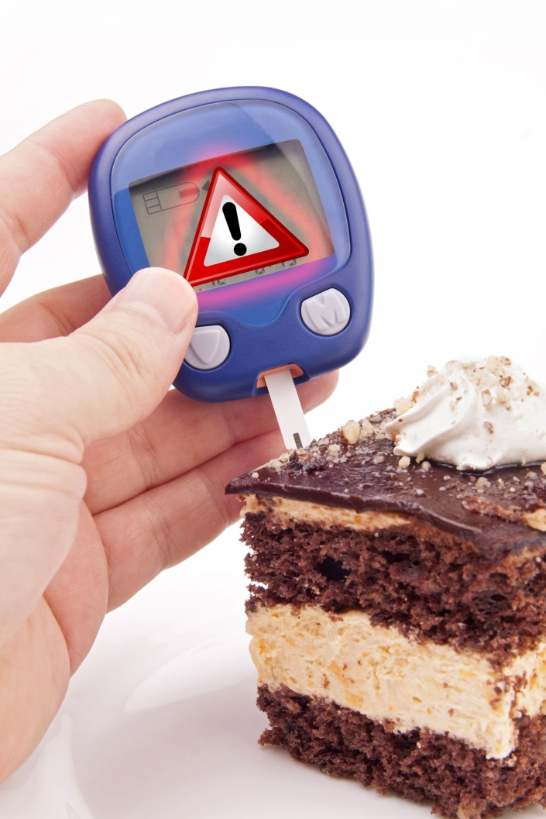
Blood Sugar: <100
A blood glucose test measures the amount of a type of sugar, called glucose, in your blood.
Diabetes is the most common disease related to blood sugar regulation failure.
Notes:
Fasting Blood Sugar: <100
Blood sugar or glucose is a type of sugar that travels through the blood stream. It acts as a basic fuel for the body and is needed for energy and proper cell functioning, particularly brain cells and muscles. Diabetes is the most common disease related to blood sugar regulation failure. Diabetes is a disease that affects over 25.8 million children and adults. If left untreated, diabetes can cause many medical complications including cardiovascular disease, kidney disease, unhealthy cholesterol levels, clogged arteries, metabolic syndrome, blindness, nerve disease, and limb amputations.

Slide 11
Blood Sugar: <100
To maintain healthy blood sugar levels and prevent diabetes:
Exercise regularly
Eat plenty of fiber and whole grains
Maintain a healthy weight
Skip fad diets and make healthy choices
Notes:
To maintain healthy blood sugar levels and prevent diabetes:
Exercise regularly
Eat plenty of fiber and whole grains
Maintain a healthy weight
Skip fad diets and make healthy choices

Slide 12
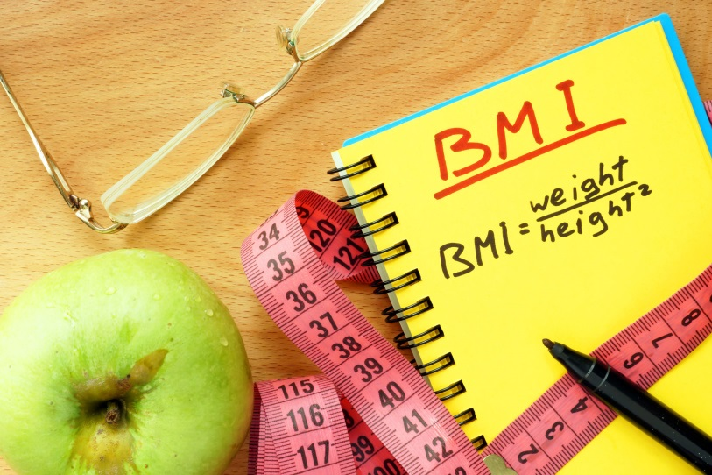
BMI: 18-25
BMI is a ratio between height and weight and is used as a tool to help judge body fat and weight
According to BMI calculations, there are five weight categories: underweight, normal, overweight, obese and extreme obese.
Notes:
BMI: 18 to 25
BMI is a ratio between height and weight and is used as a tool to help judge body fat and weight. According to BMI calculations, there are five weight categories: underweight, normal, overweight, obese and extreme obese. These weight categories help indicate the risk of severe health problems, including heart disease, stroke, high blood pressure, high cholesterol, cancer, diabetes, sleep apnea, osteoarthritis, female infertility, urinary stress incontinence, and gastroesophageal reflux. There are certain people who should not use BMI as the basis for determining relative disease risk. Competitive athletes and body builders, whose BMI is high due to muscle, and women who are pregnant or lactating should not be disturbed if their BMI is not within the normal range.

Slide 13
BMI: 18-25
To take control of your BMI:
Burn more calories than you consume by exercising and maintaining a healthy lifestyle
Eat healthfully
Exercise at least 30 minutes a day

Slide 14
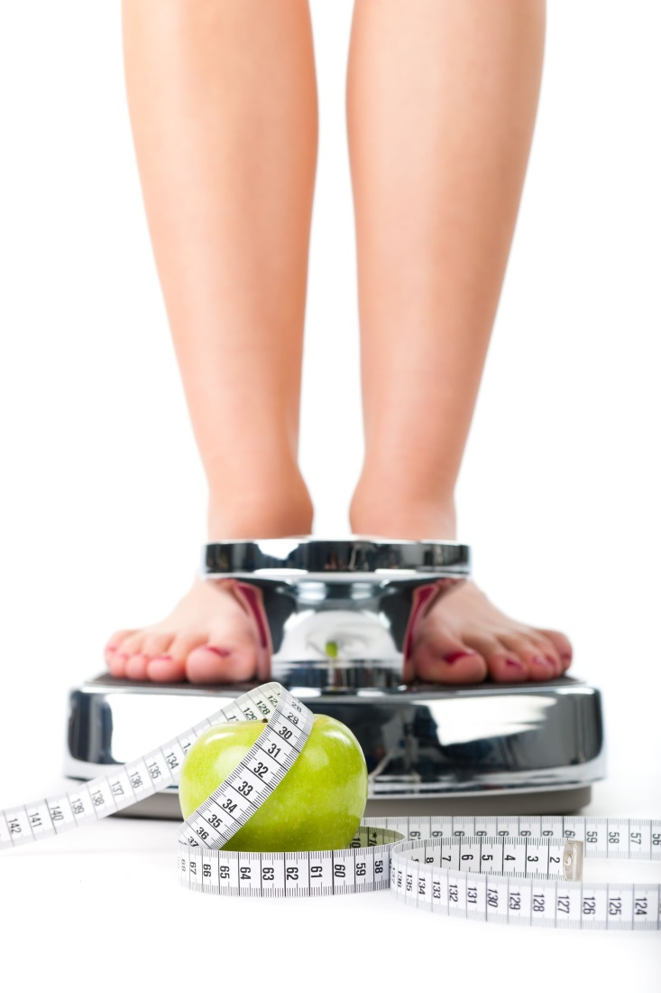
Waist Circumference: <40 (m), <30 (w)
Fat distribution is as important as body weight because it helps predict weight-related health problems such as diabetes, high blood pressure and heart disease
Notes:
Waist Circumference: <40 (men) & <35 (women)
Fat distribution is now just as important as total body weight when it comes to weight-related health problems. This is because body fat that accumulates around the waist and stomach area poses a greater risk than fat stored in the lower half of the body. Therefore, the measurement of your waist size (circumference), like BMI, can predict future health problems, including type 2 diabetes, dyslipidemia, hypertension and cardiovascular disease, especially when BMI is between 25 and 35. Waist size can also be useful for athletes who are categorized as overweight in terms of BMI. For example, an athlete with increased muscle mass may have a BMI greater than 25 – making him or her overweight on the BMI scale – but a waist
circumference measurement would most likely indicate that he or she is, in fact, not overweight.
The American Heart Association recommends a waist circumference of 40 inches or less for males and 35 inches or less for females. Beginning at age 20, you should measure your waist circumference and look for changes in measurement over time, as this can indicate an increase or decrease in abdominal fat, which is associated with an increased risk of heart disease and other chronic diseases.
To help keep weight down and your waistline trim—DIET, EXERCISE AND SLEEP.

Slide 15
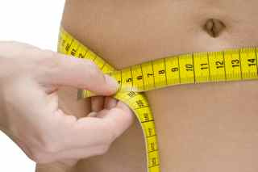
What are your numbers?
BMI
[Weight in pounds / (height in inches x height in inches)] x 703
Waist Circumference
Place a tape measure around your bare abdomen just above your hip bone. Be sure the tape is snug, but does not compress your skin, and is parallel to the floor. Relax, exhale, then measure.
Notes:
Note: If you do not feel comfortable doing this activity, you can simply walk them through it so that they can complete it at home.
Activity: BMI
Supplies: pen/pencil, paper, tape measures, calculators and BMI worksheet
Keeping our body mass index (BMI) and waist circumference within healthy ranges affect our long term health. Therefore, today we will practice calculating BMI and/or measuring our waist circumference.
Pass out a paper, pencils, calculators and tape measures.
BMI: Ask participants to calculate their BMI with the following formula:
[weight (lb) / [height (in)]²] x 703. Interpretation: A healthy BMI should be between 18-25.
Waist Circumference: Instruct participants to measure their waist size: Place a tape measure around your bare abdomen just above your hip bone. Be sure that the tape is snug, but does not compress your skin, and is parallel to the floor. Relax, exhale, then measure. Interpretation: Males: < 40; Females: < 35
Discussion: While respecting people’s privacy, discuss ways in which healthy numbers can be obtained: (Examples include: healthy/smart nutrition, exercise, stress management & sleep.)

Slide 16
Aging is inevitable…
By embracing a healthy lifestyle throughout your life, you will have a greater ability to engineer a positive approach to the aging process.
Notes:
Aging in an inevitable and unavoidable process. It is a process that brings on many changes as a person progresses from childhood to adulthood. The way in which you take care of yourself through the years both physically and mentally will impact the ways in which you enter your later years. Life does not diminish with aging. In fact, the acceptance of aging can be something that is positive, joyful, and exciting. With aging comes new experiences, knowledge, wisdom and a greater ability to engineer a positive approach to the aging process. I hope today that the Keys to Embracing Aging program highlighted the power of knowing your health numbers!

