Slide 1
Stress Management

Slide 2
Establishing healthy lifestyle behaviors throughout your life influences optimal aging
Positive Attitude
Eating Smart and Healthy
Physical Activity
Brain Activity
Social Activity
Tuning-in to the Times
Safety
Know Your Health Numbers
Stress Management
Financial Affairs
Sleep
Taking Time for You
Notes:
Today we will be concentrating on the power of stress management…but I wanted you to see what all of the keys to embracing include. Remember—these keys represent lifestyle behaviors. Practiced through the lifespan (although it is never to late to start), these lifestyles contribute to health, well-being, life quality and even longevity.
Attitude is Everything
Eating Healthy
Get Fit
Brain Health
Be Social
Tune-in to the Times
Stay Safe
Know Your Numbers
Manage Your Stress
Financial Affairs
Sleep Tight
Take Time for You
Today we are going to highlight the power of stress management. So, let’s begin by talking about what stress is.

Slide 3
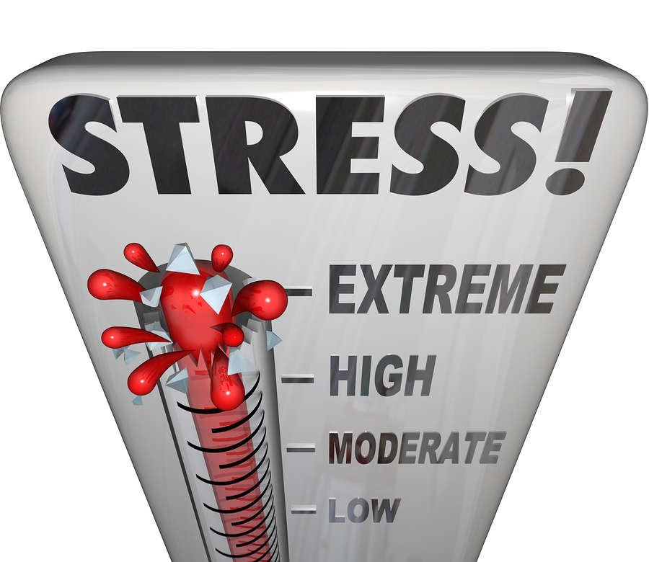
What is Stress?
Stress: The body’s response to events & experiences
Stress can:
Help you rise to challenges and face tough situations
Be good or bad
Stressors:
The events that provoke the stress
Notes:
WHAT IS STRESS?
Stress is the way your body responds to experiences and events. Appropriate stress is healthy and useful – and can even help you rise to a challenge and face tough situations with focus, strength, stamina and heightened alertness. But, stress can also be overwhelming and cause DISTRESS – such as anxiety, tension, or irritability.
Learning what causes you stress and how to manage it in a positive way can help you cope and live a more balanced and healthy life.
In order to begin identifying what causes you stress, we need to talk about stressors. Stressors are simply events that provoke stress. Some stressors are caused by negative events such as a family argument, physical danger, test anxiety, or concern over finances. Events that we look forward to such as celebrations or going to a movie with a friend are also stressors. Stressors can be single events or a result of a multiple events that pile up.
So, what stresses you out? Does anyone have an example of a stressor that they have faced and would be willing to share?

Slide 4
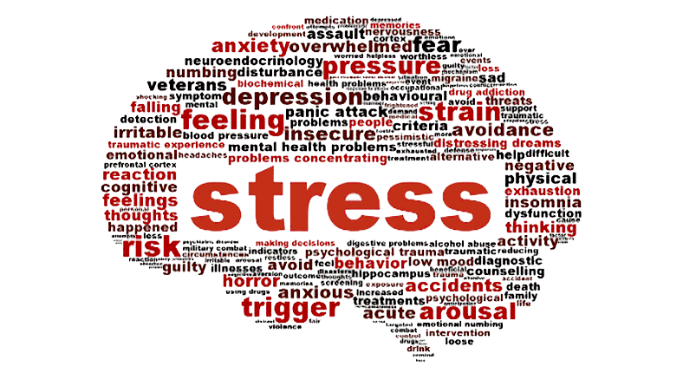
The Body Reacts to Stress in 3 Ways
Alarm
Resistance and Adaptation
Exhaustion
Notes:
Stages of Stress
The body reacts to stress is three ways:
Stage 1: Alarm. Certain hormones are pumped into the bloodstream, which speeds up the heart rate, increases respiration and slows down digestive activity. The body is ready for either fight or flight.
Stage 2: Resistance and Adaptation. The body tries to repair the damage caused in stage one and bring the body back to a “normal condition.” It is only when stress is not positively dealt with that the third stage occurs.
Stage 3: Exhaustion. A person’s body cannot be stressed all the time. Release must occur or exhaustion may result.
If someone shared an example of a stressful event/stressor earlier, ask them to share how their body reacted to that stressor.

Slide 5
Symptoms of Stress Overload
Anxiety or panic attacks
Upset stomach
Headache
Chest pain
Skin changes, such as eczema
Difficulty sleeping
Sadness or depression
Notes:
When we become overloaded with stress, our bodies can react in negative ways. We often think about the emotional symptoms of stress – such as anxiety or irritability. In reality, though, your body can have physical signs of stress without you even realizing how stressed you really are. Some of these might include:
Anxiety or panic attacks
Upset stomach
Headache
Chest pain
Skin changes, such as eczema
Difficulty sleeping
Sadness or depression
Everyone experiences stress differently. Some of us may react to stress by lashing out at others while some of us will internalize our stress and “deal with it”. Regardless of how you deal with stressful events, we can all experience these symptoms of stress overload. This is why it is so important to learn to manage our stress in appropriate ways.

Slide 6
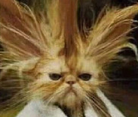
Manage Your Stress
Change the situation
Avoid the stressor
Alter the stressor
Change your reaction
Accept the stressor
Adapt to the stressor
Notes:
While we cannot rid ourselves of stress, we can learn to manage it. The ultimate goal in stress management is to achieve a balanced life, with time for work, relationships, relaxation, and fun – plus the resilience to hold up under pressure and meet life’s stressors head on.
Identify the sources of stress in your life
The first step in stress management is to identify the stressors in your life. Are there any stressors you can change by avoiding, reducing exposure or eliminating them completely? Can you go to work earlier if parking is a problem or organize your time differently so that you are not studying for an exam at the last minute?
Learning healthier ways to manage stress
Since everyone has a unique response to stress, there is no “one size fits all” solution to managing it. No single method works for everyone or in every situation; therefore, it is important to experiment with different stress reduction strategies to lessen your feelings of stress. Focus on what makes you feel calm and in control.
Two common strategies for managing stress include changing the situation and changing your response to the situation. If there is a situation that you can identify that causes stress, avoid it. For example, if the crowds and chaos of the State Fair make you feel anxious to the point that you do not like to go, stay home instead. In unavoidable situations, such as a holiday dinner with in-laws, you may have to change your reaction. Accept it for what it is, focus on what is really important, adapt to the environment, and move on.
Stress Management Strategy 1: Change the Situation
• Evaluate your physical environment. If the color on the walls affects your mood or if you are worried about a toddler falling down the stairs or a loved one with dementia wandering out of the house in the middle of the night – modify your environment with paint, gates or alarms on the door.
• Take a look at the people in your life. Is there is a person or a group of people who really cause you stress? If so, you may need to distance yourself or resign from that organization/group.
• Review your calendar. Sometimes stress results from our inability to say “no.” Look at your commitments. Are you doing what you want to do, should do, have to do? If part of your stress is overcommitting yourself, pare back. Many commitments and tasks are beneficial but if it is hurting your health, it may not be worth it.
Stress Management Strategy 2: Change Your Reaction
• Laugh, don’t cry. Some things we just can’t change. These are the things that we need to learn to accept versus letting them bother us. So your neighbor painted his garage hot pink. Instead of getting worked up when you drive past, accept the pink and laugh at his lack of style.
• Compromise. Our need to be “right” often interferes with good communication and can cause stress when we are so focused on what the other person is doing. If we ask someone to change, we need to be willing to change ourselves.
• Let it go. Ask yourself does it really matter? Will it matter in five years? We sometimes have to pick our battles. For instance, a mother and child fought most mornings about what the child was going to wear to school. The child chose gym shorts and t-shirts over the mother’s choice of “school clothes.” It was causing stress in their relationship as well as starting the day off with ugly confrontation. When the mother finally decided to let it go and allow her child to choose which clothes to wear, the morning conflict ended. The mother recognized that it really didn’t matter if the child wore a t-shirt or a polo as long as the child went to school clean, decently dressed and learned while he or she was there.
Having realistic expectations of yourself, shifting your focus to looking at what is really important and taking care of yourself emotionally and physically will also increase your confidence to deal with stressors. Sometimes, taking a deep breath, meditating, relaxing or taking time to smell the roses allows you to appreciate the little things so that you don’t overreact over the big things.

Slide 7
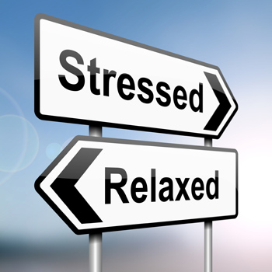
Manage Your Stress
Set aside relaxation time
Connect with others
Do something you enjoy every day
Keep your sense of humor
Notes:
Beyond a take-charge approach and a positive attitude, you can reduce stress in your life by making healthy lifestyle choices and taking care of yourself. If you regularly make time for rest and relaxation, you’ll be in a better place to handle life’s stressors when they inevitably come. Don’t get so caught up in the hustle and bustle of life that you forget to take care of your own needs. Nurturing yourself is a necessity, not a luxury.
Set aside relaxation time. Include rest and relaxation in your daily schedule. Don’t allow other obligations to encroach. This is your time to take a break from all responsibilities and recharge your batteries.
Connect with others. Spend time with positive people who enhance your life. A strong support system will buffer you from the negative effects of stress.
Do something you enjoy every day. Make time for leisure activities that bring you joy, whether it be stargazing, playing the piano, or working on your bike.
Keep your sense of humor. This includes the ability to laugh at yourself. The act of laughing helps your body fight stress in a number of ways.
Optional Activity:
Supplies: pen/pencil, Stress Management worksheet
To manage your stress, it is helpful to know what resources you do have. Many resources fall into broad categories such as supportive social networks, personal skills and interests, as well as your life experiences. Ask participants to complete the Stress Management worksheet:
Write a list of specific resources that you currently have in Column 1 (Examples may include: helpful friends, strong family, savings, coping ability, hobbies, caring minister, great family traditions, creativity, experiences with challenges, religious faith, pay and leisure activities, local library, personal journal realistic expectations, healthy lifestyle, family pet, mentors, advisors, or counselors.)
Make a new list that includes all of the stresses and challenges you are currently facing in Column 2 (Examples may include: balancing caregiving and work, health problems, job loss, divorce, or decision-making).
Take your list of challenges (Column 2) and compare/pair it with your list of existing resources (Column 1). Can you identify any resources that can help you deal with your challenge? Do you have stressors that cannot be addressed with existing resources? Circle these stressors in Column 2.
For any stressors that do not have a resource, create a list of resources that would help and think about ways in which you can seek such help in Column 3.
Finally, discuss the strength of identifying existing and needed resources. Brainstorm resources for particular stressors as a group.

Slide 8
Stress, Stress, Stress!
(4) Always (3) Usually (2) Sometimes (1) Never Do you:
____always have a lot to do and no time to do it? |  | ____need to win the games you play in order to enjoy them?
____worry about what would happen if you ever had to take a day off sick? |  | ____feel guilty if you take time to just do nothing?
____speed up the car to beat the red light? |  | ____have trouble saying “no” to requests for your time?
____expect everyone, especially yourself, to do their very best all the time? |  | ____keep your problems and worries to yourself?
____consider “small talk” to be a waste of time? |  | ____think of yourself as a “go-getter”?
____always know what time it is? |  | ____need to have other people admire you?
____feel sorry for yourself because of how hard you have to work? |  | ____find yourself still working when everyone else has gone home?
____have a tendency to be short-tempered with family or friends? |  | ____always have a deadline or set one for yourself?
____have trouble dealing with a change in plans? |  | ____have almost no time for your hobbies or yourself?
____find it hard to make time for exercise? |  | ____tend not to ask for help?
*Total Score ____
20 – 30 | A little more positive stress in your life could help you achieve the things you want.
31 – 50 | You’ve found a good balance between handling stress and avoiding it. You’re managing your stress!
51 – 60 | You could be dealing with one or more stress-related problems.
60 + | Stress alert! Time to take some positive action to manage your stress.
Notes:
Now, let’s examine how you currently manage your own stress.
This table can be found in the evaluation. Direct your participants complete this survey about “How Stressed are You?”
Upon completion, have a discussion about participant’s stress levels…and what they do about their stress.

Slide 9
Aging is inevitable…
By embracing a healthy lifestyle throughout your life, you will have a greater ability to engineer a positive approach to the aging process.
Notes:
Aging in an inevitable and unavoidable process. It is a process that brings on many changes as a person progresses from childhood to adulthood. The way in which you take care of yourself through the years both physically and mentally will impact the ways in which you enter your later years. Life does not diminish with aging. In fact, the acceptance of aging can be something that is positive, joyful, and exciting. With aging comes new experiences, knowledge, wisdom and a greater ability to engineer a positive approach to the aging process. I hope today that the Keys to Embracing Aging program highlighted stress management and gave you some ideas on how you can better manage the stress in your life.

