Slide 1
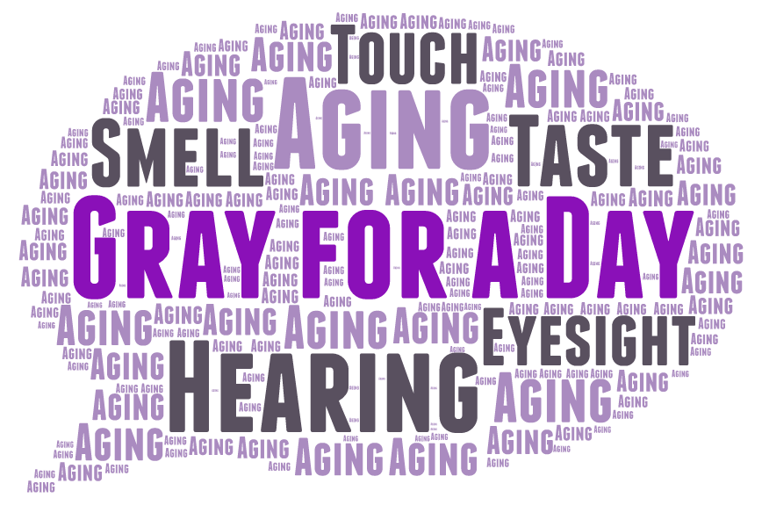
Notes:
Welcome & Introductions
So, what is Gray for a Day? Today we are going to be experiencing what it might feel like to have age-related sensory and functional decline. To do so, we’re going to gear up, participate in various activities, and have some great discussion. But first, I want to give you a little background on the age-related sensory and functional declines that we’re going to be experiencing today.

Slide 2
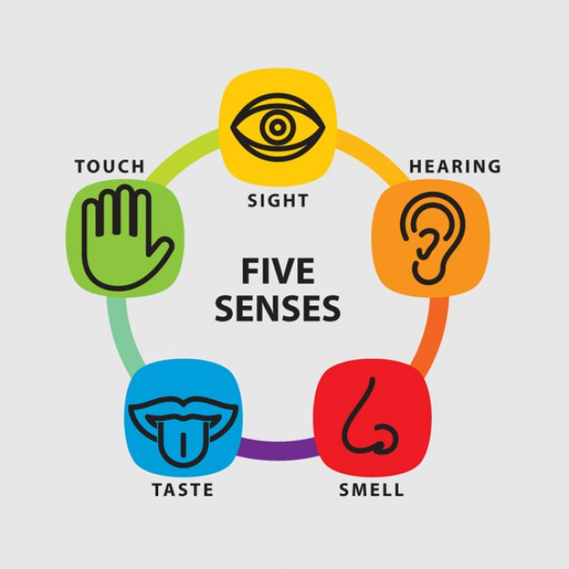
The Senses
Age-related sensory decline is normal!
Sensory change accelerates at different ages, but generally begins in your 50s:
Hearing – mid-40s
Vision – mid-50s
Touch – mid-50s
Taste – mid-60s
Smell – 70s
Notes:
Who can tell me what the five senses are? Touch, sight, hearing, smell, and taste. [click] When we’re younger, our senses generally work pretty well, right? But what happens as you age? Things don’t work as well! This is normal and is called age-related sensory decline. [click]
So, let’s brainstorm: What age-related sensory challenges do you think typical older adults face? [allow participants to list changes]
Alright, so we’re aware of the changes that can happen, but WHEN do they start to happen? Does anyone know at what age age-related sensory decline starts? [allow participants to guess]
[click] We know that our senses decline as we age, but the onset and rate of decline differ remarkably among people – though researchers say that decline generally begins in a persons 50s. More specifically, hearing loss can begin in your 40s, vision and touch decline in your 50s, taste in your 60s, and smell in your 70s. [click through list]
So let’s talk about each of these a little bit further…

Slide 3


Sensory Decline
50% of all older adults experience hearing loss that affects their communication and relationships with others
Adults 45+ are more likely to report vision loss than younger adults
Leading eye diseases that affect older adults:
Cataracts
Glaucoma
Macular degeneration
Diabetic retinopathy
Notes:
Hearing loss is a very powerful sensory decline that many older adults face to some extent. But, we have to remember that someone with hearing loss is not easily identified – there are no thick glasses, white canes, or seeing eye dogs. Helen Keller, who was both deaf and blind said, “The problems of deafness are deeper and more complex, if not more important than those of blindness. Deafness is a much worse misfortune for it means the loss of the most vital stimulus”.
Hearing loss has a particularly strong impact on relationships and communication with others. Imagine if you can no longer hear your friends and family as clearly as you used to – would you be excited to go to social events? Why/why not? Many people who suffer from hearing loss may feel embarrassed and do not want others to know their struggle – so they might simply stop coming to social events with friends and family members. How else might hearing loss affect your relationships with others? How would hearing loss affect your overall ability to communicate with others?
Normal vision impairment includes a decrease in: sharpness of vision (visual acuity), the ability to focus on objects, ability to discriminate between certain colors, ability to function in low-light levels and adapt to dark and glare, and ability to judge distances. But there are four leading eye diseases that affect older Americans: macular degeneration, cataracts, diabetic retinopathy, and glaucoma.
Cataracts are a clouding and yellowing of the normally clear lens of the eye – “it’s like looking through yellowed-waxed paper”
Glaucoma is a result of faulty drainage of eye fluids (which, if left untreated, can put too much pressure on the optic nerve and cause permanent damage) and results in the loss of peripheral vision
Macular degeneration is caused by damage to the macula and causes damage to your central or “straight ahead” vision.
Diabetic retinopathy is caused by damage to the blood vessels in the eye. It is a possible complication of diabetes – not all people who are diabetic will get retinopathy.

Slide 4



Sensory Decline
As we age, our sense of touch decreases which can make detection of temperature, vibration, pressure, and pain more difficult
Humans can recognize over 10,000 scents, and a decline in this ability can be a safety issue for older adults
For some older adults, the ability to taste sweet & salty items are the first ones to be affected by sensory loss
Notes:
Touch – As we age, our sense of touch can be impacted. The loss of tissue and elasticity in skin cells means that we may become less responsive to stimuli. It might be harder to detect temperature, vibration, pressure, and even pain. What potential problems might this cause? (cannot feel hot water as quickly; decreased response time to temperature hazards or pain)
Smell – 40% of people over the age of 80 have difficulty identifying common foods or other items through smell. As you can imagine, this can affect your ability to smell offensive body or household odors, or even warning odors such as smoke, gas, or spoiled foods. It’s also important to note that 2/3 of our ability to taste is dependent upon our ability to smell. So, if we cannot smell, we may not be interested in certain foods and foods may start to taste differently than they used to. What safety issues might arise if you have a decreased sense of smell? What “warning odors” might you not be able to detect? (smoke, gas, spoiled foods)
Taste – Our sense of taste is limited to four basic categories: sweet, salty, sour, and bitter. With age, sweet and salty tastes seem to be the first ones affected by sensory loss. By age 65, you will lose about 50% of your taste buds, and by your late 70s, you will have approximately 1/6th of the taste buds you had at the age of 20. Again, what hazards might be encountered if you are not able to taste as well as you used to? (spoiled foods) How could this decline affect your ability to eat healthfully? (foods may not taste as good/be appetizing; people may put more salt on their food, thus adversely affecting their blood pressure; people may put more sugar on their food, thus adversely affecting their blood sugar, etc.)

Slide 5



Functional Decline
54 million adults in the U.S. have arthritis. This number is expected to grow to 78 million by 2040.
Mobility is the most common disability among older Americans
40% of older adults have experienced shortness of breath
Notes:
In addition to decline related to the senses, it is also important to consider functional declines.
Dexterity. As we age, our dexterity is likely to decline, and arthritis is one of the biggest causes of that decline. 50% of adults 65+ report having a doctor diagnosed arthritis. How many of you know someone who has arthritis? What daily struggles do you think arthritis sufferers might face?
Mobility. As you age, you are also more likely to experience a decline or change in mobility, or your ability to move around. 65% of adults with a disability have difficulty walking. What challenges come along with decreased mobility?
Lung efficiency. Finally, one other physical change that can affect your daily life as an older adults is a decrease in lung efficiency. As one ages, they might experience a decrease in their lung capacity (the maximum amount of air that can be breathed out following a maximum inhalation), weakening of the respiratory muscles, and a decline in the effectiveness of lung defense mechanisms. This can make it harder to engage in vigorous exercise, fight off infections and pneumonia, and can make it easier to experience shortness of breath.

Slide 6
LET’S GET GRAY!
Insert one cotton ball into each ear
Tie a strip of plastic wrap around your head, or affix to eye/sunglasses OR put on simulation glasses
Put a cotton ball up one nostril
Tape several fingers at the knuckle
Put on a pair of gloves
On the palm side of your hand, insert a popsicle stick into your gloves with each index finger
Put a few popcorn kernels in your shoe
Put a straw in your mouth and breathe through it
Notes:
So now that we’ve reviewed the senses and learned a little bit about sensory and functional decline, let’s get gray!
[Instruct participants to follow along, applying only one product at a time. Be sure to discuss what each product simulates.]
Cotton in your ears – hearing loss
Plastic wrap over eyes – vision loss or vision problems, specifically decreased visual actuity
Cotton ball – loss of sense of smell
Finger tape – arthritis & stiffening of the joints
Popsicle sticks – severe arthritis
Gloves – loss of sense of touch (loss of tissue and elasticity in skin cells)
Popcorn kernels – pain associated with poor circulation, neuropathy, and arthritis
Straw – decreased lung efficiency (also simulates disease such as COPD)
*Note: Instruct participants to only breathe through the straw as they are comfortable. Instruct them to take breaks if necessary and to stop using the straw at any time.

Slide 7
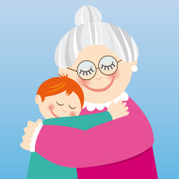
Great news! Your grandson is here to visit.
But, uh oh! He can’t tie his shoe.
Notes:
Let’s try a real-life activity to see how age-related sensory decline can make day-to-day life more difficult.
Imagine your 3 year-old grandson is here for a visit, but he can’t tie his shoe. Turn to your neighbor and try to tie your piece of string around their wrist. But, wait! Do you know many 3 year-olds that hold still? So, if you are the 3 year-old, be sure to wiggle your wrist around! Once one person has their shoe tied, switch and tie the other’s shoe.
Discuss: What was that activity like for you? Were you frustrated? What challenges did you face? How did you compensate for those challenges?

Slide 8
ACTIVITY STATIONS
Notes:
Briefly explain each station and note where the worksheets/materials are located. Let the participants know how much time they will have at each station, and the order in which you will switch stations.
After each group has settled into the activity, facilitators should observe and ask questions: How is it going? How is the graying gear making things more difficult? How are you compensating? How would you feel if you had to deal with these challenges on a daily basis?
After the stations are complete, come together as a group to discuss the experience.

Slide 9
Let’s Discuss…
  Do all older adults experience these types of decline?
Notes:
No! Of course not! Though sensory decline is normal with increasing age, not everyone will experience it and those who do will experience it different ways and with different severities. In spite of this, most older people adjust quite well and are able to compensate for their sensory losses.
One of the biggest misconceptions about older adults is that they are UNABLE to hear, see, think, smell, walk, do…But, that’s simply not true. The things that we experienced today are indicative of some older people, but not all. Sadly, though, many older adults are treated as though they are unable, and that type of treatment is not okay.
So, let’s talk about how our lives would be different if we were to experience sensory declines…

Slide 10
Let’s Discuss…
How would your daily life be different if you had to live with the sensory and functional decline that you experienced today?
Notes:
Note: Sensory loss in any of the senses can be emotionally distressing and may affect everyday tasks, such as reading, moving about safely, doing housework, and sharing conversation. While everyone is different, some people may experience frustration, confusion, fear of becoming a burden, isolation, withdrawal, anxiety, fear of losing independence, or even depression. The challenges of life do not become easier as one ages. However, individuals who are prepared and informed can cope successfully with these life changes.

Slide 11
Let’s Discuss…
How can you better interact with a person who might be facing
age-related sensory and functional decline?
Notes:
Note: Many participants may reference “speaking up” or talking more loudly with older adults. Here is additional information regarding that topic: When it comes to hearing loss, people often think that it’s better to shout at them so the person can hear. This is NOT appropriate. In many cases, if a person is wearing hearing aids, shouting can hurt their ears because of the way many hearing aids pick up certain noise and pitches. And it is also apparent when someone is shouting – your facial expressions change or you may seem frustrated. INSTEAD, ensure that you are close enough to a person – don’t try to talk to them from across the room – and speak a bit louder, but don’t shout.

Slide 12
Let’s Discuss…
What can you do now to potentially reduce the magnitude of age-related sensory and functional decline?
Most damage to the senses is caused by environmental factors!
Notes:
Note: This is where you should talk about preventative strategies. After all, most damage to the senses is caused by environmental factors!! Eat well and exercise. Don’t smoke. Use ear protection if you are in a loud environment (fireworks, concert). Use eye protection (sunglasses or hat) to avoid the sun, or safety glasses when you’re doing activities such as shooting guns or working with risky materials or chemicals. Bottom line: protect yourself.
Being optimistic and coping with sensory loss also contributes to an improved quality of life – so always remember to keep a positive attitude.
Be sure to advertise other programming here: Stay Strong, Stay Healthy, Keys to Embracing Aging, and nutrition programming would be good supplements.

Slide 13
Thank you!
We greatly appreciate your willingness to complete an evaluation of this program.

